Slide 1


Slide 2
Education is a means of delivering our vision of tomorrow
^{What is your vision?}

Slide 3
Learning Goals
Stretch your thinking – want you to consider the conversation during the evening
Make explicit links to equity, excellence and growth mindset
Promote questions – be curious

Slide 4
“To ensure inclusive and equitable quality education and promote lifelong learning opportunities for all”
4th UN Goal for Sustainable Development
Notes:
In common

Slide 5
OECD Report Excellence and Equity, 2016
“All learners need to acquire the knowledge and skills needed to promote sustainable development. Only in Canada, Estonia, Finland, Hong Kong (China), Japan, Macao (China) and Singapore do at least four out of five 15-year-old students master the baseline level of proficiency in science, reading and mathematics.”

Slide 6
Senior Advisor for Education – PISA OECD- International Perspective
Learning is an Activity that is Characterized By:
  informed and collaborative professionals using research and user-generated wisdom
  embracing diversity
  learner centered, personalizing education experience
Andreas Schleicher
Notes:
ADULTS FIRST THEN KIDS/ quote research easier in ENGLISH/ application

Slide 7
Senior Advisor for Education – PISA OECD
Assess Learning Success By Delivering:
  equity
  instructional leadership
  sustained networks
  culture as capital
Andreas Schleicher

Slide 8
Ontario, 2017
1.4 million students JK-8 and 630,000 high school students
72 school districts
31 English public, 4 French public, 29 English Catholic, 8 French Catholic & 10 School Authorities, Provincial Schools, Hospital Boards in 4,800 schools
124,000 FTE teachers (74,000 JK-8 and 7,300 FTE administrators & 9,000 ECE –early childhood educators
194 days of school/year = about 1,200 hours of school – we want to make sure each hour of instruction counts
  http://www.edu.gov.on.ca/eng/educationFacts.html

Slide 9
Diversity
Over 2 million of Ontario’s 13.4 million are visible minorities – Chinese, South Asian, Black
Diverse: 3 million are immigrants – 30%
Urban: 92% of Ontarians live in 16 large urban cities
Aging: first time the percentage over 65 is greater than under 14 years
Ontario students
  13% are ELL
  10% born outside Canada
  22% speak languages other than English & French

Slide 10
Diversity
More than a third of young adults in Canada are from families where both parents are from another country. BBC, August 2, 2017
More than 50% of Toronto District School Board children have English as a Second Language. TDSB Annual Report
80% graduate high school and go to post-secondary education. TDSB Annual Report

Slide 11
Knowledge is only as good as its intelligent application
Schmoker, 2006

Slide 12
Vision
“Ontario is committed to the success and well-being of every student and child. Learners in the province's education system will develop the knowledge, skills and characteristics that will lead them to become personally successful, economically productive and actively engaged citizens.
Ontario will cultivate and continuously develop a high-quality teaching profession and strong leadership at all levels of the system. Our education system will be characterized by high expectations and success for all. It will be responsive, high quality, accessible and integrated from early learning and child care to adult education.
Together, we will build on past achievements and move forward with ambitious goals.” (Ministry of Education)
Notes:
My last slide

Slide 13
Belgium – Student Achievement
PIRLS -2016 – 4th grade
  Singapore (576)
  Belgium –Flemish (525) French (479)
  Ontario (544)
PISA – 2015 – 15 year olds
  Science (502) Canada (528)
  Reading (499) Canada (527)
  Mathematics (507) Canada (516)

Slide 14
PISA Equity
Belgium -19% variation explained by SES, Canada 9% - OECD average 12.9%
Resilient Students Variation
  Belgium 27.2%, Canada 38.7%
Immigrant Students Variation
  Belgium 28%, Canada - 5%
Notes:
POOR KIDSSUCCEED AGAINST THE ODDS

Slide 15
PISA Equity Belgian Context
Gender
  Gap in self-efficacy in science is the highest
  Males outperform females in science 12 points (OECD average 3.5 for males)
  Females outperform in reading 16 points (OECD average 27)
  Males outperform females in math 14 (OECD average 8 for males)
Notes:
stereotypes

Slide 16
PISA 2015, Equity
Problem Solving
  Low in collaborative problem solving – 41/50
  Valuing teamwork was one of the lowest 46/55 (correlation negative to low SES and performance)
Percentage of Students Repeated a Grade
  34% -rank 6/69 – one of the highest

Slide 17
One Influences the Other
Research
Professional Practice

Slide 18

How can we as Educators
Positively impact students’ learning both individually and collectively? (Ted Talk)

Slide 19
Impactful Strategies, John Hattie, 2016
Collective teacher efficacy (1.57) – coherency of effective strategies – can compensate for SES
Conceptual change programs (1.16) –present the concepts and at the same time discuss common misconceptions
Response to Intervention (1.07) – structured programs with targeted tiered levels of intervention -all, some, few

Slide 20
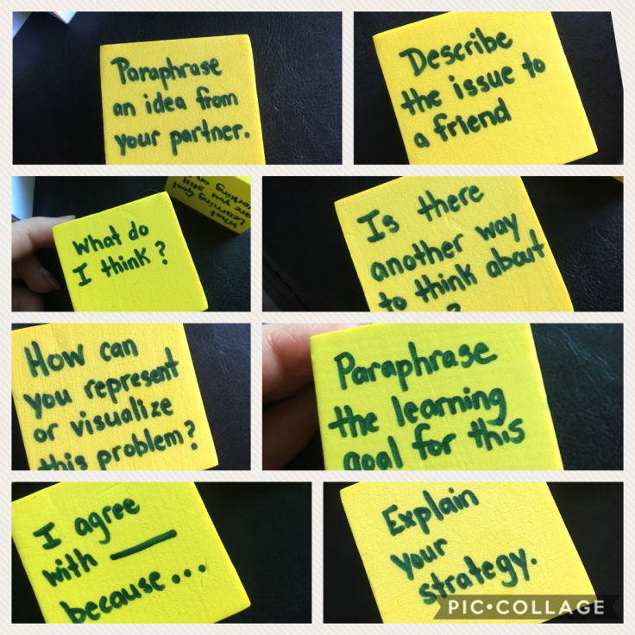

Slide 21
Biology of Learning World Development Report, 2018
Research has expanded our understanding of the brain & learning – the brain is malleable and adapts through neuroplasticity
The adult brain largely complete by late adolescence and then is continuously pruned to reach optimal number of synapses (100-500 trillion)
First develop simple networks, and then more complex built on foundational bases such as auditory, visual for linguistic – sequential & cumulative
Physical, sensory-motor, cognitive and social emotional development are interlinked

Slide 22
Biology of Learning World Development Report, 2018
More malleable for higher order cognitive and social emotional skills – childhood, adolescence and early adulthood; however, the brain’s ability to adapt and learn continues through life
Deprivation – food, security, love, enriching experiences can negatively impact the foundational base
Hormones can act as triggers –dopamine and serotonin are positive and cortisol for stress and anxiety can have negative effects

Slide 23
Biology of Learning World Development Report, 2018
Teaching strategies can influence how students approach challenges and learn – academic optimism & growth mindset
Experiences can assist or impede – stimulation, enriching experiences, nutrition, emotional security
For learners who experienced disadvantages and stressors –trusting relationships, stability and enriching environments and experiences can mediate the deprivations and improve life outcomes
  http://www.worldbank.org/en/events/2018/02/01/world-development-report-2018-learning-to-realize-educations-promise

Slide 24
Growth Mindset: Not yet… (Dweck)
Teachers can guide students to think more optimistically
Use positive language
Work with students to assess their own work and reflect on how to improve = provide pathways to complexity
Allow for choice
Frame invitational questions
Allow students to redo and revise their work using rubric/criteria
Build personal relationships and share how you overcame challenges
  Focus on Growth projections K12 - Superintendent Larry Spring, NY

Slide 25
To do that teachers need to feel
Happy, appreciated, valued, joyful and excited
In a major US study teachers report frustrated and overwhelmed as the dominant emotion

Slide 26
Relationships Matter
Simon, Judge, and Halvorsen-Ganepola (2010) found that co-workers who got along reported higher job satisfaction and quality of life, and similar studies have reported a 50% increase in employee satisfaction if they enjoy their co-workers (Riordan, 2013). A second important find was that the more closely aligned co-workers were in terms of their values, the more they respected and trusted each other. Last, they discovered that co-workers who valued relationships in general, spent more time trying to get to know each other and find common ground.

Slide 27
OECD 3 Categories of Competencies –Need to be Explicitly Taught
Category | Descriptors
Using Tools Interactively | Interactive use of: Language, symbols, & text Knowledge and information Technologies
Interacting in Heterogeneous Groups | Relate well to others (empathy) Cooperate and work in teams (collaborative) Manage and resolve conflict Move projects forward
Acting Autonomously | Ability to act within a bigger picture (self-awareness) Form and conduct life plans & personal projects (mindset, self-motivation & efficacy) Defend and assert rights, interests, limits and needs Self-regulation

Slide 28
Yale Center for Emotional Wellness
Emotional Wellness impacts
Attention, memory and learning – anxiety & stress release cortisol impacts executive function & memory
Decision-making – negative emotions make people judge others more harshly, positive people are more creative and flexible
Relationships – anger alienates students, difficult to build trusting relationships
Health & well-being – positive, optimistic lead to serotonin release
  http://ruler.yale.edu

Slide 29
Mindset (attitudes and motivation) explains a greater proportion of achievement. The aim is to develop a “well-calibrated mindset”,
Believing the work will be useful for one’s future education and career,
Interest in the specific subject/discipline,
Having low test anxiety,
Having a strong sense of belonging to one’s school,
Believing if you work hard, you can succeed (Doing more than is expected, working on tasks until everything meets the expectations)
  Denoel, E., Dorn, E., Goodman, A., Hiltounenm J., Krawitz, M. & Mourshed, M. (2018). Drivers of Student Performance: Insights from Europe. McKinsey & Company.

Slide 30
Mindfulness
Mindfulness & Meditation
10 minutes of intentional practice can distress and lead to increase focus and calm behaviours
Can increase positivity
Students learn they can control their breathing, focus and behaviours – aligns with growth mindset &Neuroplasticity
    Simon Fraser University –Culham & Shivhare, 2018

Slide 31
Reflective Writing
Goal Setting
Self-asses on quality of writing using criteria
using reflective writing for self-regulating. It’s a form of spaced practice
What was helpful from today’s lesson? What concept(s) did you learn?
How can use this concept/skill in a different subject?
What will you differently and why?

Slide 32
Talk and Think
Student Discussions responding to texts or prompts are foundational to learning. Text improve comprehension and high level thinking skills, builds schema, motivates and engages, develops and expands language for reading & writing, enhances comprehension
Critical to add vocabulary – equity – ELL, poverty
Necessary to build comprehension,
  Gambrell, 2004

Slide 33


Equity

Slide 34
Teachers bring every day into their classrooms:
Content knowledge
Strategies & approaches
Materials & Resources
Attitudes
Lanada, 2017, Teachers in High Poverty Schools

Slide 35
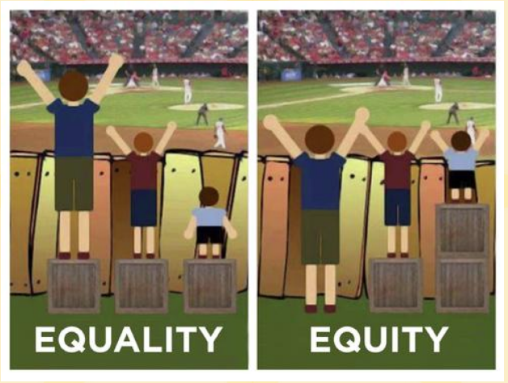
A view from the side

Slide 36
Equity
Canada, Denmark, PRC (Hong Kong & Macao) highest levels of performance & achieve equity
SES Matters - Socio-economically disadvantaged students are 3x less likely to achieve proficient performance
USA achieve the highest increases in closing equity gaps
Immigrants – less likely than native born to achieve proficiency SES being equal
  24% are considered resilient

Slide 37
Equity – Imperative to Close Gaps
SES
  Generational, situational
Gender
Immigrants & Refugees
Special Education

Slide 38
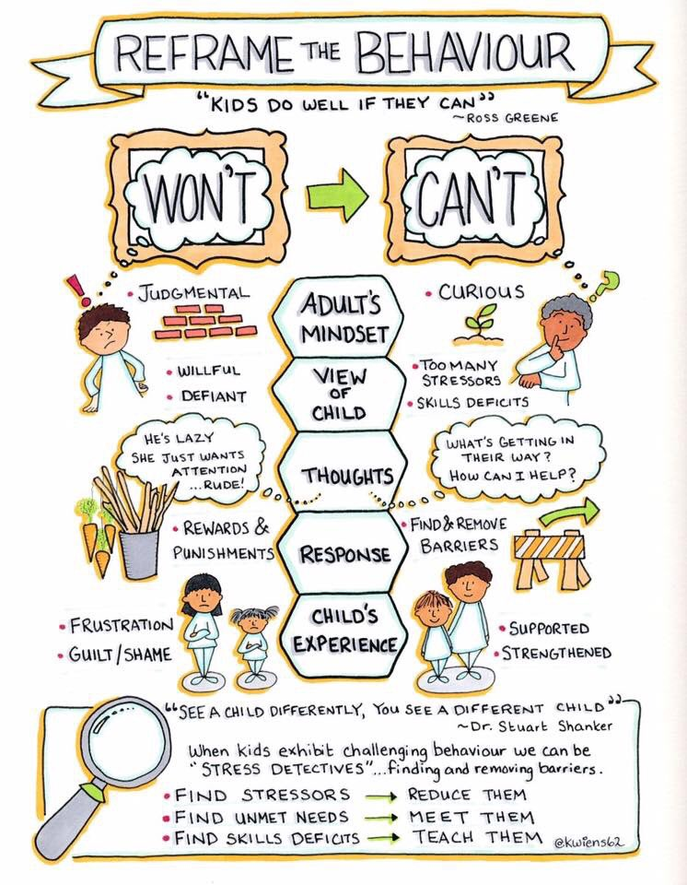
For students with Special Needs

Slide 39
Equity Issues
"Children in poverty are more likely to experience trauma and toxic stress, have less access to early learning experiences and hear 30 million fewer words by age 3 than affluent children," Sara Mead, Bellwether Education Partners, on the impact of Head Start. Mead has conducted extensive research on Head Start and other early learning childhood policies.
  http://www.usnews.com/news/articles/2015/10/07/preschool-program-for-low-income-students-lacks-sustained-benefits

Slide 40
PISA 2015 – Equity
Not a Predetermined Future
Disadvantaged students in OECD countries are, on average, almost 3 times more likely to be low performers than advantaged students. They also tend to spend 35 minutes per week less in regular science lessons, are twice as likely to have repeated a grade by the time they sit the PISA test, and almost three times more likely to be enrolled in a vocational rather than an academic track. Canada tries to balance equity & excellence.

Slide 41
Ontario’s Experience
Based on Need – Not Punishment
Give additional funding, resources and support to schools of underserved students
Literacy & Numeracy Secretariat
Schools on the Move (EQAO)
Create targeted interventions – Model Schools

Slide 42
Low Performing Students: Why They Fall Behind & How to Help Them –OECD, 2016
To overcome Multiple Risk Factors
High expectations with targeted, evidence-based supports
Enlist Community & Parental Involvement
Special programs including remedial - RTI
Reduce inequalities in Early Education
Gendered interventions
BFLL – Blegium/Flemish Language Learners
Optimism, Growth Mindset

Slide 43
OECD, PISA, 2010
Variability
Between schools
Within Schools
36%
64%

Slide 44
Embracing a Culture of Failure (Hattie)
Do you view failure as essential for successful feedback
How do you talk about mistakes? Do you ask where to next?
Do you give feedback on the task, the process and the self-regulation?
How do you reward achievement and/or effort?
How do you view your mistakes and feedback that others give you?
Notes:
Evelyn Back In Writing drafts writing process, science experiments, rubrics that recognize self evaluation and action planning

Slide 45

Resilience and Growth Mindset

Slide 46
Tenacity and Growth Mindset
Dweck’s research into the growth mindset in regards to tenacity and its effects on achievement, especially in an educational setting, she discovered 4 factors that affect ongoing learner tenacity or grit:
Learner beliefs about themselves
Learner goals
Learner feelings about their social connectedness
Learner self-regulatory skills
https://positivepsychologyprogram.com/5-ways-develop-grit-resilience/

Slide 47
Academic Tenacity and Growth Mindset
Academic Tenacity - Mindsets and Skills that Promote Long-Term Learning (Bill and Melinda Gates Foundation)
look beyond short-term concerns to longer-term or higher-order goals
withstand challenges and setbacks to persevere toward these goals.
https://files.eric.ed.gov/fulltext/ED576649.pdf
Notes:
This report gives details and interesting research black kids value group goals much more than white kids detc.

Slide 48
Social Emotional Piece of Growth Mindset
“You can’t get to the content if the relationship and the social-emotional well-being piece is not being attended to first.”
http://hechingerreport.org/two-studies-point-to-the-power-of-teacher-student-relationships-to-boost-learning/

Slide 49
Norms of Collaboration Norwegian Principals and Teachers 2017
We agree to:
Listen to others (give full attention)
Be prepared (have your readings done, review notes, be ready to learn, bring student work samples)
Stick to the agenda with flexibility
Start and end on time
Allow for think time (use Think, Pair, Share)
Be respectful and professional and use a calm voice
Be open-minded to new thoughts and ideas
Everyone has wisdom
HOW MIGHT YOU USE NORMS OF COLLABORATION WITH YOUR TEAM?

Slide 50
Positive School Climate Characteristics that Foster Growth Mindset
Showing pride in school
Collaboration
Kindness
Taking pride in one’s work
Leadership
Helping others
Using time wisely
Being prepared
Love of learning
Making good choices
Notes:
Norms of collaboration that reculture and are inspiring end with something you can start with

Slide 51
Positive School Climate Characteristics that Foster Growth Mindset
Active listening
Cooperation
Using appropriate communication
Caring
Self-reliance
Perseverance/resilience
Making an insightful comment
Organization
Going above and beyond

Slide 52
Education is a means of delivering our vision of tomorrow
What does that mean for your next week in your school?
Notes:
O share over drinks Thing you will try

Slide 53
WITH OISE I CAN
evelynkendall.wilson@utoronto.ca

