Slide 1
Project team meeting Buenos Aires Committee 5
September 14th 2017
Stijn Rybels Maria Jimena Rodriguez Pinzon

Slide 2
Agenda
Practical information
Date
Venue
Accomodation
Participants
Website
Financial management

Slide 3
Practical information
Date: in the week of 17th - 21st of September 2018
To decide in Buenos Aires: Duration of the conference + competition

Slide 4
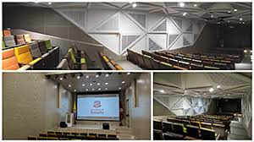
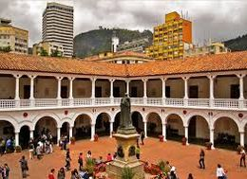
Aula Mutis capacity: 80 persons aprox.

Slide 5
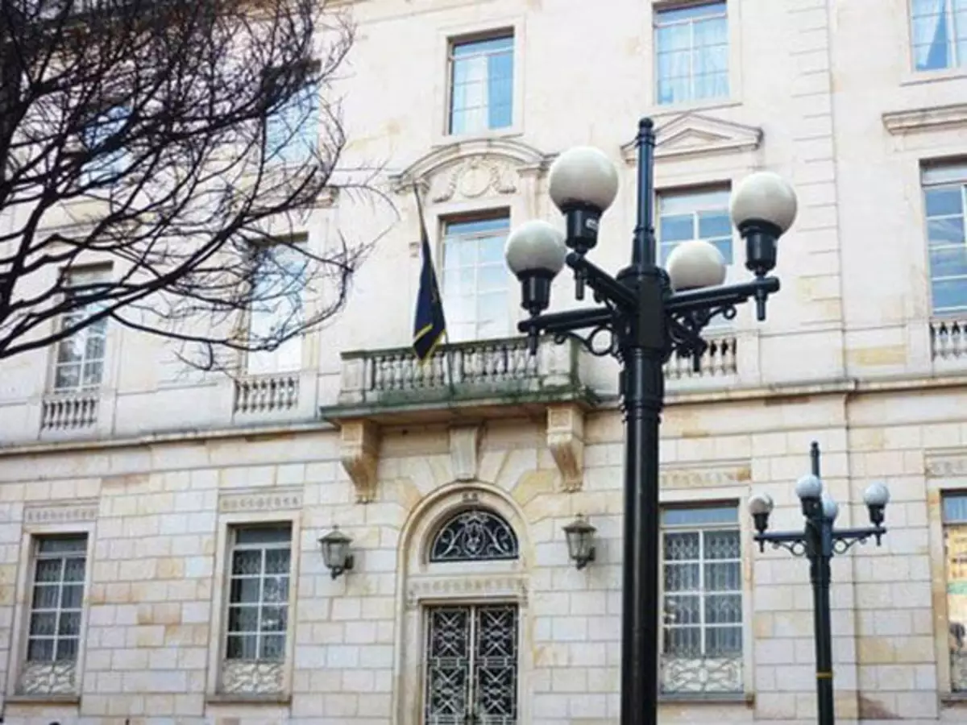
Jockey Club Capacity: 200 persons aprox.

Slide 6
Accomodation
Options for accommodation for staff (close to the campus)
Options for accommodation for students

Slide 7
Participants
LA Partners:
Number of participating Students: 4 → total = 48
Number of participating Staff: 6 → total = 72
EU partners:
Number of participating Staff: 4 → total = 24
Total number of participating Staff: 96
Total number of participating students: 48

Slide 8
Website
Example of conference website hosted by UA: https://www.uantwerpen.be/en/conferences/ressh2017/call-for-papers/
Structure of the website:
Homepage
With navigation, news, contact, short intro, calendar,….
Program
Call for papers
Registration – e-forms available for free + upload for abstracts = possible
Partners
Practical information
Location – venue (google maps can be included)
Accommodation
…
The registration can manage up to 30 abstracts (abstracts need to be assigned manually)
Possibility to include a free call for abstract plug-inn: http://easychair.org/
Creation of conference email address (mails will be send to Stijn and Maria)
Citylab_la_2018@gmail.com

Slide 9
Financial management
In General
Staff working on Citylab project
Travel costs
Lumpsum according to the distance to cover.
Cost of stay (120€)
3 per diems (depending on the duration of the conference) will be Managed by the University of Rosario to cover accommodation, catering and lunch.
Students on the Citylab project Travel costs
Lumpsum according to the distance to cover.
Cost of stay (55€)
3 per diems (depending on the duration of their stay)

Slide 10
Overview cost of stay and cost of travel
Travel costs and cost of stay Bogota
City of Departure | Student/ Staff | Number of Participants | City of Destination | Travel Distance/lumpsum | Number of days (per participant) | Travel cost EURO | Cost of stay EURO | Totaal EURO
Antwerp | Staff | 6 | Bogota | 1100 | 3 | € 6 600,00 | € 2 160,00 | € 8 760,00
Nuevo Leon | Staff | 6 | Bogota | 530 | 3 | € 3 180,00 | € 2 160,00 | € 5 340,00
Nuevo Leon | Student | 4 | Bogota | 530 | 3 | € 2 120,00 | € 660,00 | € 2 780,00
Guanajuanto | Staff | 6 | Bogota | 530 | 3 | € 3 180,00 | € 2 160,00 | € 5 340,00
Guanajuanto | Student | 4 | Bogota | 530 | 3 | € 2 120,00 | € 660,00 | € 2 780,00
caracas | Staff | 6 | Bogota | 275 | 3 | € 1 650,00 | € 2 160,00 | € 3 810,00
caracas | student | 4 | Bogota | 275 | 3 | € 1 100,00 | € 660,00 | € 1 760,00
caracas | Staff | 6 | Bogota | 275 | 3 | € 1 650,00 | € 2 160,00 | € 3 810,00
caracas | Student | 4 | Bogota | 275 | 3 | € 1 100,00 | € 660,00 | € 1 760,00
Lima | Staff | 6 | Bogota | 275 | 3 | € 1 650,00 | € 2 160,00 | € 3 810,00
Lima | Student | 4 | Bogota | 275 | 3 | € 1 100,00 | € 660,00 | € 1 760,00
Lima | Staff | 6 | Bogota | 275 | 3 | € 1 650,00 | € 2 160,00 | € 3 810,00
Lima | Student | 4 | Bogota | 275 | 3 | € 1 100,00 | € 660,00 | € 1 760,00
Rio De Janeiro | Staff | 6 | Bogota | 820 | 3 | € 4 920,00 | € 2 160,00 | € 7 080,00
Rio De Janeiro | student | 4 | Bogota | 820 | 3 | € 3 280,00 | € 660,00 | € 3 940,00
Florianopolis | Staff | 6 | Bogota | 820 | 3 | € 4 920,00 | € 2 160,00 | € 7 080,00
Florianopolis | Student | 4 | Bogota | 820 | 3 | € 3 280,00 | € 660,00 | € 3 940,00
Barcelona | Staff | 4 | Bogota | 1100 | 3 | € 4 400,00 | € 1 440,00 | € 5 840,00
Aalborg | Staff | 4 | Bogota | 1100 | 3 | € 4 400,00 | € 1 440,00 | € 5 840,00
Madrid | Staff | 4 | Bogota | 1100 | 3 | € 4 400,00 | € 1 440,00 | € 5 840,00
Torino | Staff | 4 | Bogota | 1100 | 3 | € 4 400,00 | € 1 440,00 | € 5 840,00
Compiegne | Staff | 4 | Bogota | 1100 | 3 | € 4 400,00 | € 1 440,00 | € 5 840,00
Belgrano | Staff | 6 | Bogota | 820 | 3 | € 4 920,00 | € 2 160,00 | € 7 080,00
Belgrano | Student | 4 | Bogota | 820 | 3 | € 3 280,00 | € 660,00 | € 3 940,00
Cordoba | Staff | 6 | Bogota | 820 | 3 | € 4 920,00 | € 2 160,00 | € 7 080,00
Cordoba | student | 4 | Bogota | 820 | 3 | € 3 280,00 | € 660,00 | € 3 940,00
Pereira | Staff | 6 | Bogota | 180 | 3 | € 1 080,00 | € 2 160,00 | € 3 240,00
Pereira | Student | 4 | Bogota | 180 | 3 | € 720,00 | € 660,00 | € 1 380,00
 |  |  |  | TOTAL |  | € 84 800,00 | € 40 380,00 | € 125 180,00

Slide 11
Financial management - Procedures
Option 1: “Normal” reimbursement procedure
Flights and accomodation are prefinanced by each HEI
Normal reimbursement procedure after the meeting
Option 2: cfr. Lima and Buenos Aires
UA books the flights and accomodation for the participants
Option 3: “hybrid procedure”
Travel costs:
Each HEI receives a prefinancement (according to the lumpsums) to finance the fleights of staff and students
Costs of stay:
UR will book with the per diems accomodation for staff and provides catering
Students will have to book their own accomodation through their HEI

