Slide 1

How should public administration and policy-making be organized and coordinated to optimally implement intermodality under each of the future development scenarios?
BRAIN-TRAINS workshop
IDLab
18 september 2017
Vidar Stevens
Prof. dr. Koen Verhoest
Department of Political Science
University of Antwerp, Belgium

Slide 2
Agenda
What is (public) governance?
What level of policy-level and administrative integration are required to turn scenarios into reality?
Coordination toolbox for intermodality
The involved actors

Slide 3
Act I
What is governance?
Joint capacity to steer society

Slide 4
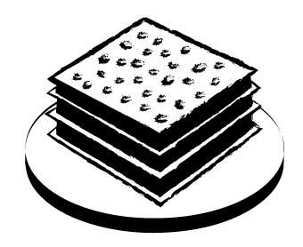
3 models
New Public Governance
New Public Management
Bureaucracy
1900s
1980s
2000s

Slide 5
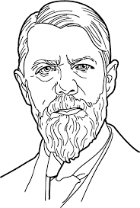
Bureaucratic governance
Relations based on Hierarchy
Routines, procedures, permanence
Competence-based
Paper trail
Rule of law
(householdname: Max Weber)

Slide 6
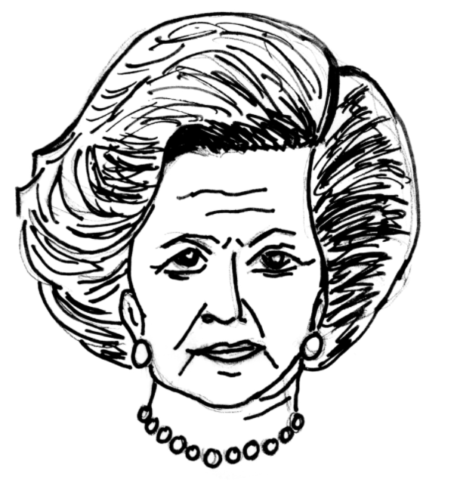
New Public Management
Relations based on Competition
Private sector management
Performance contracts
Privatisation
Downsizing
(household name: Margaret Thatcher)

Slide 7

New Public Governance
Relations based on Cooperation
Private Private partnerships
Integration and coordination
Networks
(household name: tbd)

Slide 8
Different forms of integration
Policy-level integration refers to the extent to which political actors try to create greater coherence in decision-making for issues that transcend the boundaries of established policy fields, and which do not correspond to the institutional responsibilities of individual departments (Meijers and Stead, 2009).
Administrative integration, then, denotes the extent to which involved administrative actors (together with private or privatized companies, civil society organizations, etc.) streamline practices and collaborate in the policy implementation phase (Mulford and Rogers, 1982).

Slide 9
Act II
The current and expected levels of policy-level and administrative integration in the scenarios.

Slide 10
Current level of policy-level integration
- Autonomous decision-making between political actors from different levels of government regarding the transposal of the EU ITS-directive.
- Minimal policy coherence between federal and regional levels of government to comply to the set targets of the EU-level.
- Up till now, there has only been very limited collaborative effort to establish a comprehensive and uniform policy strategy that transcends the different levels of government

Slide 11
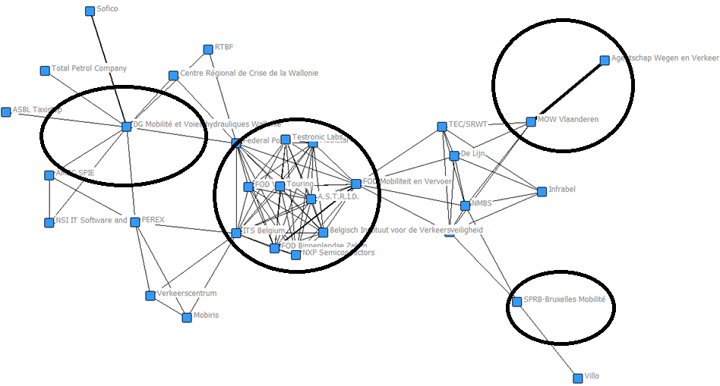
Current level of administrative integration

Slide 12
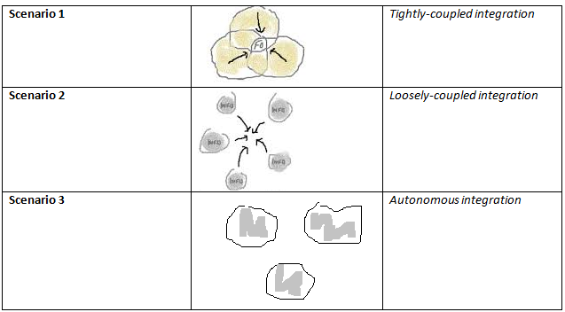
Expected levels of integration

Slide 13
Act III
Coordination toolbox

Slide 14

A Graveyard of Collaborations (Cleff, 2008)
70%

Slide 15
The collaboration as determinant?
“For different reasons, the collaboration itself can hinder at different stages of the policy-making and implementation process”, according to Manoharan (2013) and Mulgan & Albury (2003).

Slide 16
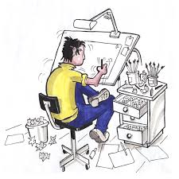
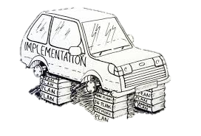
How to manage the collaboration in the policy cycle?
Policy-level integration/ design
Administrative integration/ implementation

Slide 17
Managing the design-phase
From ideas to plans.

Slide 18
3 types of uncertainty
Notes:
Substantive uncertainty has to do with uncertainty with regard to the (different interpretations actors involved have of the) nature of complex problems and possible solutions. In addition to substantive uncertainty, there is strategic uncertainty. This stems from the strategic choices actors make with regard to articulating their preferences.
Finally, networks are characterized by institutional uncertainty. That is to say, the political actors will have different institutional backgrounds in terms of how they usually address issues, organize their processes, make decisions, arrange their activities, etc. This has its consequences for what specifically political actors expect with regard to how discussions and the process itself in networks are organized and accommodated.

Slide 19
Resolving substantive uncertainty
Furtherance of goal intertwinement.
Promotion of substantive variety.
Breaking through asymmetrical policy discussions.
Preventing premature cognitive fixations.
Promoting cognitive reflection.
Organizing substantive selection.
Linking arenas of research and problem solving.
Facilitating instead of decisive research.
Joint commissioning of research.
Boundary work.

Slide 20
Resolving strategic uncertainty
(Un)coupling actors, arenas and games.
Designing games, agreements about:
  objectives;
  participation;
  working methods;
  information-sharing;
  process-steps;
  decision-making.
Actively engaging in substantive discussions (hands-on management approach).

Slide 21
Resolving institutional uncertainty
Changing network rules focused on composition.
Changing network rules focused on outputs.
Changing network rules focused on interactions.
Reframing through the launch of major plans.
Reframing through narratives.
Reframing through sensitizing concepts.
Reframing through the use of focusing events.
Managing trust through institutional redesign.
Redesigning the primacy of politics.

Slide 22
Managing the implementation-phase
From plans to services.

Slide 23

Leadership commitment

Slide 24
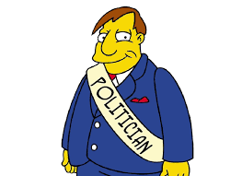
Ministers’ and stakeholders’ buy-in

Slide 25

Clearly defined joint outcomes

Slide 26
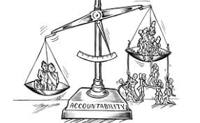
A good accountability framework

Slide 27

Sufficient resources

Slide 28

Measuring performance and progress

Slide 29
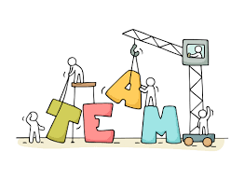
Right representation, skills and competencies

Slide 30
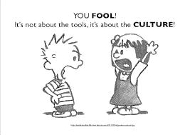
Organizational cultures that support coordination

Slide 31
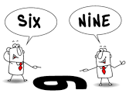
Shared language and values

Slide 32
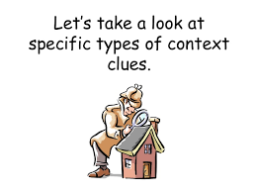
A contingency approach

Slide 33
Act IV
Who has to be involved?

Slide 34
Different players
Stakeholders: public interest groups (NGOs), trade unions, harbour unions, business interests, occupational associations, etc.
Agencies, semi-autonomous organizations, statutory bodies, private (law) based organizations, harbours, etc.
Peripheral departments: Federal and regional (affected) departments.
Central departments: Federal and regional Departments of Mobility.
Political core: Ministers and cabinet members.

Slide 35

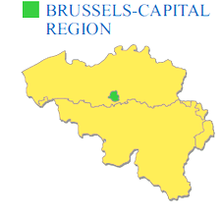
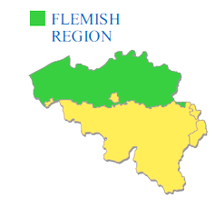
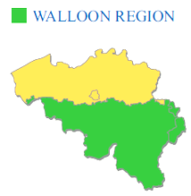
Different type of organizations, different levels of government.

Slide 36
Who should take the lead?
  At the political-level?
    A Federal Minister?
    A regional Minister? From Wallonia, Brussels Capital Region or Flanders?
    A neutral facilitator?
  At the administrative level?
    An intergovernmental coordination network?
    An expert group? A follow-up committee?
    Separate administrative leaders for each level of government?

Slide 37
How many and which actors must be involved in the decision-making?
  Only the political core?
    Solely Ministers of Mobility, or also of Ministers of (affected) departments (e.g. economy, finance, environment)?
  An administrative network?
    How many departments and agencies? And when is a department/agency relevant or ‘affected enough’ to join the collaboration?
  Stakeholders?
    How to select ‘the right’ stakeholders?

Slide 38
Outlook? Detailed?
How ‘long-term should the policy strategy be? An outlook to 2020? 2030? 2050? 2100?
  And how to deal with long-term policy strategies when there are new elections?
How detailed must the policy strategy be?
  Only output parameters?
  Abstract future outlooks?
  Detailed, and non-reversible, policy strategies.

Slide 39
Thank you for your attention

