Slide 1
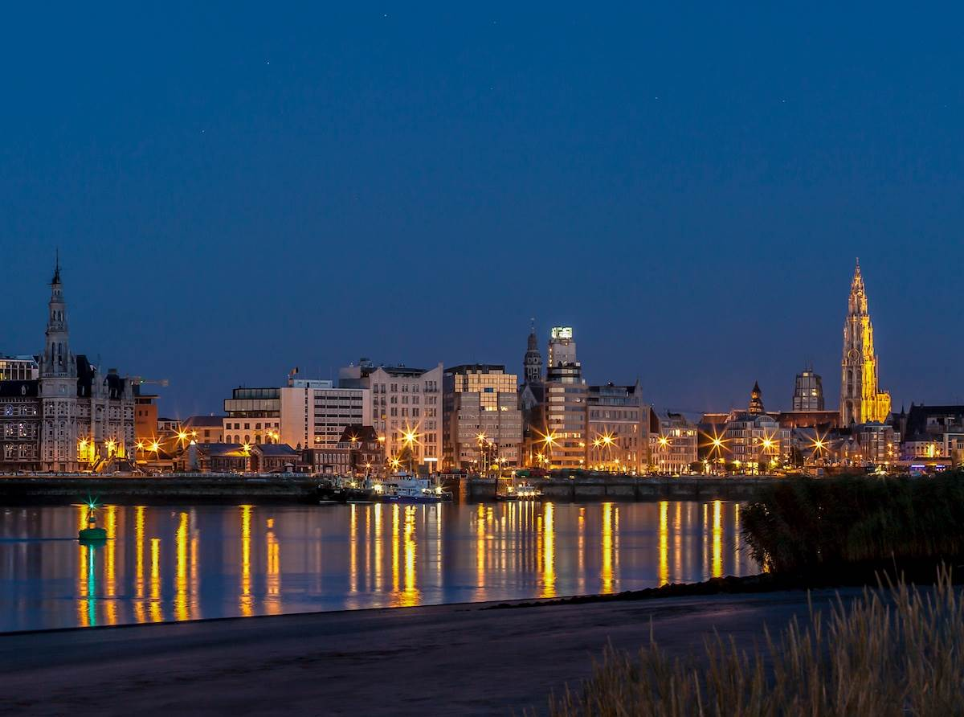

Slide 2
Impala gebruikersdag
Journée des utilisateurs d’Impala
Renke Saerens
23/04/2015

Slide 3
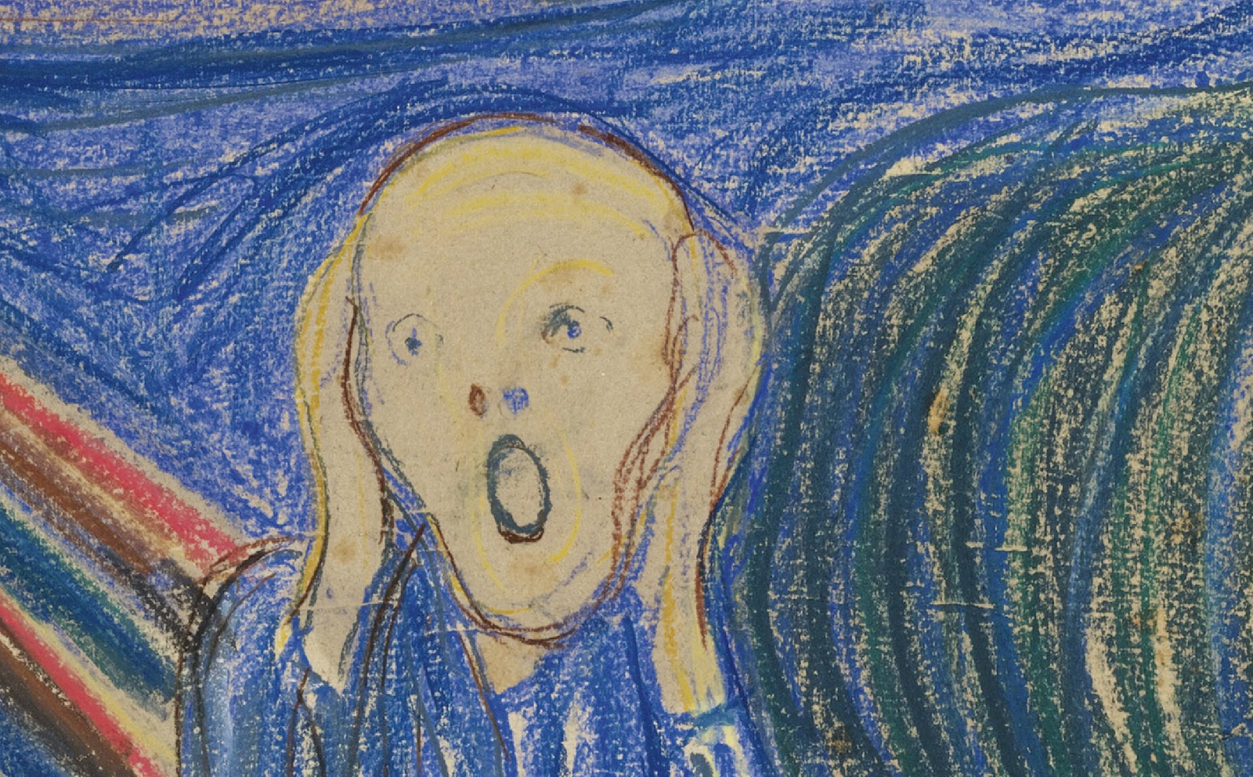
Will there be ILL?

Slide 4
Impala use 2004 - 2014
New developments
    bpost application
    Return dispatch
    Quick link and bar code
How to measure your Impala traffic?
(Jan Corthouts)

Slide 5
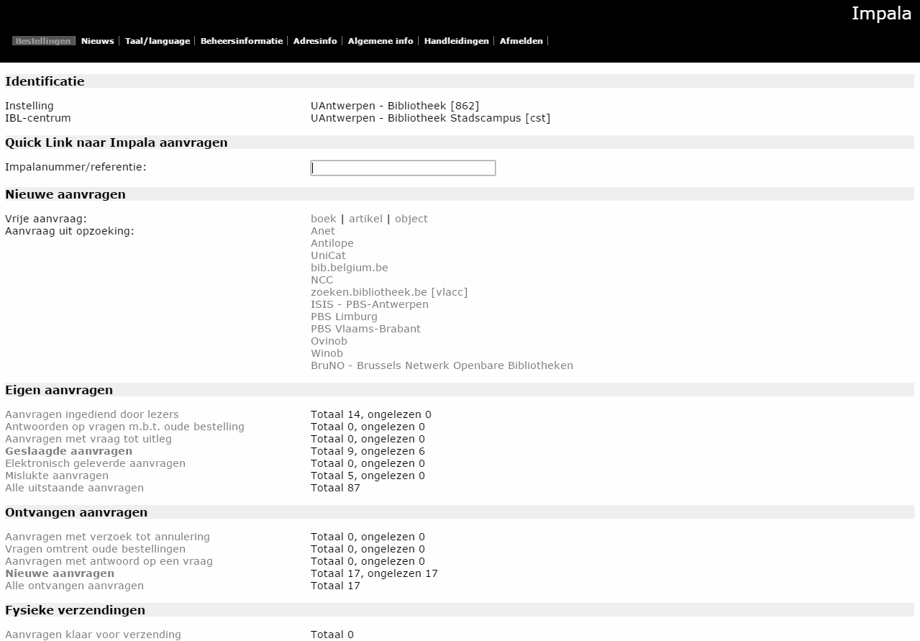
Impala use 2004 - 2014

Slide 6
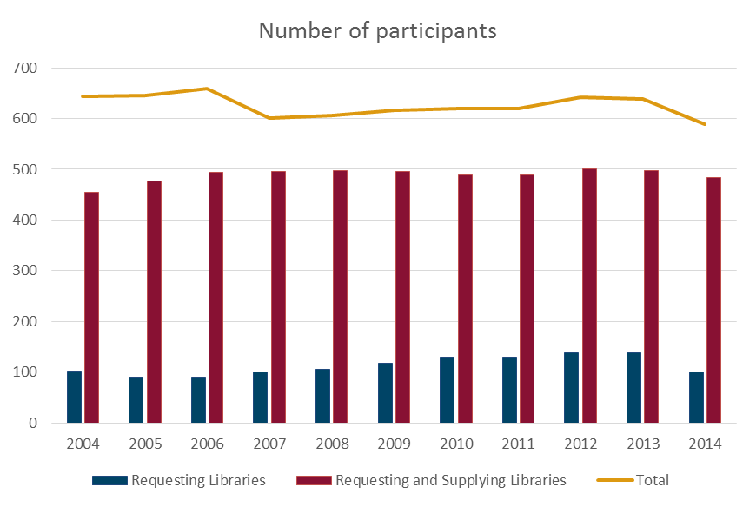

Slide 7
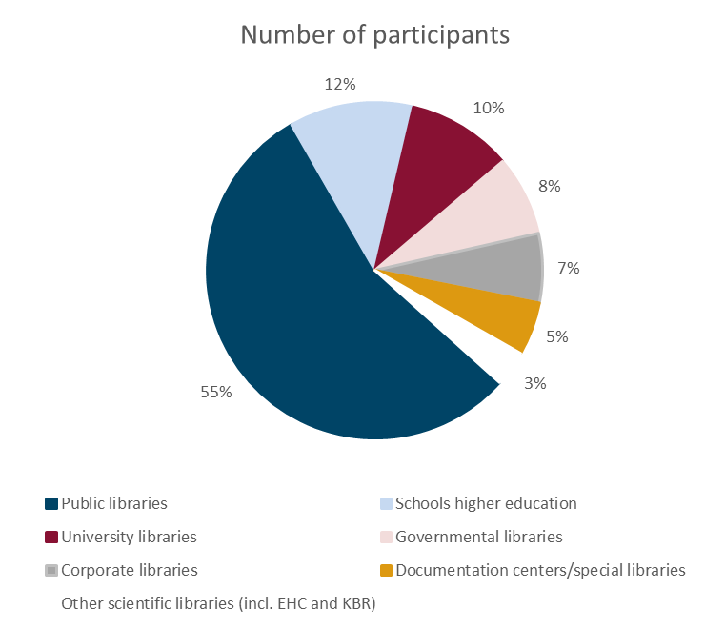

Slide 8
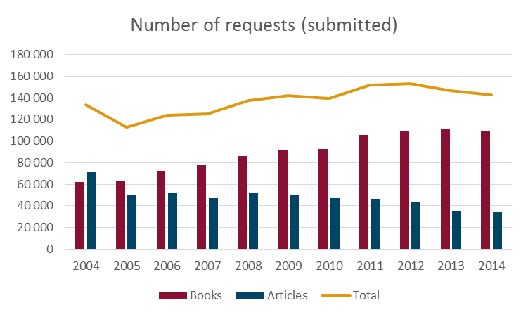
Notes:
OB’s sinds 2001, graduele stijging van de totalen sinds 2005, voordien daling ten gevolge van daling in artikels

Slide 9
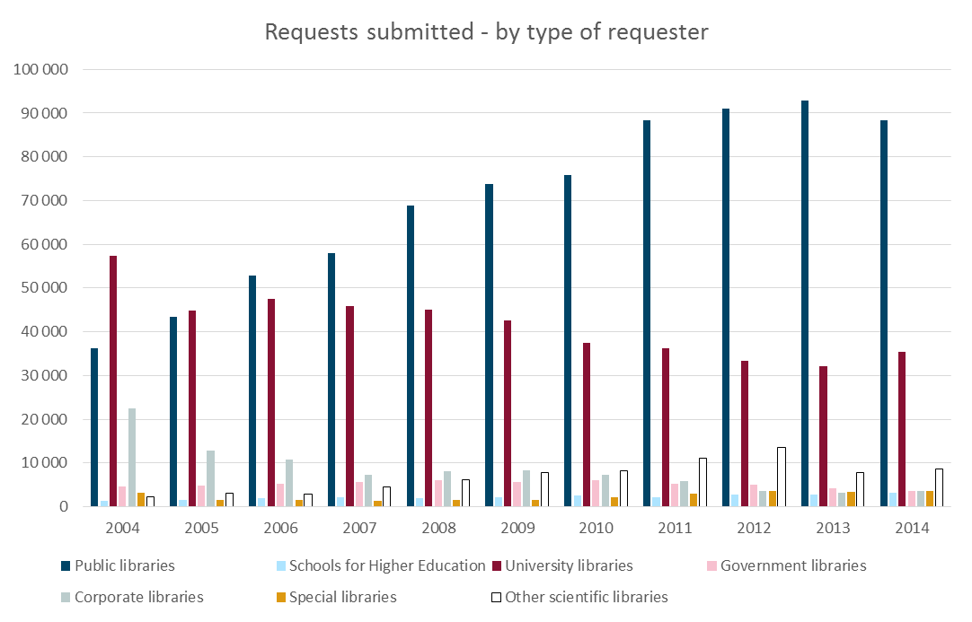

Slide 10
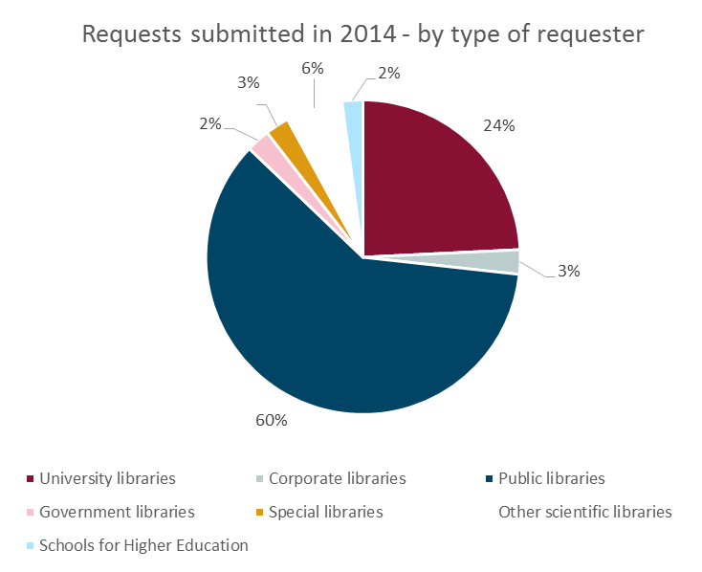

Slide 11
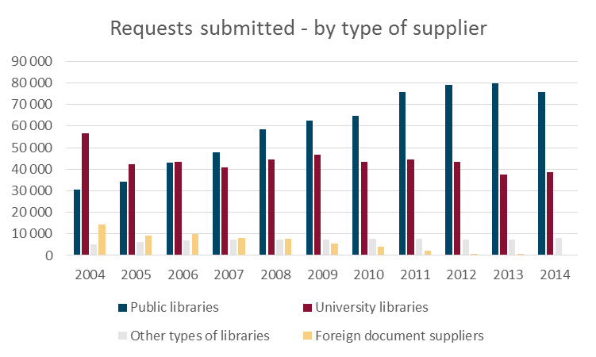

Slide 12
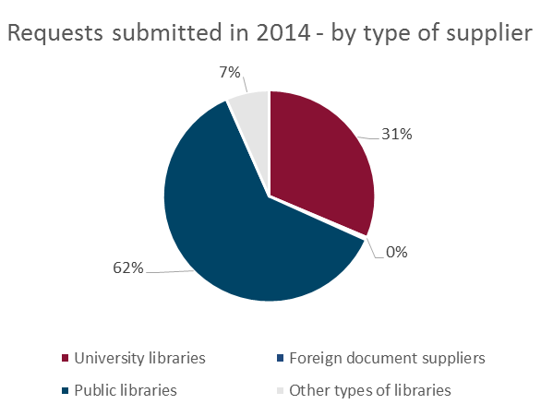

Slide 13
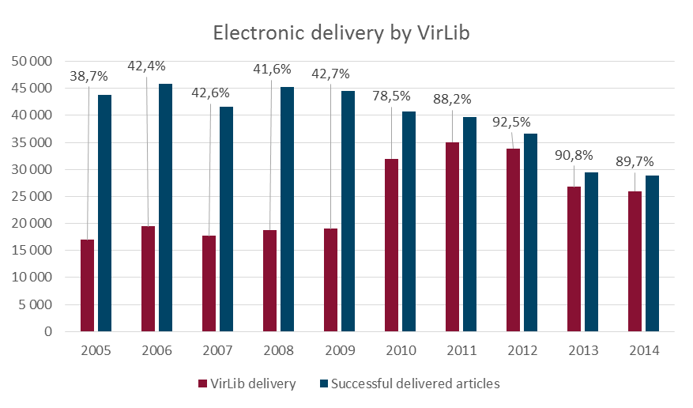
Notes:
Virlib gratis sinds 2010

Slide 14
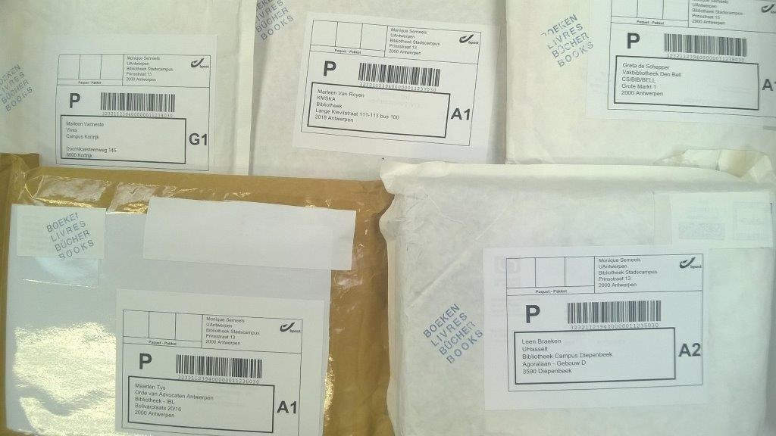
bpost application

Slide 15
bpost application
New features in Impala for the dispatch of parcels:
print labels
manage parcels
track shipment
Supplying library Requesting library
Return
Send

Slide 16
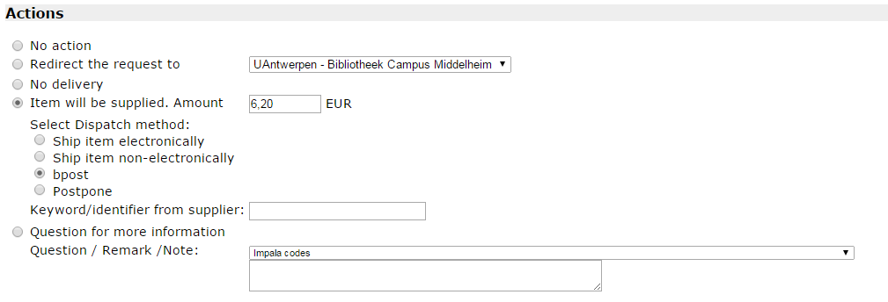
bpost application

Slide 17
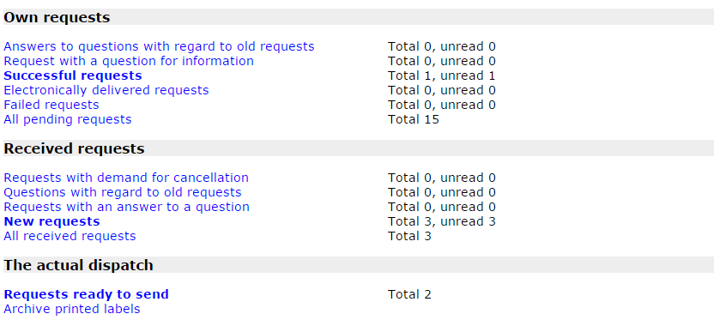
bpost application

Slide 18
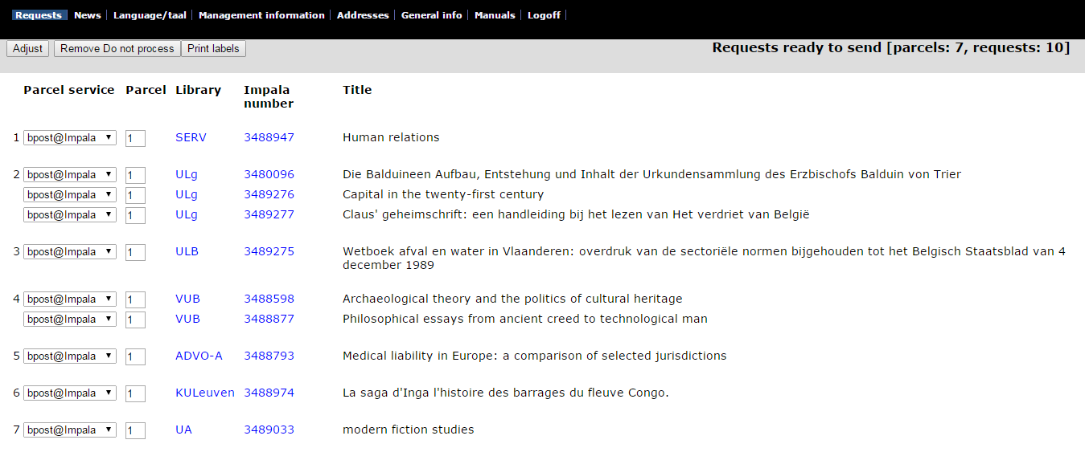
bpost application

Slide 19
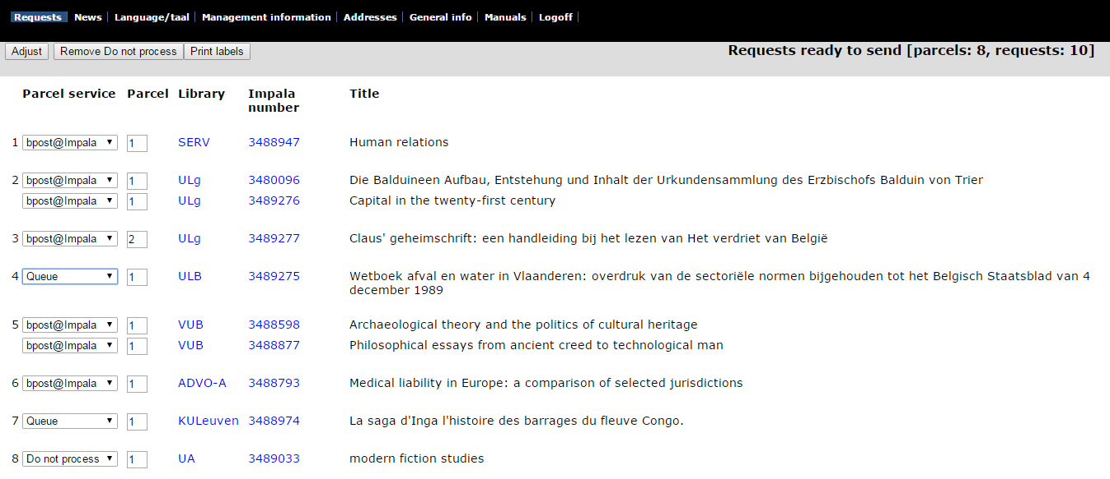
bpost application

Slide 20
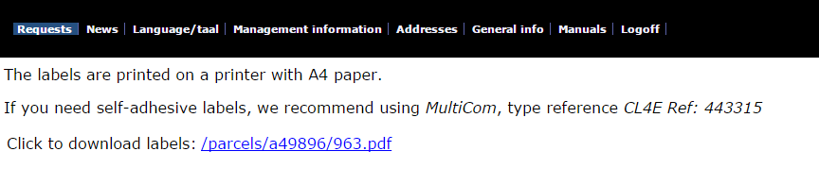
bpost application

Slide 21
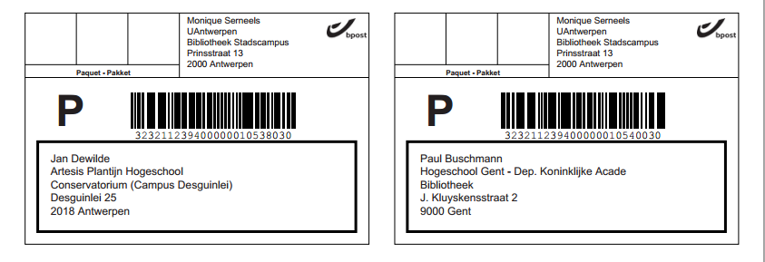
bpost application

Slide 22
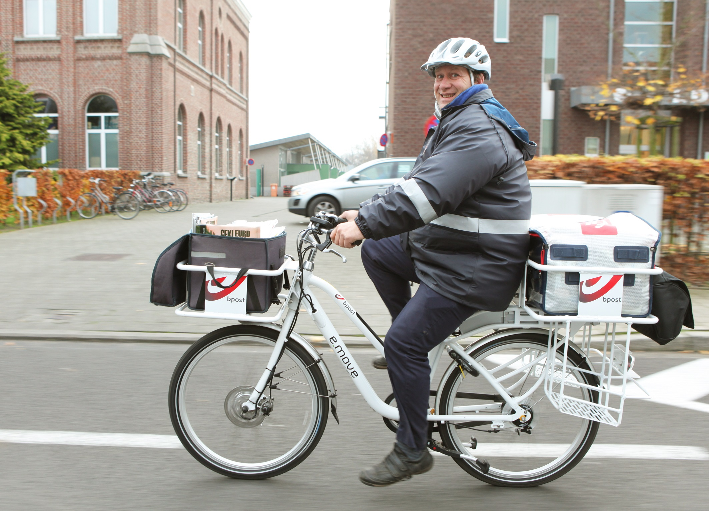

Slide 23
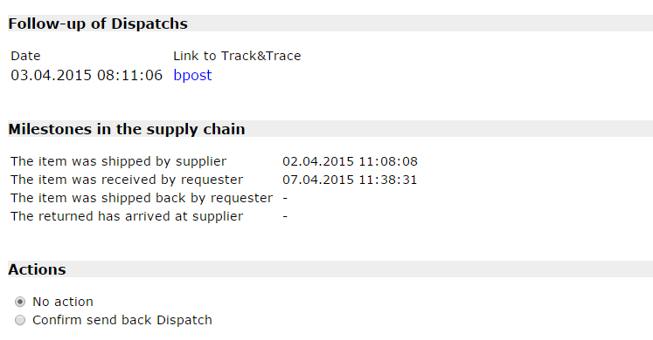
bpost application

Slide 24
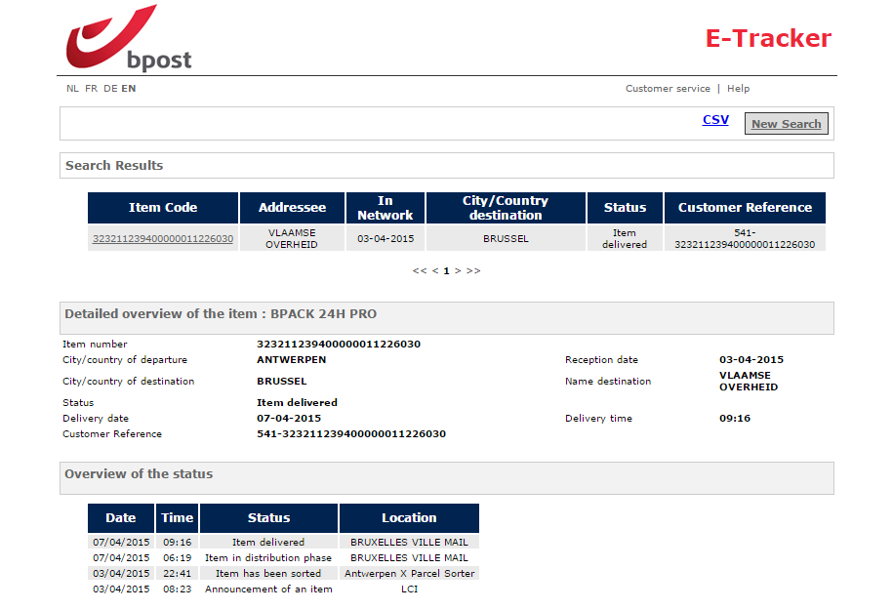
bpost application

Slide 25
bpost application
Advantages:
Easy to print labels, complete with address
Fast delivery
    98% delivered next day
    2% delivered after 2 days
Verification in case of missing books

Slide 26
bpost application
Procedure:
contact Impala@uantwerpen.be for activation
existing bpost contract or new contract
-> online contract approval
-> account can be set up in 2 to 3 days
standard bpost rates or lower
direct invoices from bpost to your financial department
more information:
http://anet.be/doc/anet/impala/html/bpost.html

Slide 27
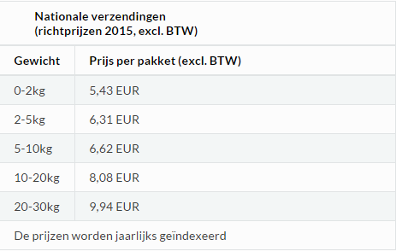
bpost application
Standard bpost rates:

Slide 28

Return dispatch

Slide 29
Return dispatch
Impala tracks the milestones in the supply chain
-> both send AND return dispatch
Available for every client
-> not only connected to the bpost application
Supplying library Requesting library
Return
Send

Slide 30
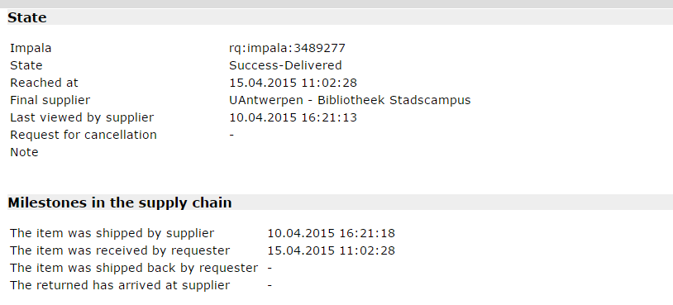
Return dispatch

Slide 31
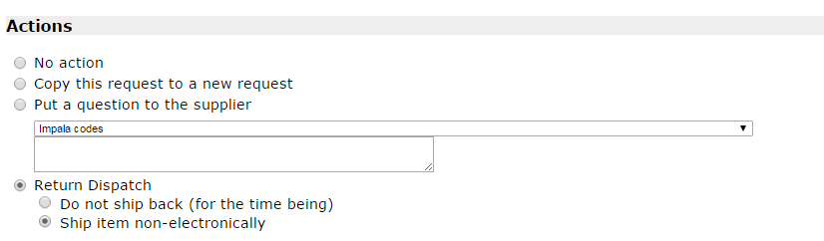
Return dispatch

Slide 32
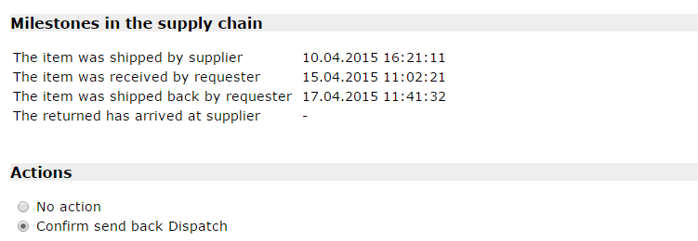
Return dispatch

Slide 33
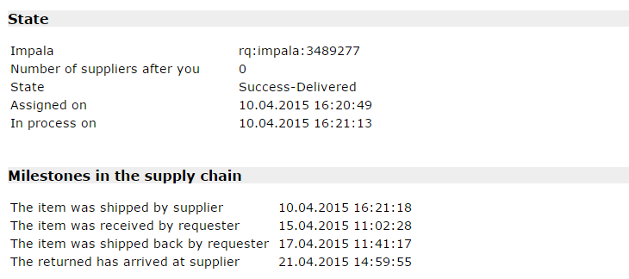
Return dispatch

Slide 34

Quick link and bar code

Slide 35
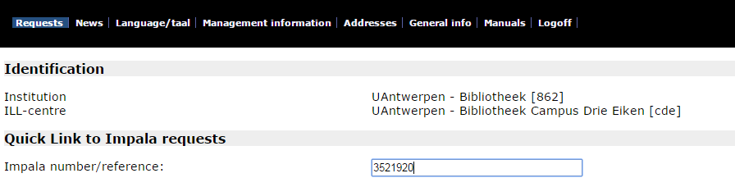
Quick link and bar code

Slide 36
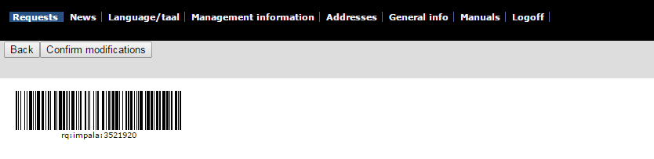
Quick link and bar code

Slide 37
Questions?
Impala@uantwerpen.be
http://anet.be/doc/anet/impala

