Slide 1
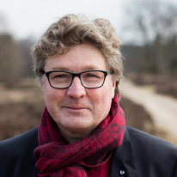
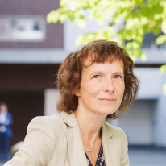
Science for a responsible environment
Prof. dr. Ronny Blust
Vice-Rector Research
IMDO Board Member

Slide 2
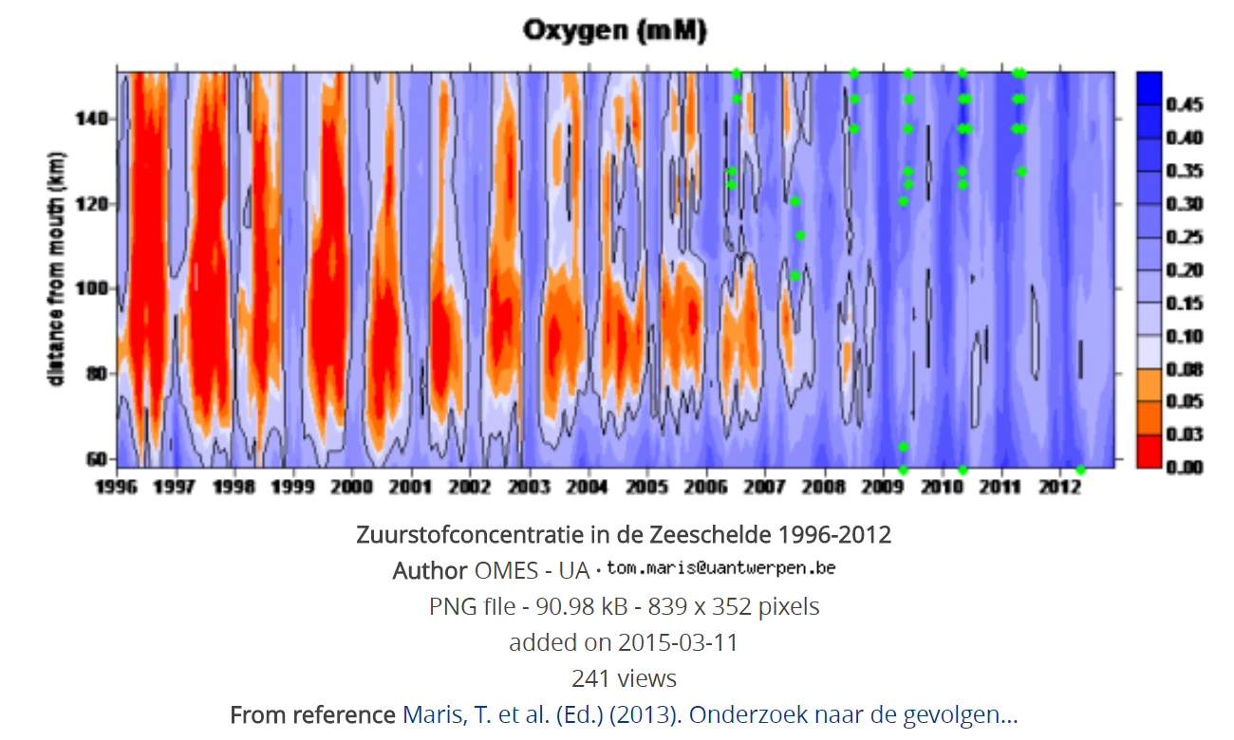

Slide 3
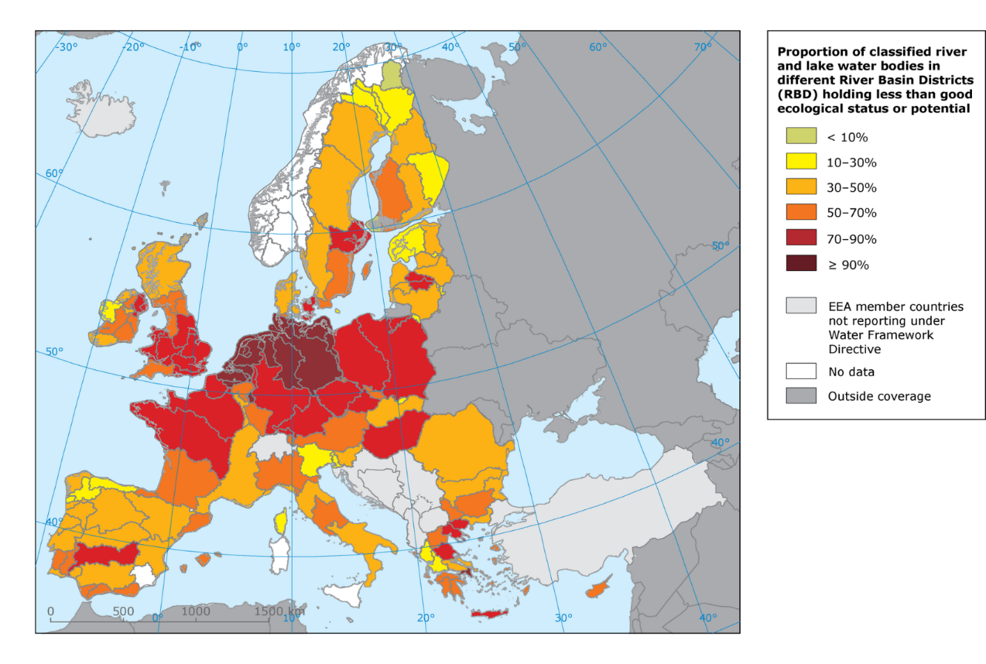
Proportion of classified river and lake water bodies in different River Basin Districts (RBD) holding less than good ecological status or potential
https://www.eea.europa.eu/soer-2015/europe/freshwater

