Slide 1



Seminar day at the University of Liège
lecture room R.7, building B28
November 28th, 2019
Theory of
Quantum and
Complex systems
Jacques Tempere
TQC, Department Fysica, Universiteit Antwerpen
Functional integral description of a superfluid Fermi gas
Path-integral outline of this talk:

Slide 2
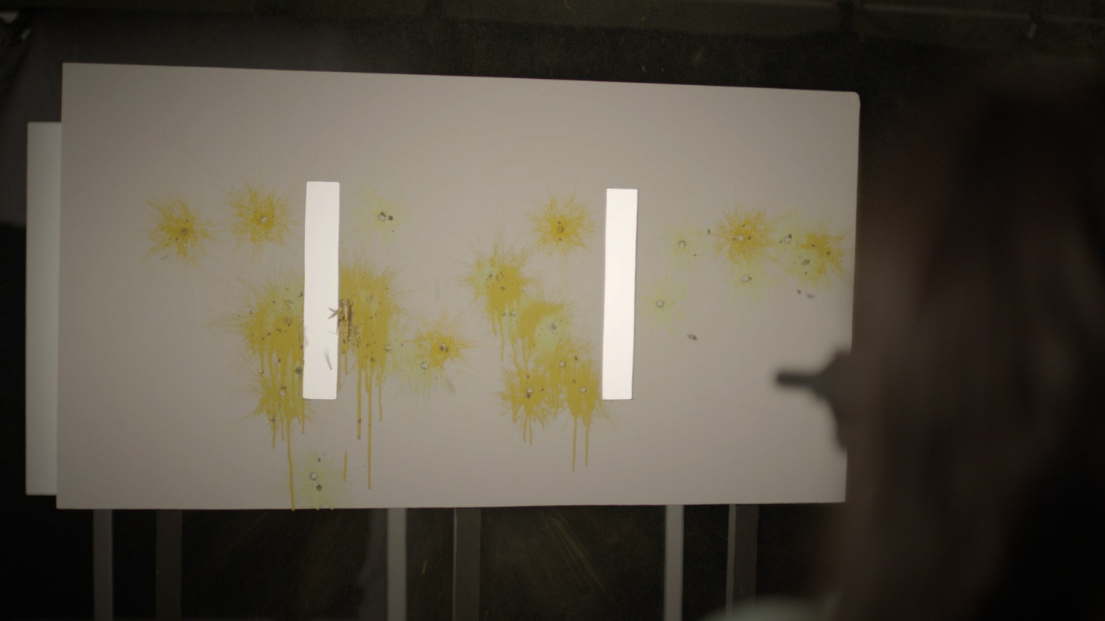

Part I: path integrals for a quantum particle

Slide 3


Introduction: Path integrals for a quantum particle
Two alternatives: add the amplitudes
1
B
A
2

Slide 4
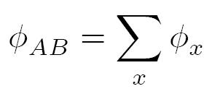
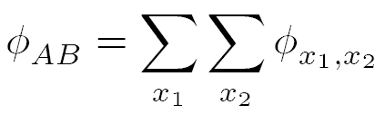
Introduction: Path integrals for a quantum particle
x
Many alternatives: add the amplitudes
B
A

Slide 5
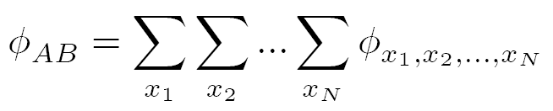
Introduction: Path integrals for a quantum particle
x
Many alternatives: add the amplitudes
B
A
t

Slide 6

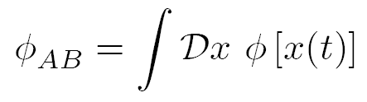
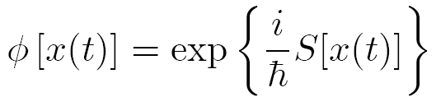
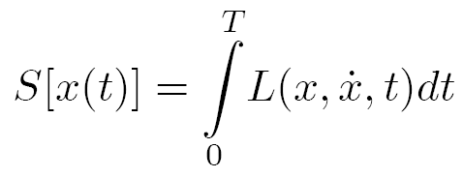
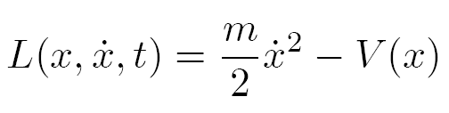
Introduction: Path integrals for a quantum particle
Many alternatives: add the amplitudes
x
is called the path integral propagator
The amplitude corresponding to a given path x(t) is
Here, S is the action functional:
With L the Lagrangian, eg.
x(t)
B
A
t
H. Kleinert, Path Integrals in Quantum Mechanics, Statistics, Polymer Physics, and Financial Markets, 5th ed.
(World Scientific, Singapore, 2009)

Slide 7

Introduction: Path integrals for a quantum particle
Many alternatives: add the amplitudes
x
is called the path integral propagator
The amplitude corresponding to a given path x(t) is
Here, S is the action functional:
With L the Lagrangian, eg.
δS ≈ h
B
A
x_{cl}(t)
t
No operators any more!
H. Kleinert, Path Integrals in Quantum Mechanics, Statistics, Polymer Physics, and Financial Markets, 5th ed.
(World Scientific, Singapore, 2009)

Slide 8
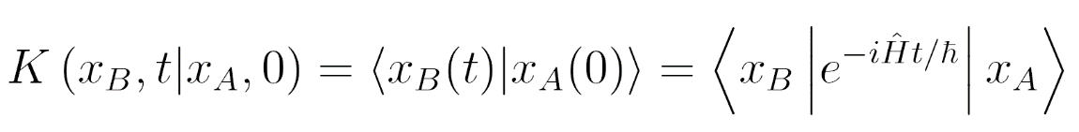
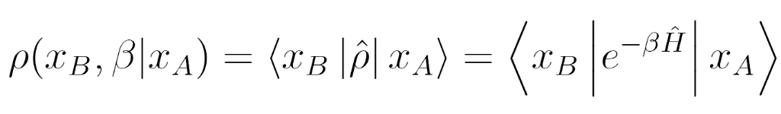
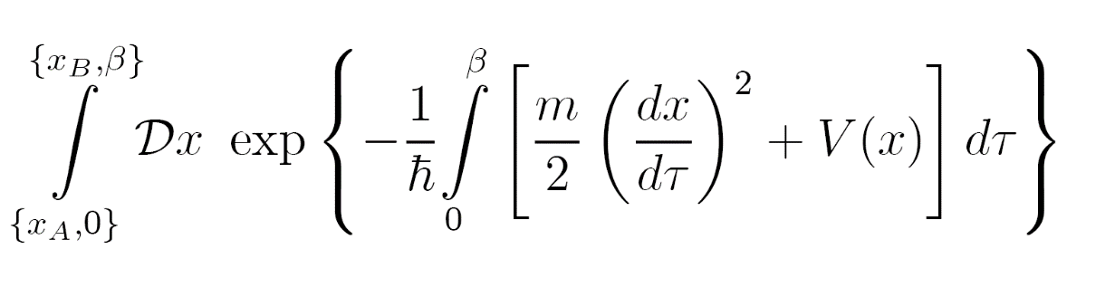
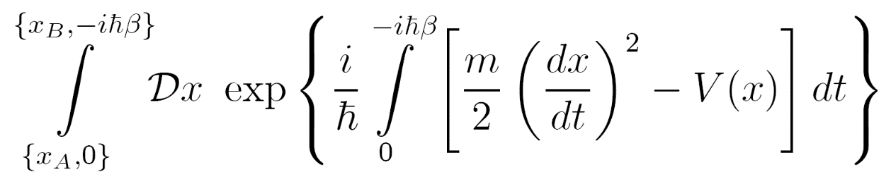
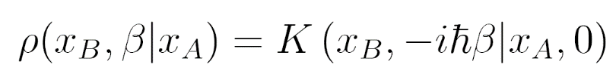
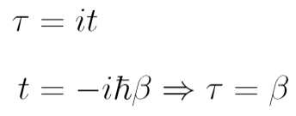

Introduction: Path integrals for quantum statistical physics
Thusfar, we discussed the path integral propagator
To study the phases of the atomic Fermi gas and its thermodynamics, we need
the density matrix:
From the above, it is clear that the density matrix can be expressed as an analytic continuation of the propagator:
Euclidean action
H. Kleinert, Path Integrals in Quantum Mechanics, Statistics, Polymer Physics, and Financial Markets, 5th ed.
(World Scientific, Singapore, 2009)

Slide 9
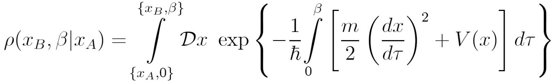
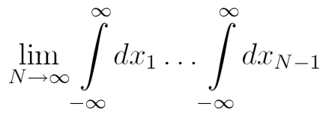
Introduction: Path integrals for quantum statistical physics
Sum over all paths x(τ) going from x_{A} to x_{B} , as τ goes from 0 to β.
τ
β
x_{N-1}
x_{j}
Δτ = β/N
x₂
0
x₁
x_{A}
x_{B}
x
H. Kleinert, Path Integrals in Quantum Mechanics, Statistics, Polymer Physics, and Financial Markets, 5th ed.
(World Scientific, Singapore, 2009)

Slide 10
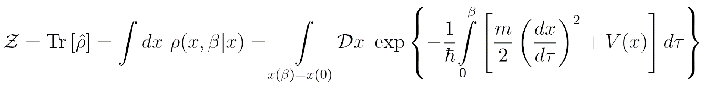
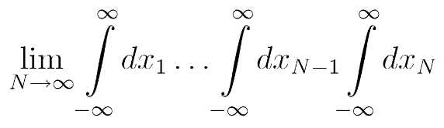
Introduction: Path integrals for quantum statistical physics
Sum over all periodic paths x(τ) as τ goes from 0 to β.
τ
x_{j}
0=β
x₁
x
x_{N}
Δτ = β/N
H. Kleinert, Path Integrals in Quantum Mechanics, Statistics, Polymer Physics, and Financial Markets, 5th ed.
(World Scientific, Singapore, 2009)

Slide 11

Part II: path integrals in field theory

Slide 12
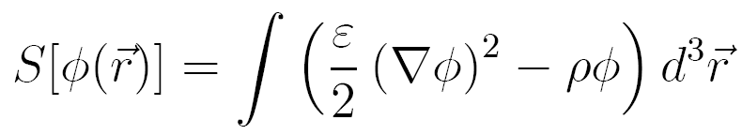
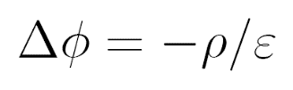
From particle paths to fields
Newtonian particles have action functionals from which the equation of motion
can be derived for the (unique) classical path followed by the particle.
Classical fields also have action functionals from which the field equations
can be derived yielding the (unique) classical field configuration.
Example: electrostatics
permittivity electrostatic charge density
potential
extremizing this action yields the field equation:
Poisson equation
of electrostatics

Slide 13
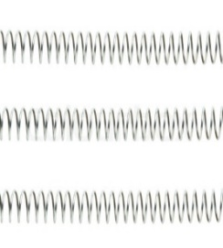
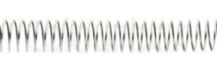
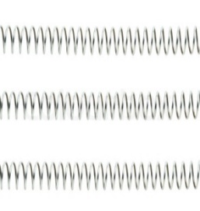
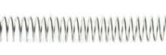
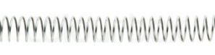
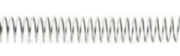
From particle paths to fields
For quantum particles, all paths must be taken into account, weighted by the exponent of the particle action.
For quantum fields, all field configurations must be taken into account, weighted by the exponent of the field action.
Quantum field: a distribution of
numbers at every spacetime point
Classical field: a
single number at every spacetime point
time
q_{3,3}
q₄(t₃)
t₃
3
4
5
q₅(t₃)
6
x
q₆(t₃)
q_{3,2}
q₄(t₂)
x
t₂
3
4
5
q₅(t₂)
6
δ
q_{3,1}
q₆(t₂)
q₄(t₁)
x
t₁
3
4
5
6
ε
q₅(t₁)
q₆(t₁)
space

Slide 14

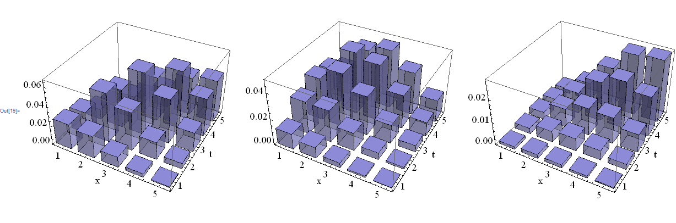
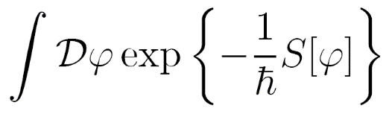
From particle paths to fields
The “path” integral prescription is to average over all possible field configurations
For ϕ_{x,τ} giving each field configuration a weight .
ϕ_{x,τ}
ϕ_{x,τ}
ϕ_{x,τ}
τ
τ
τ
exp{− S[ϕ_{x,τ}]/}
+
exp{− S[ϕ_{x,τ}]/}
+
exp{− S[ϕ_{x,τ}]/}
+…
This “path integral” sum is again denoted by

Slide 15
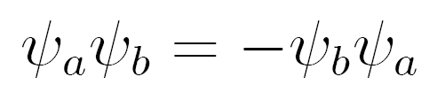
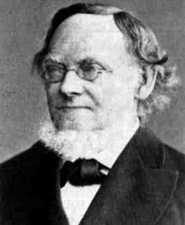

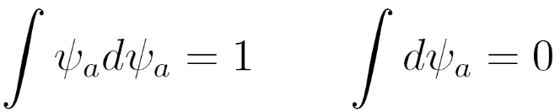
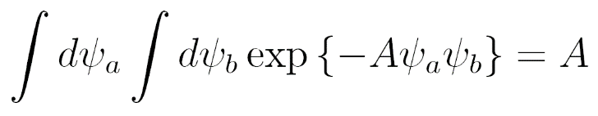
Side note: fields for fermions
We require that the “numbers” living on the spacetime points
anticommute, i.e.
No ordinary algebra (R, C,...) does this. Imposing this rule for the
multiplication leads to a new algebra, the Grassmann algebra G .
As a consequency, functions become really simple:
Integrations simplify as well:
τ
example
“[Perhaps] a time will come when it will be drawn forth from the dust of oblivion and the ideas laid down here will bear fruit. ”
example

Slide 16
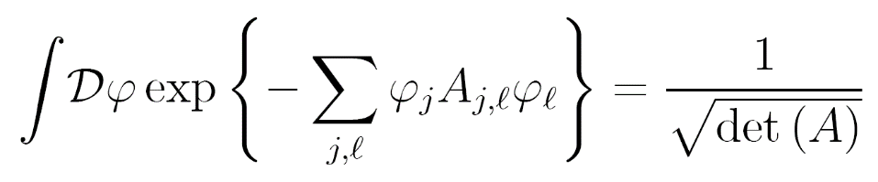

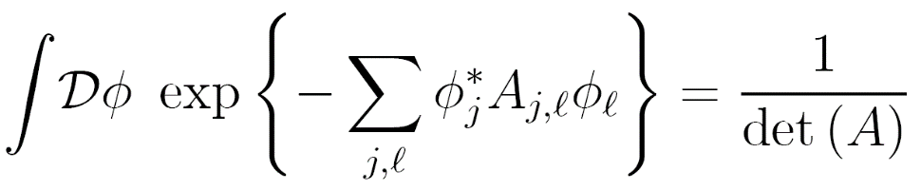
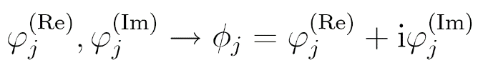
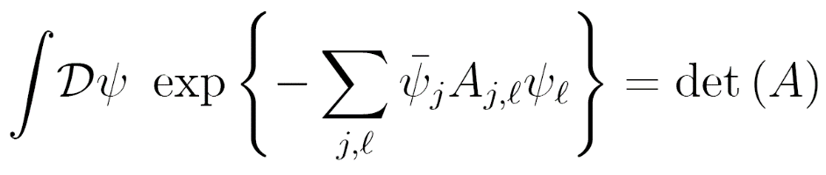
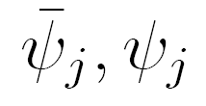
Analytically Solvable Path Integrals for fields
Sadly, there is basically only one integral that we can do analytically,
namely that for quadratic action functionals.
τ
re-label:
2 real fields (=one complex field)
per spacetime point:
2 Grassmann fields per
spacetime point:

Slide 17

Part III: The ultracold atomic Fermi gas
No two fermionic pralines are allowed in the same state.

Slide 18

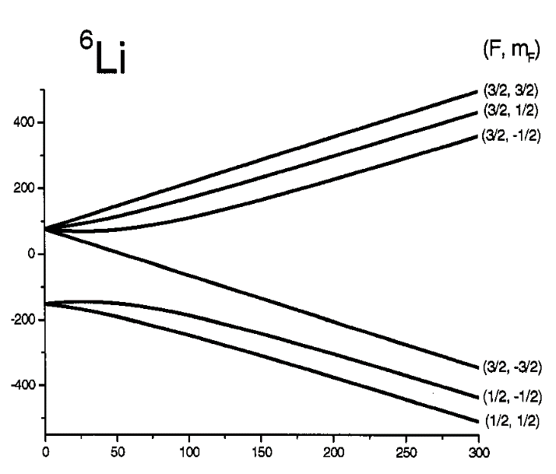
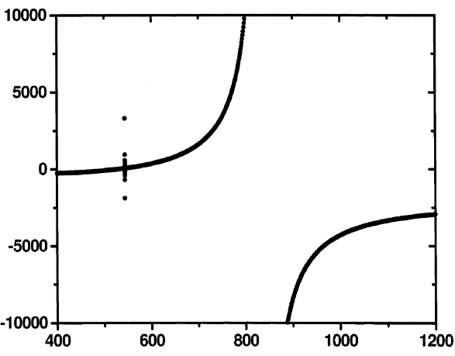
Ultracold atomic Fermi gases
Quantum gases are optically cooled, trapped collections of ultracold atoms.
Typically: 10⁵-10⁶ atoms at nanokelvin temperatures.
Common fermionic species in experiment:
⁶Li and ⁴⁰K
Interactions: s-wave contact interactions,
only between opposite spin fermions.
Energy (MHz)
spin up
Scattering length (a_{Bohr})
spin down
Magnetic field (G)
Magnetic field (G)
Graphs: thesis G.B. Partridge (promotor R. Hulet), “Pairing of fermionic lithium-6 throughout the BEC-BCS crossover”, Rice Univerisy 2007

Slide 19
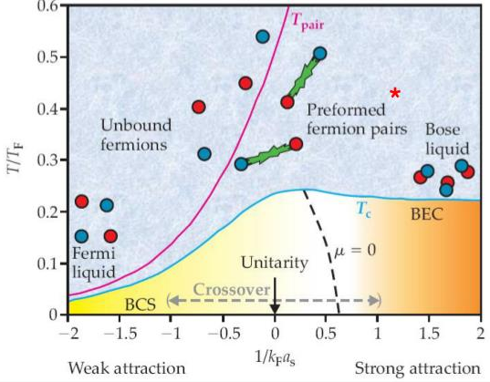

Superfluidity and the BEC-BCS crossover
Image source:
C.A.R.Sa de Melo,
Physics Today, oct.2008
BCS side of the resonance
10000
5000
0
-5000
-10000
BEC side of the resonance
Scattering length (a_{Bohr})
1200 1000 800 600 400
Magnetic field (G)

Slide 20
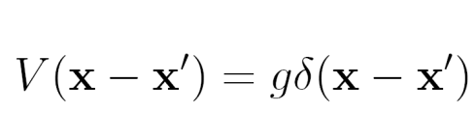

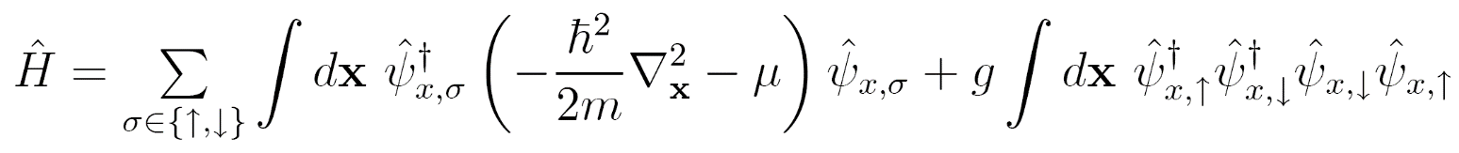
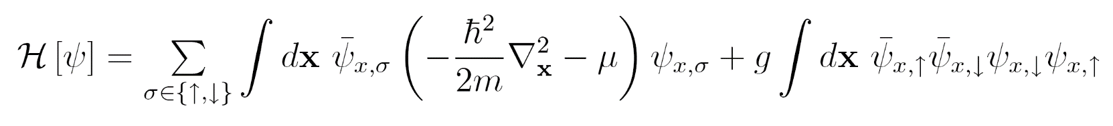
Constructing the action functional
The Hamiltonian of the Fermi gas interacting through a contact potential
with is:
For the path integral version, trade the operators for Grassmann fields:
The field Lagrangian corresponding to this Hamiltonian is

Slide 21
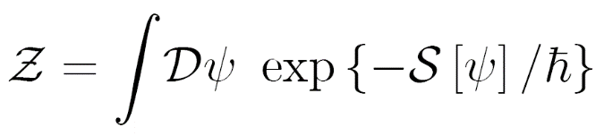
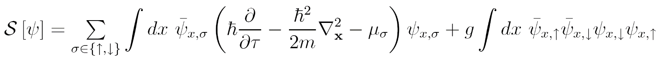
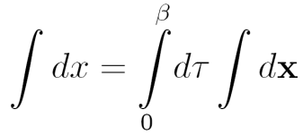
Constructing the action functional
The partition sum is
where action for the fermionic field is given by
Fix number of up and down fermions separately

Slide 22
Constructing the action functional
The partition sum is
where action for the fermionic field is given by
Quadratic action ☑
Quartic term ☒

Slide 23
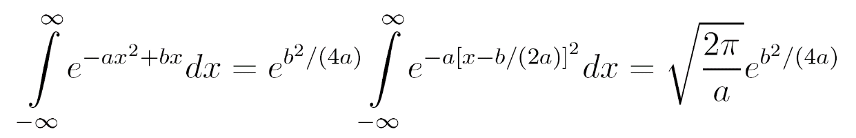
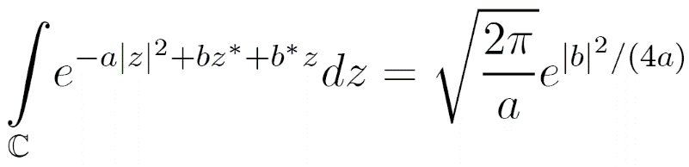



Trick #1 : completing the square
Remember the following Gaussian integral:
It has a counterpart for complex variables:
“b” can be a product of Grassmann variables:
“direct” channel (b ≡ fermion density)
“exchange” channel (b ≡ magnetization density)
“anomalous” channel (b ≡ pair field)
This leads to the “Hubbard-Stratonovic Transformation” (for the anomalous channel):

Slide 24
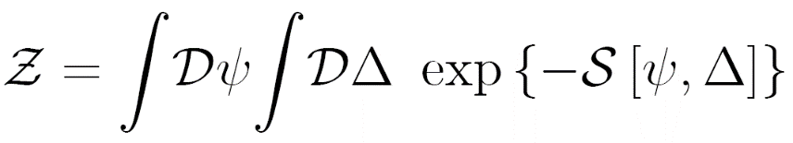
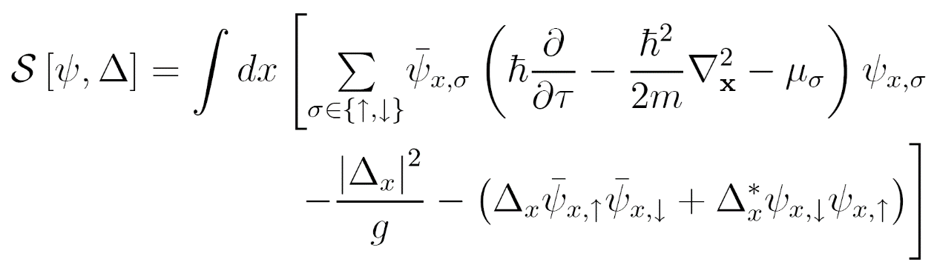











The Hubbard-Stratonovic transformation
The partition sum is
where action for the fermionic field is given by
Quadratic action
in the Grassmann
fields ☑
becomes

Slide 25


The Hubbard-Stratonovic transformation
The partition sum is
where action for the fermionic field is given by
Not quadratic at all (in fact, all powers of Δ) ☒
becomes

Slide 26

Pairs condense in the superfluid state
The introduction of new fields is used in particle physics to renormalize divergent diagrams. Some argue that these ‘new’ particles are not real, but in our case we have a clear interpretation.
The (bosonic) Δ-field represents the field of the fermionic pairs.
lower temperature
Application of path integral description to BEC-BCS crossover, see:
C.A.R. Sa de Melo, M. Randeria, and J.R. Engelbrecht, Phys. Rev. Lett. 71, 3202 (1993).
Additional details can be found for example in Stoof, Dickerscheid & Gubbels, Ultracold Quantum Fields (Springer, 2009).

Slide 27

Pairs condense in the superfluid state
The introduction of new fields is used in particle physics to renormalize divergent diagrams. Some argue that these ‘new’ particles are not real, but in our case we have a clear interpretation.
The (bosonic) Δ-field represents the field of the fermionic pairs. When these pairs Bose condense to form a superfluid, the macroscopic occupation of a single mode makes the pair field more “classical”, i.e. dominated by a single realization.
lower temperature
Application of path integral description to BEC-BCS crossover, see:
C.A.R. Sa de Melo, M. Randeria, and J.R. Engelbrecht, Phys. Rev. Lett. 71, 3202 (1993).
Additional details can be found for example in Stoof, Dickerscheid & Gubbels, Ultracold Quantum Fields (Springer, 2009).

Slide 28







Trick #2 : the saddle-point expansion
Consider the ordinary integral
For large λ, only points close to x₀ will matter:
Restricting the integral to Gaussian fluctuations makes it analytically integrable:

Slide 29





Gaussian fluctuation expansion
saddle point
saddle point
saddle point value
saddle point value

Slide 30





The saddle point value
The saddle-point contribution to the partition sum is
with
Performing the remaining integrations, we obtain the saddle point free energy
Energy
dispersions:
Chemical
potentials:

Slide 31


The pair condensate order parameter Δ
From the
gap equation:
C. A. R. Sa de Melo, M. Randeria, and J. R. Engelbrecht, Phys. Rev. Lett. 71, 3202 (1993).
J. R. Engelbrecht, M. Randeria, and C. A. R. Sa de Melo, Phys. Rev. B 55, 15153 (1997).

Slide 32


The chemical potential (spin-balanced case):
From the
gap equation:
and the number
equation:
C. A. R. Sa de Melo, M. Randeria, and J. R. Engelbrecht, Phys. Rev. Lett. 71, 3202 (1993).
J. R. Engelbrecht, M. Randeria, and C. A. R. Sa de Melo, Phys. Rev. B 55, 15153 (1997).

Slide 33

Temperature dependence of the pairing order parameter
From the
gap equation:
and the number
equation:
The temperature at which the pairing is broken is not equal to the critical
temperature for superfluidity! In the BEC region, pairs are robust and phase
fluctuations destroy superfluidity.

Slide 34







Gaussian fluctuations
Expand the action up to quadratic order in the fluctuation field
This yields the Gaussian fluctuation expansion
phase fluctuations
amplitude fluctuations
This we obtained previously
The fluctuation action
The fluctuation action can be written as
The “fluctuation matrix”
Remember the one bosonic field integral we can do:
⇒

Slide 35



The fluctuation contribution to the free energy
Solving the gap and number equations for Δ→0₊ yields T_{c} :
without
fluctuations
T_{c}/T_{F}
including
fluctuations
1/(k_{F}a_{s})
C. A. R. Sa de Melo, M. Randeria, and J. R. Engelbrecht, Phys. Rev. Lett. 71, 3202 (1993).
J. R. Engelbrecht, M. Randeria, and C. A. R. Sa de Melo, Phys. Rev. B 55, 15153 (1997).

Slide 36

The critical temperature
C.A. Regal, M. Greiner, and D. S. Jin, Phys. Rev. Lett. 92, 040403 (2004)

Slide 37
The fluctuation matrix
The action functional for the excitations of the fermion pairs:
The “fluctuation matrix”
A tremendous amount of work has been done to fully understand the fluctuation matrix
[1] J. Engelbrecht, M. Randeria, C.A.R. Sa de Melo, Phys. Rev. B 55, 15153 (1997).
[2] Y. Ohashi and A. Griffin, Phys. Rev. A 67, 063612 (2003).
[3] R. Combescot, M. Yu. Kagan, S. Stringari, Phys. Rev. A 74, 042717 (2006).
[4] D.-S. Lee, C.-Y. Lin, and R. J. Rivers, Phys. Rev. Lett. 98, 020603 (2007).
[5] G. Bighin, L. Salasnich, P. A. Marchetti, and F. Toigo, Phys. Rev. A 92, 023638 (2015).
[6] D. Pekker and C.M. Varma, Annual Review of Condensed Matter Physics 6, 269 (2015).
[7] H. Kurkjian, Y. Castin, and A. Sinatra, Phys. Rev. A 93, 013623 (2016).
... and many more ... and even more for these modes in superconductors.

Slide 38



The fluctuation matrix
The action functional for the excitations of the fermion pairs:
The inverse fluctuation matrix can be interpreted as a propagator for coupled amplitude-phase modes, and its poles (the zeros of ) reveal the dispersion and lifetime of the bosonic excitations of the superfluid.
Sidorenkov et al.,
Nature 498, 78–81(2013)
−400 μm
0 μm
+400 μm
position

Slide 39

Example: sound velocity in a Fermi superfluid
The poles of the propagator, or equivalently the zeroes of , reveal the dispersion and lifetime of the bosonic excitations of the superfluid.
S.N. Klimin, H. Kurkjian, J. Tempere, Journ. Low. Temp. Phys. 196, 102 (2019).

Slide 40

Conclusions
The path integral or functional integral technique is well suited to describe superfluid Fermi gases,
at any temperature or any interaction strength.
Two tricks (and key steps) to keep in mind:
the Hubbard-Stratonovic decomposition introduces the pair field,
the fluctuation expansion around the classical (“pair condensate”) field.

Slide 41
Title

Slide 42
Title

Slide 43


The saddle point value
The saddle-point contribution to the partition sum is
with

Slide 44



The fluctuation contribution to the free energy
Still the same gap equation:
But now we have different number equations:
(Nozières & Schmitt-Rink or NSR)
(Hu, Liu & Drummond or GPF)

Slide 45






The fluctuation matrix
The matrix elements are given by:
In these expressions, and
The fluctuation matrix only depends on Δ, temperature and chemical potentials. These are input parameters, and can be taken from QMC, experimental EOS, NSR theory, …
The Matsubara frequencies appear in the denominators of integrands, of the form
→ simply replacing iω_{n} by z gives a branch cut on the real axis.

Slide 46







Propagators in the complex frequency plane ( for fixed q)
Im[z]
Experiments measure response
functions, given in Kubo’s formalism by
Statistical Field Theory calculates
thermal Green’s functions
pole in upper half
plane = instability
Re[z]
There exists a unique analytical
continuation linking them.
pole in lower half
plane = quasiparticle

Slide 47



Analytic continuation of the fluctuation matrix
Here we use the following illustration conventions for complex functions:
The phase is shown
on a color circle
a node of the function (f[z]=0)
Im[z]
ϴ
Re[z]
grey curves: contour lines
for real and imaginary part
thick black curve
Re[f(z)] is zero
white curve
Im[f(z)] is zero

Slide 48

Analytic continuation of the fluctuation matrix
The matrix elements contain terms of the following form:
Im[z]
The phase is shown
on a color circle:
Im[z]
ϴ
Re[z]
Re[z]

Slide 49
Analytic continuation of the fluctuation matrix
The matrix elements contain terms of the following form:
This gives a branch cut at the real axis:
Im[z]
Re[z]

Slide 50

Analytic continuation of the fluctuation matrix
The matrix elements contain terms of the following form:
This gives a branch cut at the real axis:
x + 0.01 i
Im[z]
Re[z]

Slide 51

Analytic continuation of the fluctuation matrix
The matrix elements contain terms of the following form:
Nozières’ prescription for the analytic continuation through the branch cut is :
Im[z]
Re[z]

