Slide 1


Mechanism of superconductivity in a LaAlO₃-SrTiO₃ heterostructure
Theory of Quantum
and Complex systems
J. Tempere¹ ,S.N. Klimin¹, J.T. Devreese¹, D. van der Marel²
¹ Theory of Quantum and Complex Systems (TQC), Universiteit Antwerpen, Belgium
² Département de Physique de la Matière Condensee, Université de Genève, Switzerland
This work was supported by FWO-V projects G.0356.06, G.0370.09N, G.0180.09N, and G.0365.08, the WOG WO.035.04N (Belgium), the SNSF through Grant No. 200020-140761, and the National Center of Competence
in Research (NCCR) “Materials with Novel Electronic Properties–MaNEP.”

Slide 2
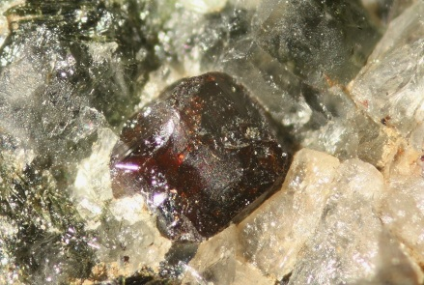
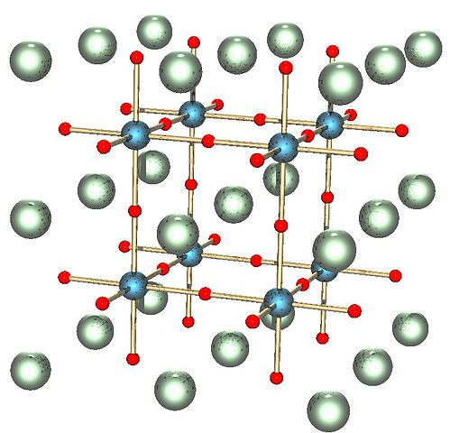
known to geologists as tausonite
Niobium-doped strontium titanate
SrTiO₃ , with perovskite structure, is an insulating crystal with 3.25 eV bandgap
e_{g}
Titanium 3d
t_{2g}
Ti
3.25 eV
O
Oxygen 2p
Sr
Niobium doping in SrTi_{1-x}Nb_{x}O₃ adds electrons in the t_{2g} conduction band, resulting in an insulator-metal transition for x>0.002. For 0.005<x<0.020 it becomes superconducting with T ≈ 0.3 K
J.G. Bednorz, K.A. Muller, Rev. Mod. Phys. 60, 585 (1988), C.S. Koonce et al. Phys Rev. 163, 380 (1967).

Slide 3
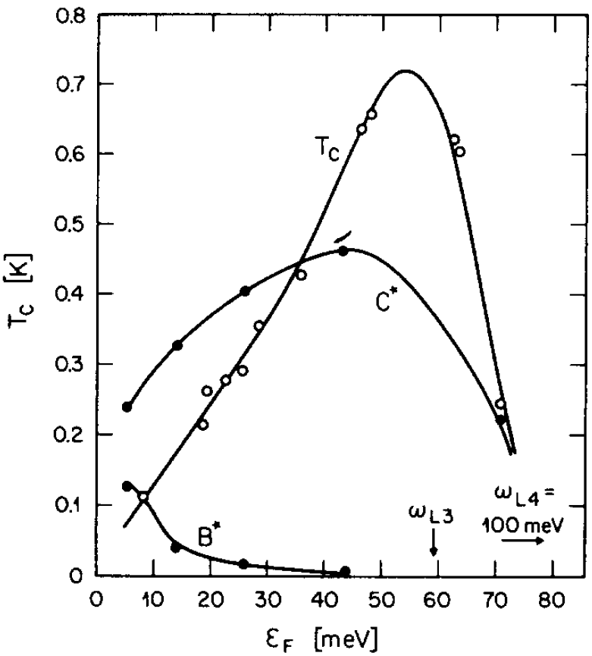
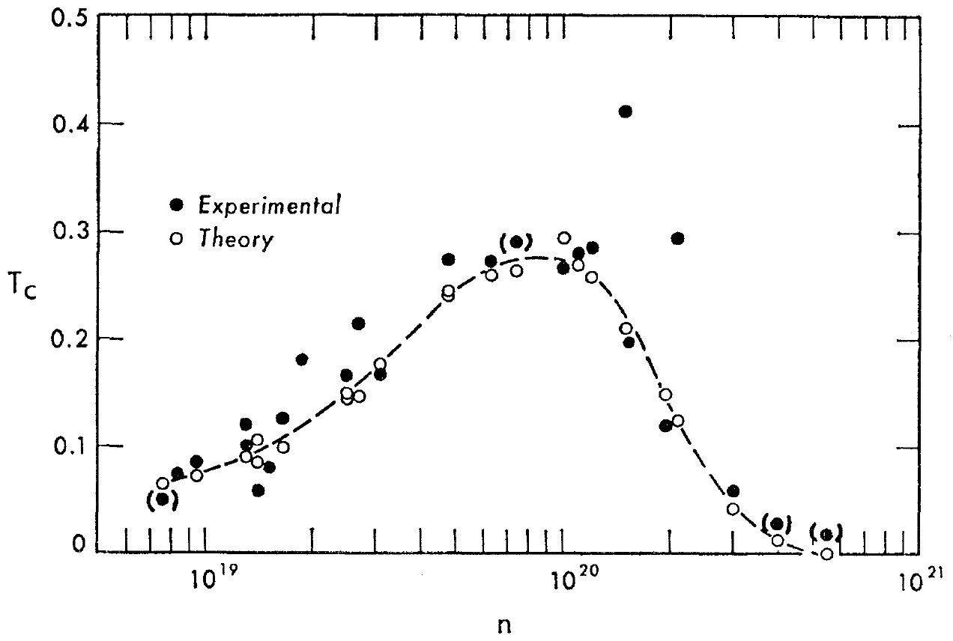
Experimentally detected superconductivity in bulk strontium titanate
Superconductivity occurs in strontium titanate at very low temperatures T < 1 K
The critical temperature non-monotonically depends on the carrier density
Baratov & Binnig, 1981
Koonce et al., 1967
¹ C. S. Koonce et al., Phys. Rev. 163, 380 (1967).
² G. Binnig et al., Phys. Rev. Lett. 45, 1352 (1980); A. Baratoff and G. Binnig, Physica B+C 108, 1335 (1981).

Slide 4
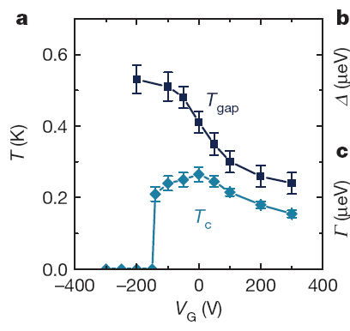
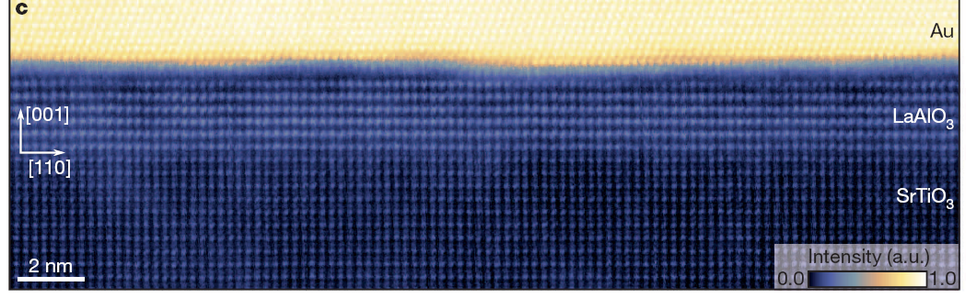
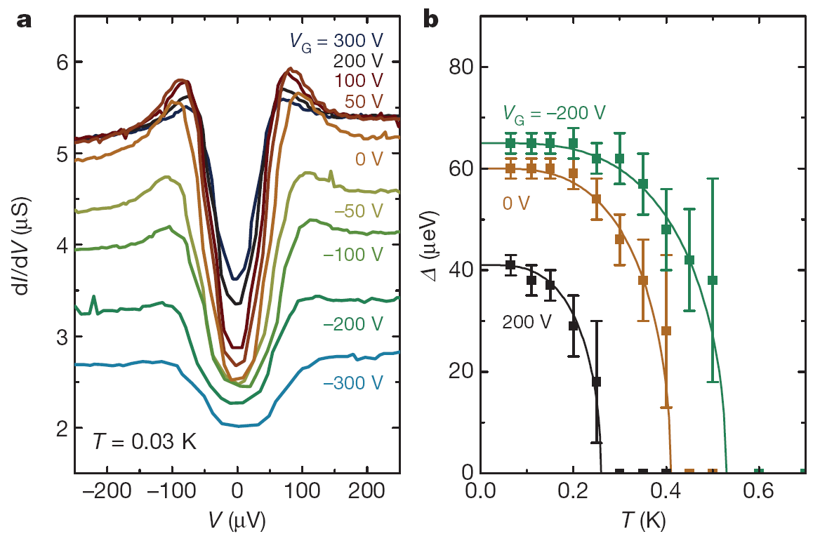
Superconductivity at the LaAlO₃-SrTiO₃ interface
Doping with niobium is not the only way! At the interface between (insulating) LaAlO₃ and (insulating) SrTiO₃ a valence discontinuity results in a 2D electron gas^{[1]}. This 2D layer becomes superconducting^{[2]} at ca. 0.5 K, and T_{c} can be tuned by tuning the carrier density with a gate^{[3,4]}.
region 3: Au gate^{[3,4]}
or vacuum^{[2]}
region 2: LaAlO₃
layer of width l
region 1: SrTiO₃
substrate
Figures from ref. [4]
[1] A. Ohtomo, H.Y. Hwang, Nature 427, 423 (2004).
[2] N. Reyren et al., Science 317, 1196 (2007).
[3] A. Caviglia et al., Nature 456, 624 (2008).
[4] C. Richter et al., Nature 502, 528 (2013).

Slide 5
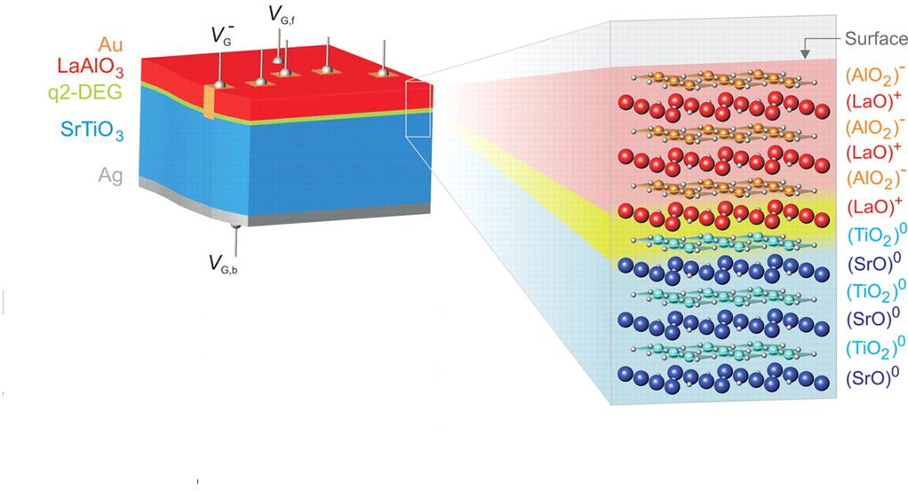
LaAlO₃-SrTiO₃ heterostructure
High-mobility quasi 2D electron gas
Picture from: S. Thiel et al., Science 313, 1942 (2006)
¹ A. Ohtomo, H. Y. Hwang, Nature 427, 423 (2004)
² N. Nakagawa, H. Y. Hwang, D. A. Muller, Nat. Mater. 5, 204 (2006)
³ S. Thiel, G. Hammerl, A. Schmehl, C. W. Schneider, and J. Mannhart, Science 313, 1942 (2006)

Slide 6
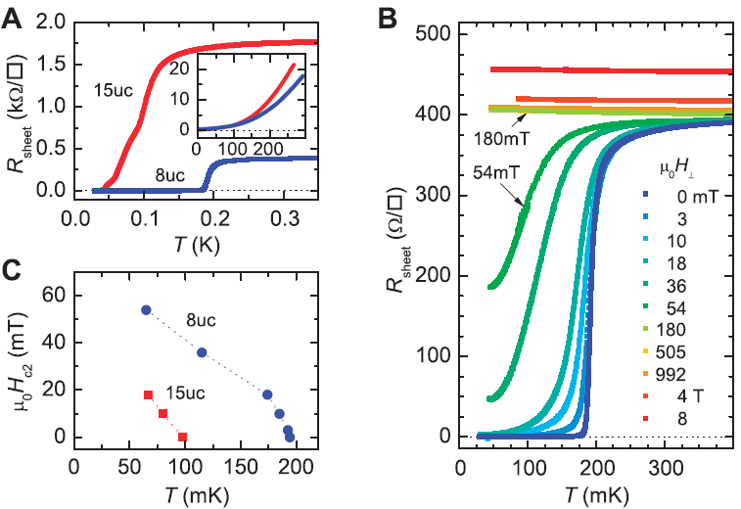
Experimentally detected superconductivity in the LAO-STO structure
N. Reyren, S. Thiel, A. D. Caviglia, L. F. Kourkoutis, G. Hammerl, C. Richter, C. W. Schneider, T. Kopp, A.-S. Ruetschi, D. Jaccard, M. Gabay, D. A. Muller, J.-M. Triscone, and J. Mannhart, Science 317, 1196 (2007).
BKT in superconductors:
B. I. Halperin and D. R. Nelson, J. Low Temp. Phys. 36, 599 (1979)

Slide 7
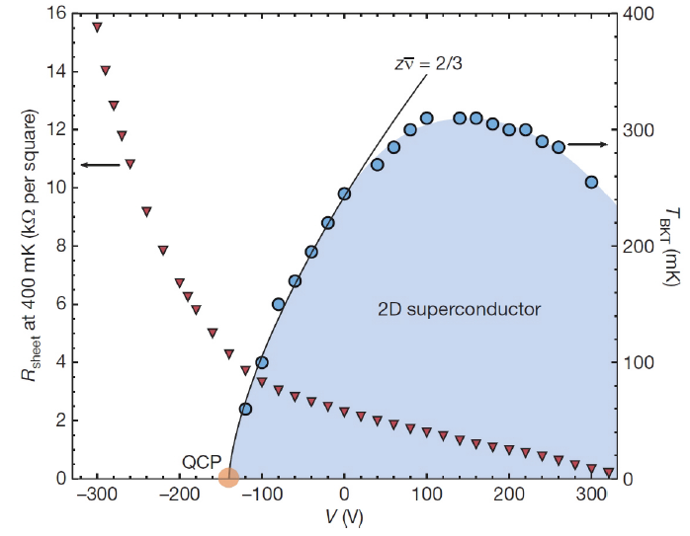
Experimentally detected superconductivity in the LAO-STO structure
A modulation of the gate voltage leads to a modulation of the carrier density in the quasi two-dimensional electron gas at the interface.
As a consequence, the density-dependent critical temperature is experimentally detected.
A. D. Caviglia, S. Gariglio, N. Reyren, D. Jaccard, T. Schneider, M. Gabay, S. Thiel, G. Hammerl, J. Mannhart, and J.-M. Triscone, Nature (London) 456, 624 (2008).

Slide 8
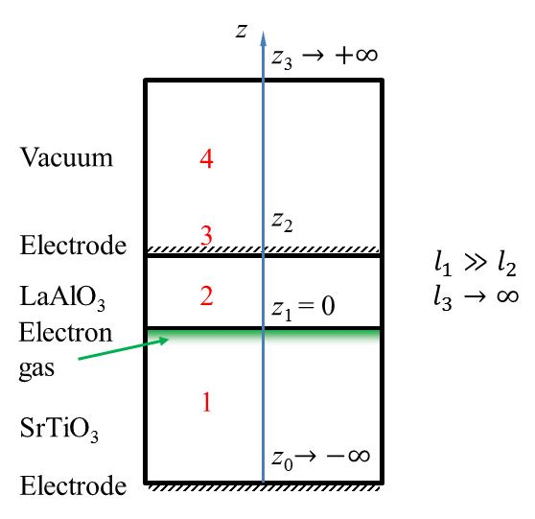
Theoretical model: multilayer structure
Scheme of a multilayer structure
The coordinate z for the n-th layer lies in the range z_{n−1} < z < z_{n}
z
LaAlO₃-SrTiO₃: the asymmetric three-layer structure
z_{K}
K
z_{K−1}
z_{n}
n
l_{n}
z_{n−1}
z₂
2
z₁
1
z₀
L

Slide 9
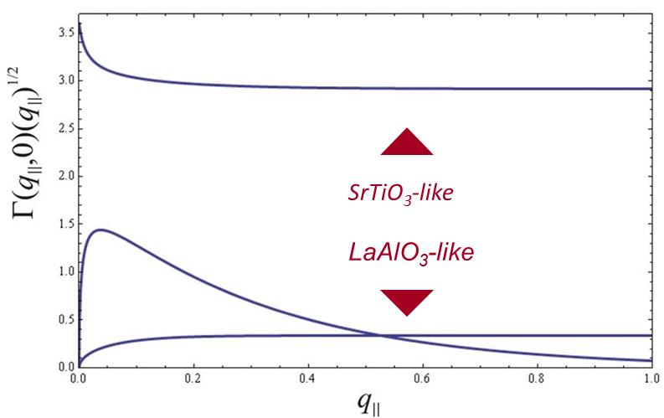
Optical phonons in the LaAlO₃-SrTiO₃ structure
Electron-phonon interaction in an asymmetric three-layer structure
Amplitudes of the electron-phonon interaction with the interface pholons in the LaAlO₃-SrTiO₃ heterostructure
The leading term in the electron-phonon interaction comes from the SrTiO₃-like interface phonons.
The half-space phonons bring much smaller contribution
S. N. Klimin, J. Tempere, J. T. Devreese, and D. van der Marel, Phys. Rev. B 89, 184514 (2014)

Slide 10
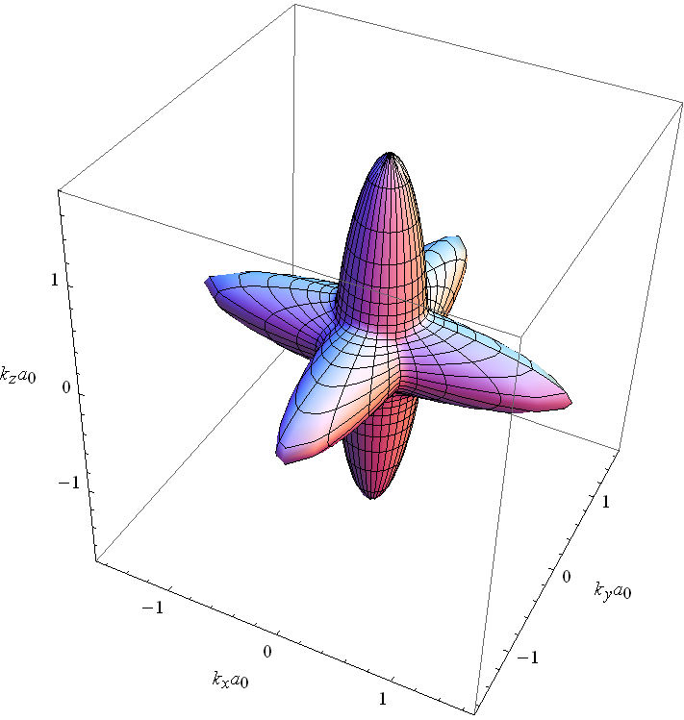
SrTiO₃: band structure
Band dispersion of the lowest unoccupied bands of SrTiO₃
Fermi surface of the cubic phase at 2% doping, showing the large anisotropy of the lowest band
D. van der Marel, J. L. M. van Mechelen, and I. I. Mazin, Phys. Rev. B 84, 205111 (2011)

Slide 11
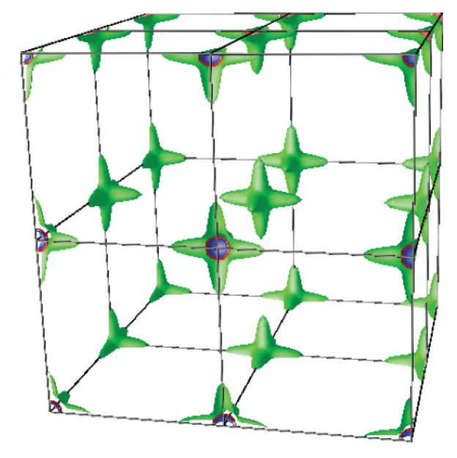
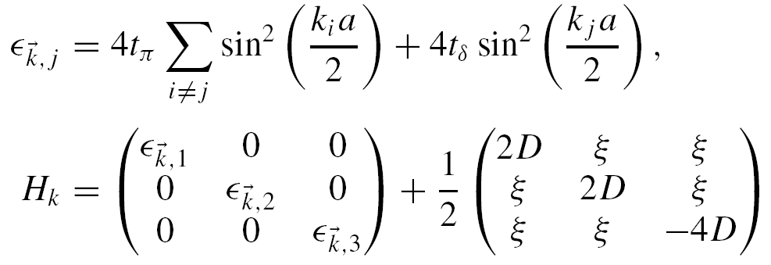
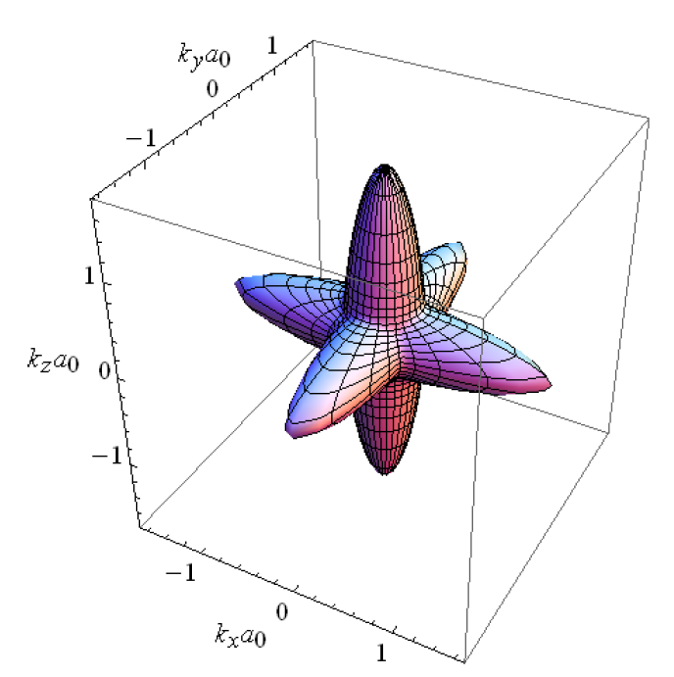

Tight-binding model
The ab-initio band structure of the t_{2g} manifold is well parametrized by the following tight-binding model:
with t_{δ}=35 meV, t_{π}=615 meV, D=2.2 meV, ξ=18.8 meV
In what follows we study 4 samples, with doping
x = 0.0011, 0.0020, 0.0087, 0.0200
corresponding to, respectively:
n₀ = 1.7 × 10¹⁹, 3.4 × 10¹⁹, 1.5 × 10²⁰, 3.4 × 10²⁰ cm⁻³
@ 2% doping
D. van der Marel, J.L.M. Van Mechelen, I.I. Mazin, Phys. Rev. B 84, 205111 (2011).

Slide 12
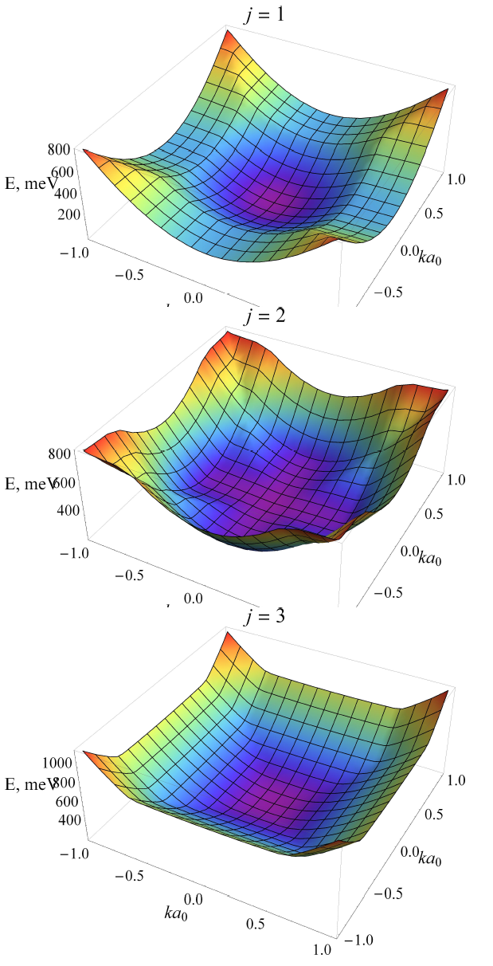
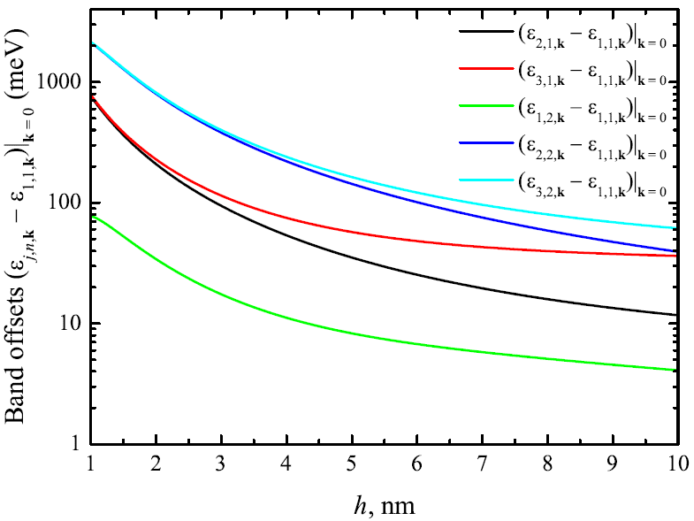



Band splitting for the quasi 2D electron gas
In addition to the enhanced splitting of the bulk bands, the size-quantization subbands appear
S. N. Klimin, J. Tempere, J. T. Devreese, and D. van der Marel, Phys. Rev. B 89, 184514 (2014)

Slide 13

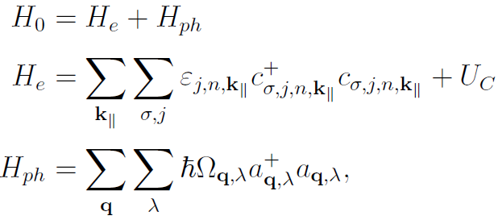
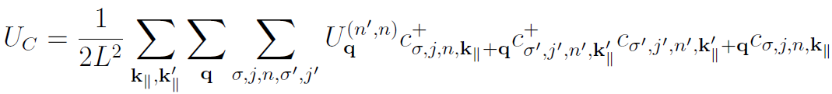
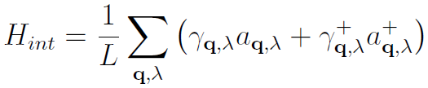

Mechanism of superconductivity
The system
Hamiltonian
One-electron energy
Coulomb interaction
Electron subsystem
Phonon energy
Phonons
Electron-phonon interaction
Matrix element for the Coulomb interaction
Matrix element for the electron-phonon interaction
Because the optical-phonon energies can exceed the Fermi energy, the BCS and Eliashberg approaches can be inapplicable
S. N. Klimin, J. Tempere, J. T. Devreese, and D. van der Marel, Phys. Rev. B 89, 184514 (2014)

Slide 14
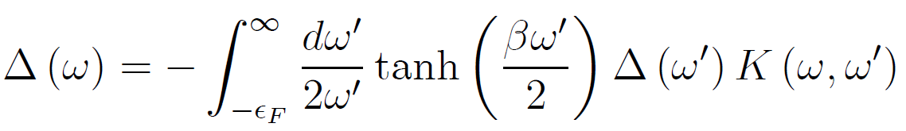
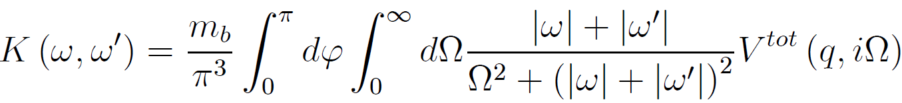
Dielectric function method for superconductivity
For polar crystals with sufficiently high optical-phonon frequencies and/or low carrier densities, the conditions for the Migdal theorem are not fulfilled. Therefore we use the dielectric function method¹ valid far beyond the adiabatic case.
The gap equation
contains the kernel function:
with
S. N. Klimin, J. Tempere, J. T. Devreese, and D. van der Marel, Phys. Rev. B 89, 184514 (2014)

Slide 15
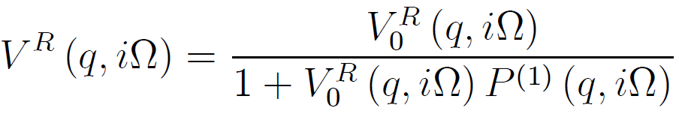
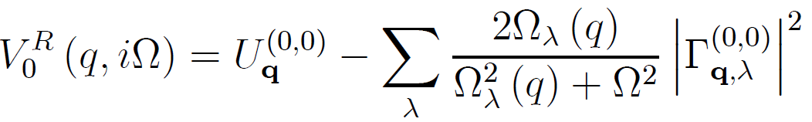
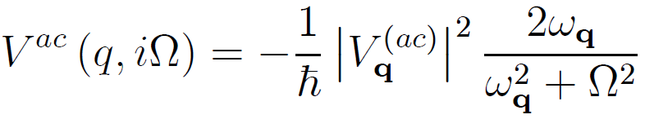
Dielectric function method for superconductivity
The effective interaction potential:
Screening is taken into account within RPA:
The non-screened potential
The acoustic-phonon contribution:
Coulomb d Electron-phonon
matrix elements
S. N. Klimin, J. Tempere, J. T. Devreese, and D. van der Marel, Phys. Rev. B 89, 184514 (2014)

Slide 16
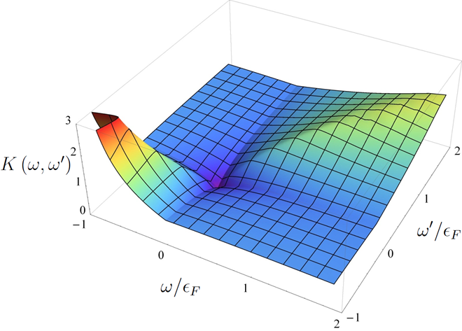
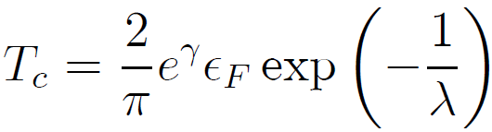
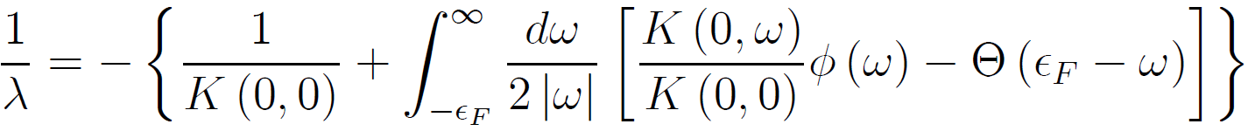
Kernel function and critical temperature
The kernel function is energy-nonlocal, as distinct from the BCS and Migdal-Eliashberg approaches, since it is provided by a retarded effective electron-electron interaction through the plasmon-phonon excitations.
Beyond the Migdal theorem, superconductivity in an electron-phonon system can exist despite the fact that the kernel function is positive for all energies
The critical temperature has been explicitly determined:
S. N. Klimin, J. Tempere, J. T. Devreese, and D. van der Marel, Phys. Rev. B 89, 184514 (2014)

Slide 17
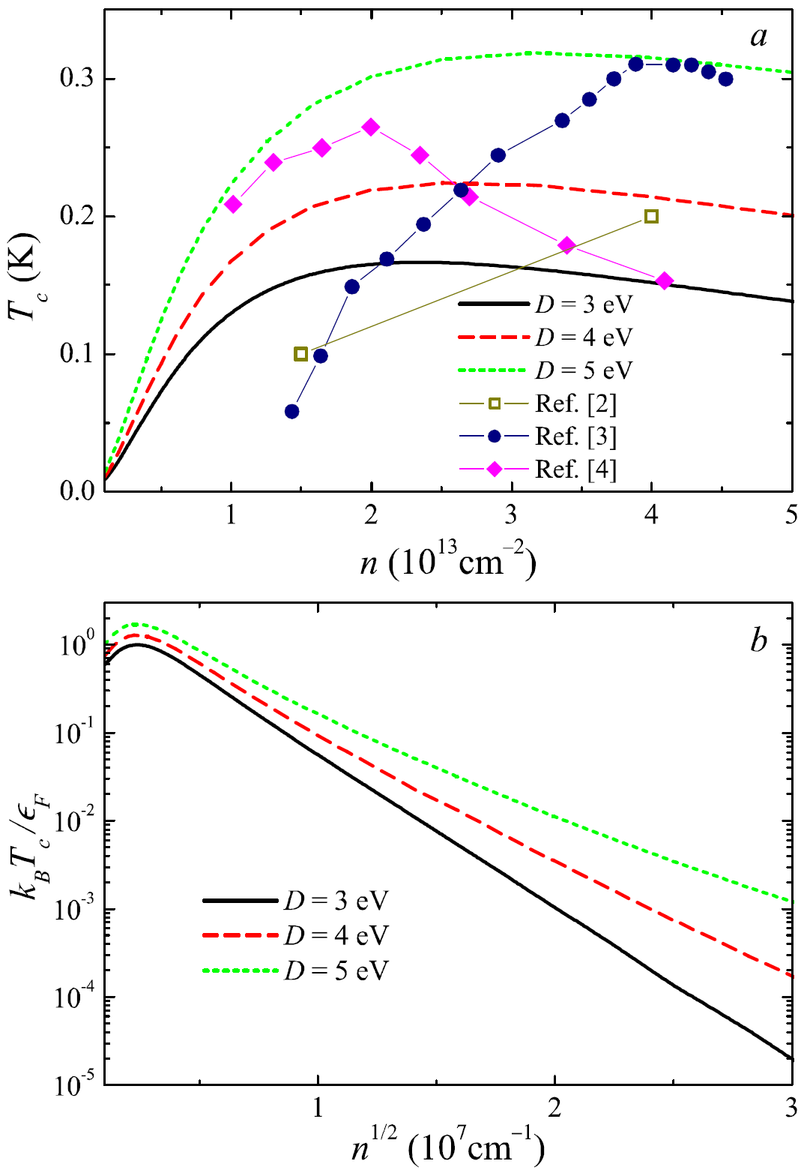
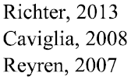
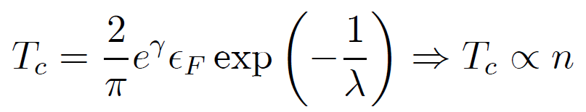
Critical temperatures: theory and experiment
The calculation, performed without fit and using parameter values known from literature, yields the critical temperatures within the same range as in the experiments.
At low densities, the critical temperature depends on the carrier density almost linearly. In this regime it is well described by a BCS-like expression with the Fermi energy instead of the Debye energy:
with λ independent on the density at low densities. This is a direct consequence of the anti-adiabatic regime at low densities.
S. N. Klimin, J. Tempere, J. T. Devreese, and D. van der Marel, Phys. Rev. B 89, 184514 (2014)
N. Reyren et al., Science 317, 1196 (2007).
A. Caviglia et al., Nature 456, 624 (2008).
C. Richter et al., Nature 502, 528 (2013).

Slide 18
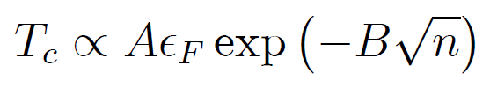
Critical temperatures: theory and experiment
The calculation, performed without fit and using parameter values known from literature, yields the critical temperatures within the same range as in the experiments.
At high densities, the density dependence of the critical temperature
shows the domination of the plasmon mechanism of superconductivity.
S. N. Klimin, J. Tempere, J. T. Devreese, and D. van der Marel, Phys. Rev. B 89, 184514 (2014)
N. Reyren et al., Science 317, 1196 (2007).
A. Caviglia et al., Nature 456, 624 (2008).
C. Richter et al., Nature 502, 528 (2013).

Slide 19
Conclusions
We have re-formulated the dielectric function method for a multilayer structure with several polar layers.
The developed technique is capable to describe superconductivity in multilayer structures with polar layers.
All phonon branches existing in the multilayer structure are taken into account.
The calculated critical temperatures lie within the same range as in the experiments without fitting.
The obtained critical temperatures support the hypothesis that the mechanism of superconductivity in the LaAlO₃-SrTiO₃ structures is provided by the electron - optical-phonon interaction.

