Slide 1
Light scattering on a metallic sphere
Nick Van den Broeck

Slide 2
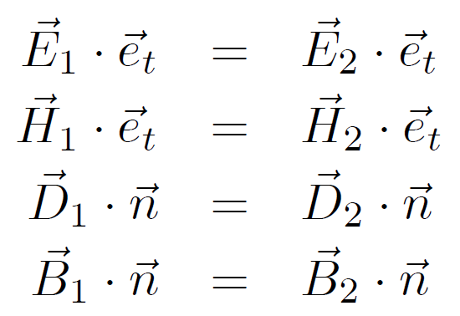
Mie-theory
Material = charges and currents: dielectric function
Maxwell equations
Vector spherical harmonics
Geometry: Boundary conditions
Solvable equations for D & H
E & B fields
Derived quantities

Slide 3
Mie-theory
Problems:
Dielectric function is assumed to be homogeneous (only dependent on distances)
Ok for large structures, but not when surfaces become important
No distinction between longitudinal and transversal waves

Slide 4
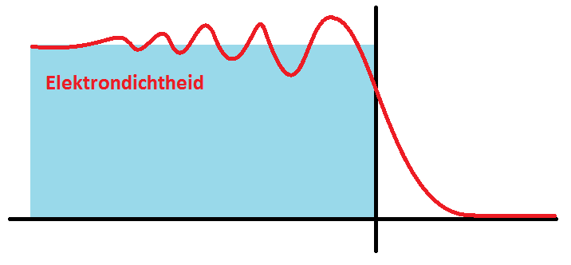
Our treatment
What we want:
Inhomogeneity
no dielectric function
no D & H fields
possibility to implement “quantum effects”
Longitudinal and transversal waves
Helmholtz decomposition

Slide 5
Our treatment
Maxwell equations
Vector spherical harmonics
Material = charges and currents: Drude theory
Helmholtz decomposition
E & B fields
Solvable equations for φ & A
Geometry: restrict electron movement
Derived quantities

Slide 6
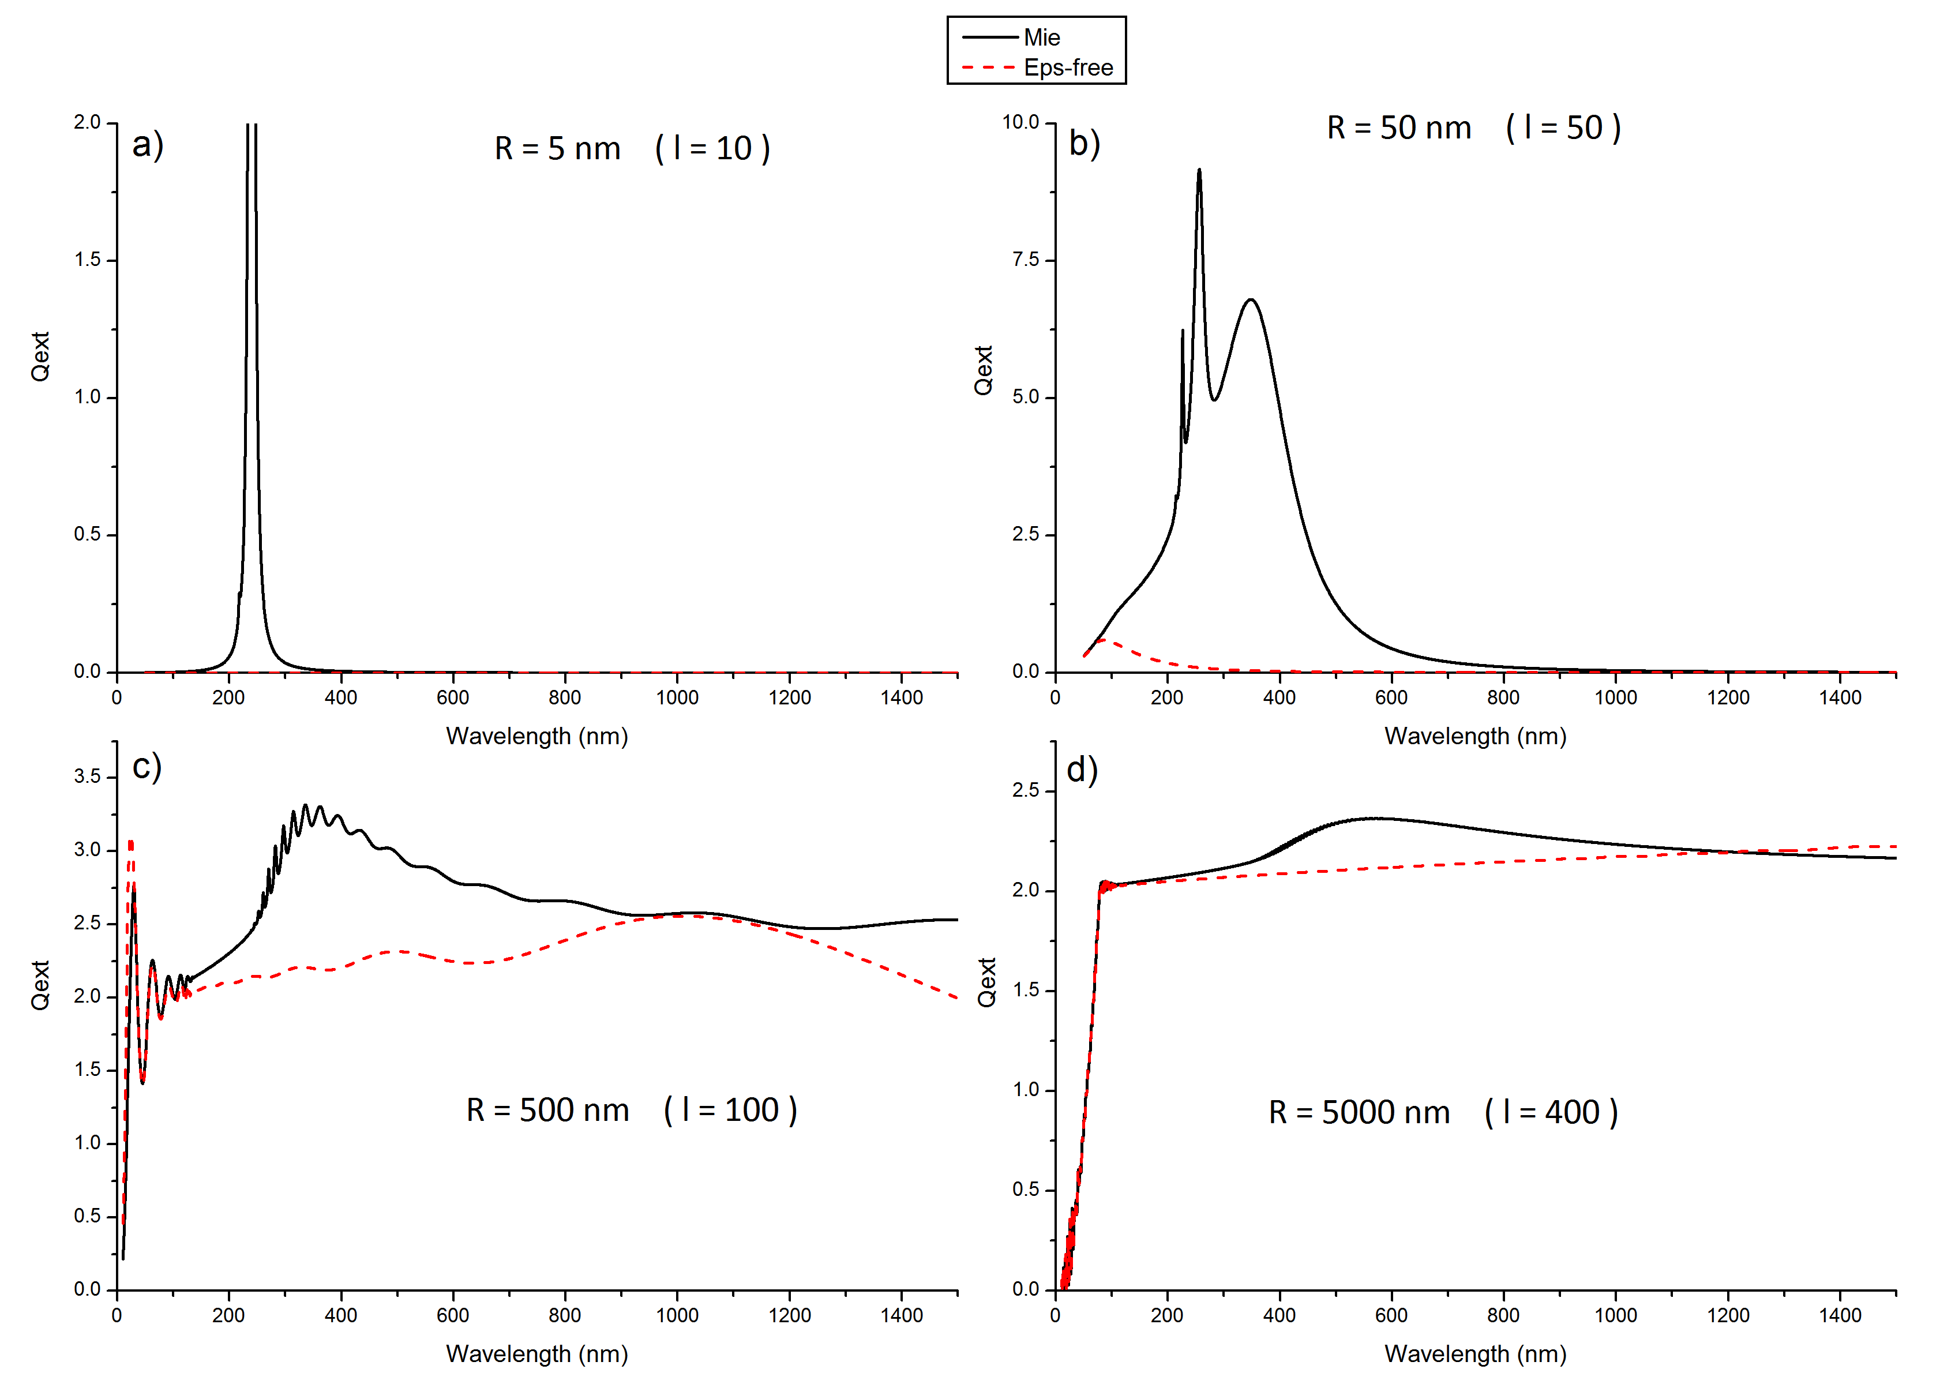
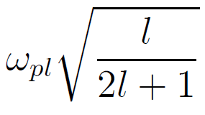
Results
Extinction spectra for different spheres
Plasma oscillations for a sphere
Mie-theory
Our treatment
R
Au
Vacuum

Slide 7
Summary
Analytical, alternative treatment of the Maxwell equations
Avoiding some problems of Mie-theory
Inhomogeneity
Longitudinal and transversal waves
Differences for even a Drude metal
Soon to be published

Slide 8
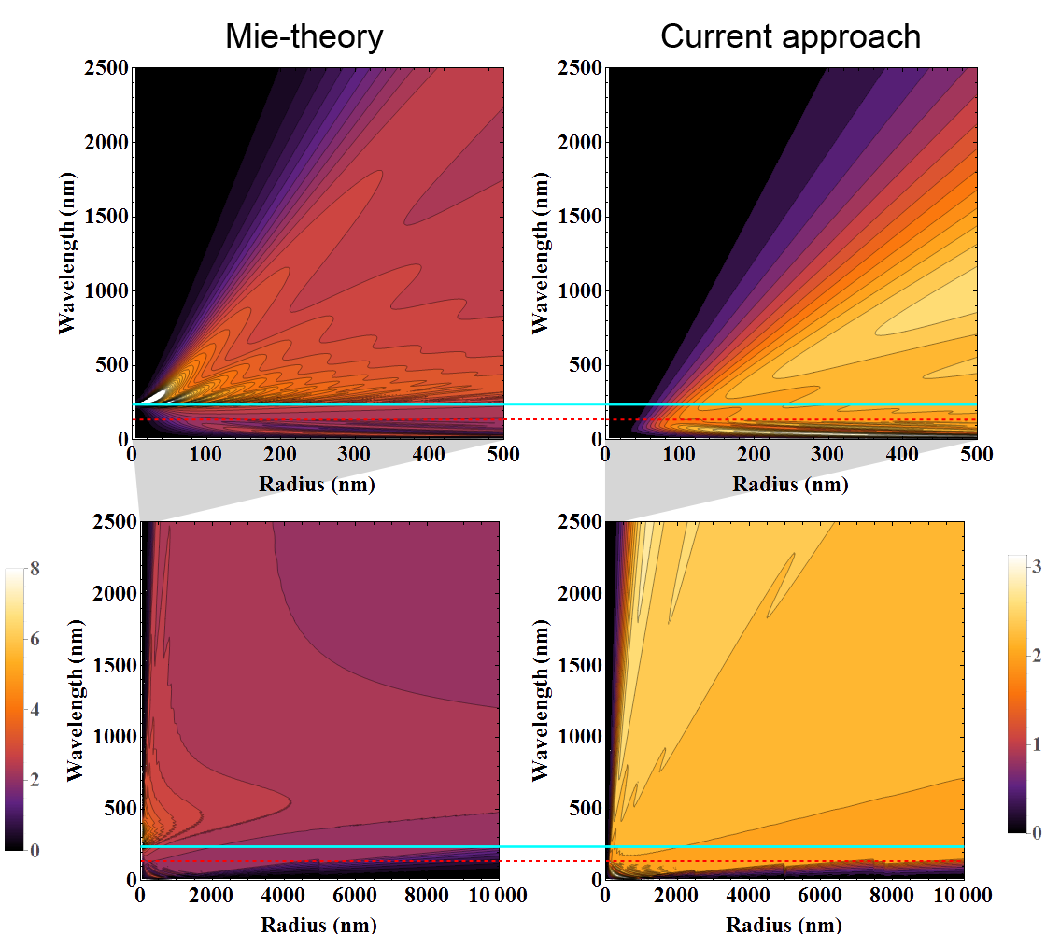
Results
Extinction spectra for different radii
Longitudinal oscillations

