Slide 1
RADFORMIN
RAndomised phase II trial of Definitive radiotherapy with or without metFORMin in patients with Inoperable stage III Non-small cell lung cancer
Mick van de Wiel
PhD-fellow Thoraxoncologie

Slide 2
STUDIE ORGANISATIE
Mick van de Wiel – PhD fellow Thoracic Oncology
Jan van Meerbeeck – Promotor
Christel De Pooter – Co-Promotor
Tim Van Den Wyngaert – Co-Promotor
Annemie Hufkens – Studieondersteuning
Rita Claes – Studieondersteuning
Contact for any questions: radformin@uza.be

Slide 3
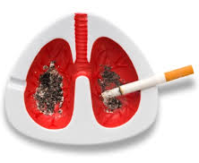
LONGKANKER
Wereldwijd > 1.8 miljoen - België: > 8000 per jaar¹
Mortaliteit 90%
80% = Non Small Cell Lung Cancer
30% NSCLC bij presentatie stadium III
Standard Of Care = Concomitante CRT
59% komt hiervoor niet in aanmerking²
Alternatief = sequentiële CRT
2-3 cycli chemotherapie (platinum-gebaseerd)
60-66 Gy (2,75 Gy/f)
PFS na 1j = 38%³
Risico op locoregionaal herval na 1j = 24%
European Society for Medical Oncology
De Ruysscher et al., Ann Oncol., 2009; 20(1):98-102-20
Aupérin et al.; JCO 2010

Slide 4
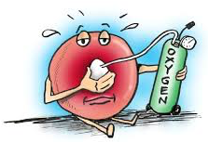
ZUURSTOF EN RADIOTHERAPIE
O₂ = nodig voor toebrengen van optimale DNA-schade
Tumorcel-hypoxie = slechte prognostische factor
Chemoresistentie
Radioresistentie (2,5 – 3x de waarde van geoxygeneerde cel)
Toegenomen gen-instabiliteit
Tendens tot invasie en metastasering
“Huidige” manier van aanpak:
Vernietigen hypoxische cellen
O₂-aanvoer verhogen
Hoe kan het anders? In theorie:
Daling van O2-verbruik door tumor → daling van tumorcel-hypoxie
Toename sensitiviteit voor radiotherapie

Slide 5
WAAROM METFORMINE? (1)
Metformine = oraal antidiabeticum type biguanide
1e keuze voor orale behandeling van DM II
WHO List of Essential Medicines (meest effectieve en veilige medicijnen in het gezondheidssysteem)
Werking bij DM II:
⬇ gluconeogenese in de lever
⬆ insuline-gevoeligheid in perifere weefsels
glucose-verbruik in spieren en vetcellen
Neveneffecten:
Meest voorkomend: gastro-intestinaal
Meest gevaarlijk: lactaatacidose (MALA)
Galega officinalis

Slide 6
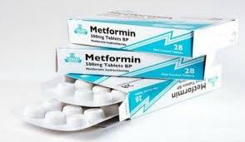
WAAROM METFORMINE? (2)
Observationeel
⬇ longkankerincidentie bij diabetici onder therapie met metformine (Tian et al. 2016)
Retrospectief
Betere outcomes bij diabetici onder therapie met metformine (Wink et al. 2016, Chen et al. 2015, Tan et al. 2011)
Notes:
⬆ tumor-respons met radiotherapie en systemische therapie in diermodellen (Koritzinsky et al. 2015)

Slide 7
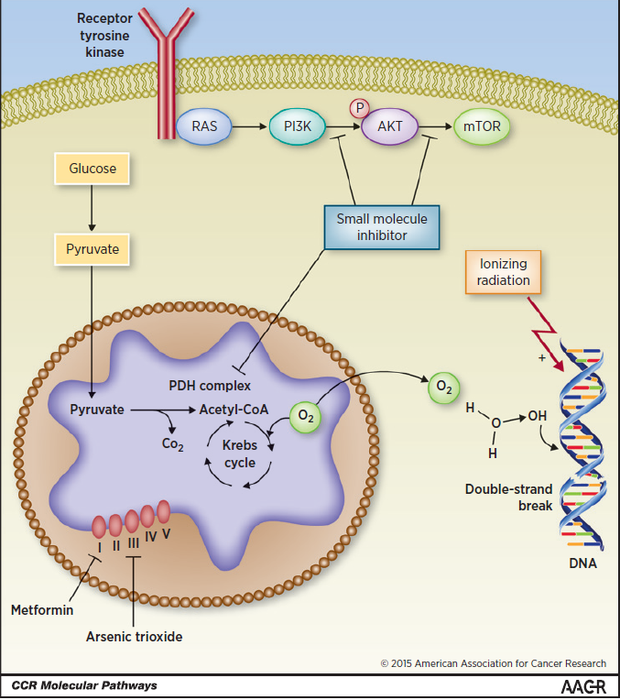
MECHANISME(N) VAN METFORMINE
Indirect effect
⬇ insuline (groei-promoverend-hormoon)
Direct effect
Regulatie AMPK/mTOR pathway:
proteïnesynthese en celproliferatie
activatie AMPK → mTOR inhibitie → inhibitie celgroei
IGF-pathway
Complex I
ATP → AMPK
⬇ O₂consumptie en dus ⬇ tumorhypoxie
Notes:
LKB1: gerelateerd met tumorsuppressie → mutatie Peutz-Jeghers
Inhibitie van de mitochondriale respiratoire keten (Complex 1)
Inhibitie van glucagon-geïnduceerde elevatie van cAMP met gereduceerde activatie van proteïne kinase A
Inhibitie van mitochondriaal glycerophosphate dehydrogenase
Onderdrukken IGF-pathway

Slide 8
METFORMINE: ZEKERHEDEN
⬇ tumorhypoxie
⬆ intrinsieke radiosensitiviteit
echter: context-afhankelijk
⬇ populatie van kankerstamcellen (CSCs)
⬇ kankercel-proliferatie
Koritzinsky et al. 2015

Slide 9
METFORMINE: ONZEKERHEDEN
Mechanisme van potentiele radiosensitisatie?
Rol hypoxie?
Dosering?
Context: mutaties LKB1 en p53?
Borderline of gemiste diagnose diabetes?
Andere spelers: immuunsysteem, micro-omgeving, tumor angiogenese, DNA herstel, ...

Slide 10
RESEARCH HYPOTHESE
Doet metformine de hypoxische tumorfractie dalen in stadium III NSCLC om zo…:
een toename in RT-geïnduceerde apoptose te creëren in longtumorcellen?
locoregionale controle in deze patiënten te verbeteren?

Slide 11
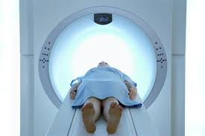
TRANSLATIONEEL ONDERZOEK
Op zoek naar biomerkers die patiënten kunnen identificeren welke een duidelijk voordeel zouden kunnen hebben aan hypoxie-gerichte therapie.
PET-scan = niet-invasieve manier om tumorhypoxie te evalueren.
Nitroimidazole-gebaseerde tracers
Gouden standaard = [¹⁸F]FMISO, [¹⁸F]HX₄
Op heden nog niet gebruikt om al dan niet gerichte behandeling te geven
Notes:
Positron Emissie Tomografie
FMISO = fluoromisonidazole

Slide 12
STUDY OVERVIEW
Study objectives & Endpoints
Eligibility Criteria
Study Design
Treatment
Withdrawal criteria
Toxicities and schedule modifications
Concomitant Medications
Clinical evaluation, laboratory tests and follow-up

Slide 13
1. STUDY OBJECTIVES & ENDPOINTS

Slide 14
1.1 OBJECTIVES
Primary Objective:
Study the effect of metformin when added to definitive locoregional radiotherapy on locoregional control and relapse rate in stage III non-small cell lung cancer patients receiving sequential chemoradiotherapy
Secondary Objectives:
Identify subsets of patients who derive maximum benefit of adding metformin to radiotherapy using innovative biomarkers

Slide 15
1.2 ENDPOINTS
Primary Endpoint:
Proportion of patients free of locoregional progression after 1 year
Secondary Endpoints:
Overall survival (OS), time to progression (TTP) and progression free survival (PFS).
Dynamics of F-HX4 uptake with metformin and chemotherapy
Impact of F-HX4 dynamics on recurrence rate
Predictive value of serum biomarkers
Dose dependency of metformin

Slide 16
2. ELIGIBILITY CRITERIA

Slide 17
2.1 INCLUSION (A)
Provision of signed and dated informed consent form.
Stated willingness to comply with all study procedures and availability for the duration of the study.
Ability to take oral medication and willing to adhere to the RADFORMIN-regimen.
Male or female, ≥ 18 years of age.
Histological or cytological proven stage III NSCLC after adequate staging with at least FDG-PET-CT scan, contrast enhanced CT-thorax and contrast-enhanced CT/MRI brain.
Absence of diabetes, (diabetes is defined as fasting plasma glucose >126 mg/dL or random plasma glucose >200 mg/dL).
Eastern Cooperative Oncology Group (ECOG) performance score (=WHO score) of 0-1.

Slide 18
2.1 INCLUSION (B)
Adequate hematologic, hepatic and renal function as follows:
Bone Marrow: Absolute neutrophil count ANC ≥ 1,500/mm³ (1.5 x 10⁹/L); White blood cells ≥ 3,000/mm³ (3 x 10⁹/L); Platelets ≥ 100,000/mm³ (100 x 10⁹/L); Haemoglobin ≥ 9 g/dL (5.58 mmol/L).
Renal function: creatinine clearance of ≥50 mL/min.
Hepatic function:
AST and ALT ≤ 2.5 x ULN
Bilirubin: ≤1.5 x ULN; for subjects with Gilbert’s syndrome bilirubin > 1.5 x ULN is allowed if no symptoms of compromised liver function are present
Adequate pulmonary function in order to be administered definitive radiotherapy. With Forced Expiratory Volume (FEV) > 1.2 litres per second or more than 50% of predicted, and DLCO > 40% predicted. (Values without administration of medical bronchodilation. In case of Tiffeneau < 70% bronchodilation will be administered)
Having received at least 2 cycles of platinum-based chemotherapy. This according to institutional standards and without progression (on a restaging CT-scan within 3 weeks after day 1 of the last given cycle).

Slide 19
2.2 EXCLUSION
Current use of metformin, sulfonylureas, thiazolidinediones or insulin for any reason.
Evidence for metastatic disease.
Conditions associated with increased risk of metformin-associated lactic acidosis: New York Heart Association class III or IV congestive heart failure, history of acidosis of any type, known kidney injury or disease, alcoholic liver disease or habitual intake of 3 or more alcoholic beverages per day.
Known pregnancy or lactating female patients.
Known allergic reactions to components of metformin.
Prior invasive malignancy within the past year (in remission, without evidence for current active disease and without maintenance therapy). Except non-melanomatous skin cancer, non-invasive carcinoma in-situ of the breast, oral cavity or cervix.
Known acquired immune deficiency syndrome.

Slide 20
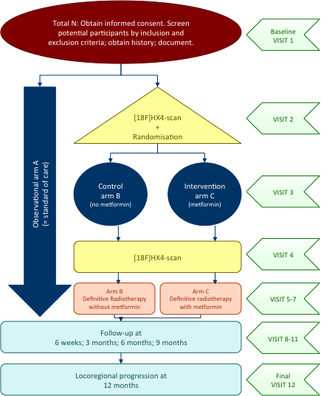
3. STUDY DESIGN

Slide 21
4. TREATMENT
Start: Day -14 before radiotherapy
Day -14 to -7: Metformin 500 mg 1x/day – 8:00 am
Day -7 to end radiotherapy: Metformin 500 mg 2x/day – 8:00 am and 8:00 pm
The purpose of metformin starting dose is to reduce possible side effects of metformin
Tablets are ideally administered together with a meal

Slide 22
5. WITHDRAWAL CRITERIA
Whatever the disease status, the treatment will always be discontinued in case of:
Patient withdrawal
Pregnancy
Significant study intervention non-compliance
If any clinical adverse event (AE), laboratory abnormality or other medical condition or situation occurs such that continued participation in the study would not be in the best interest of the participant
Disease progression which requires discontinuation of the study intervention
If the participant meets an exclusion criterion (decision depends on the P.I.)

Slide 23
6. TOXICITIES AND SCHEDULE MODIFICATIONS

Slide 24
6. TOXICITIES AND SCHEDULE MODIFICATIONS
Gastro-Intestinal Toxicity
Grade 1 - 2 | Manage symptoms
Grade 3-4 | Discontinue metformin until grade 2 toxicity; afterwards a dose reduction has to be applied
Esophagitis and dysfagia
In case of (by radiotherapy induced) esophagitis or dysphagia, standard of care measuremenst will be taken. Metformin tablets can be crushed to maintain oral intake. Symptoms will be treated with oral supplements (gel or medication) comparable with local standerd operating procedures
Any other symptom (cfr CTCAE version 4.0)
Grade 1 - 2 | Manage symptoms
Grade 3-4 | Discontinue metformin until grade 2 toxicity; afterwards a dose reduction has to be applied

Slide 25
6. TOXICITIES AND SCHEDULE MODIFICATIONS
Dose Level | Dose
0 | 500 mg b.i.d.
-1 | 500 mg q.d.
-2 | Stop protocol treatment
If the dose of metformin had to be reduced due to adverse events it will stay on the lower dose level for the entire time of administration, reescalation is not allowed

Slide 26
7. CONCOMITANT MEDICATION

Slide 27
7. CONCOMITANT MEDICATION
Non-acceptable concomitant therapy within 4 weeks prior to the first dose of study treatment until completion of study is defined as follows:
Insulin
Other oral antidiabetic drugs (thiazolidinediones, sulfonylureas, metiglinides, alpha-glucosidase inhibitors, incretin mimetics, dipaptidyl peptidase-4 inhibitors, amylin analogues, SGLT-2-inhibitors)
Caution should be in place in case of concomitant use of nonsteroidal anti-inflammatory drugs (NSAIDs) because of a possible toxic effect on the kidneys.

Slide 28
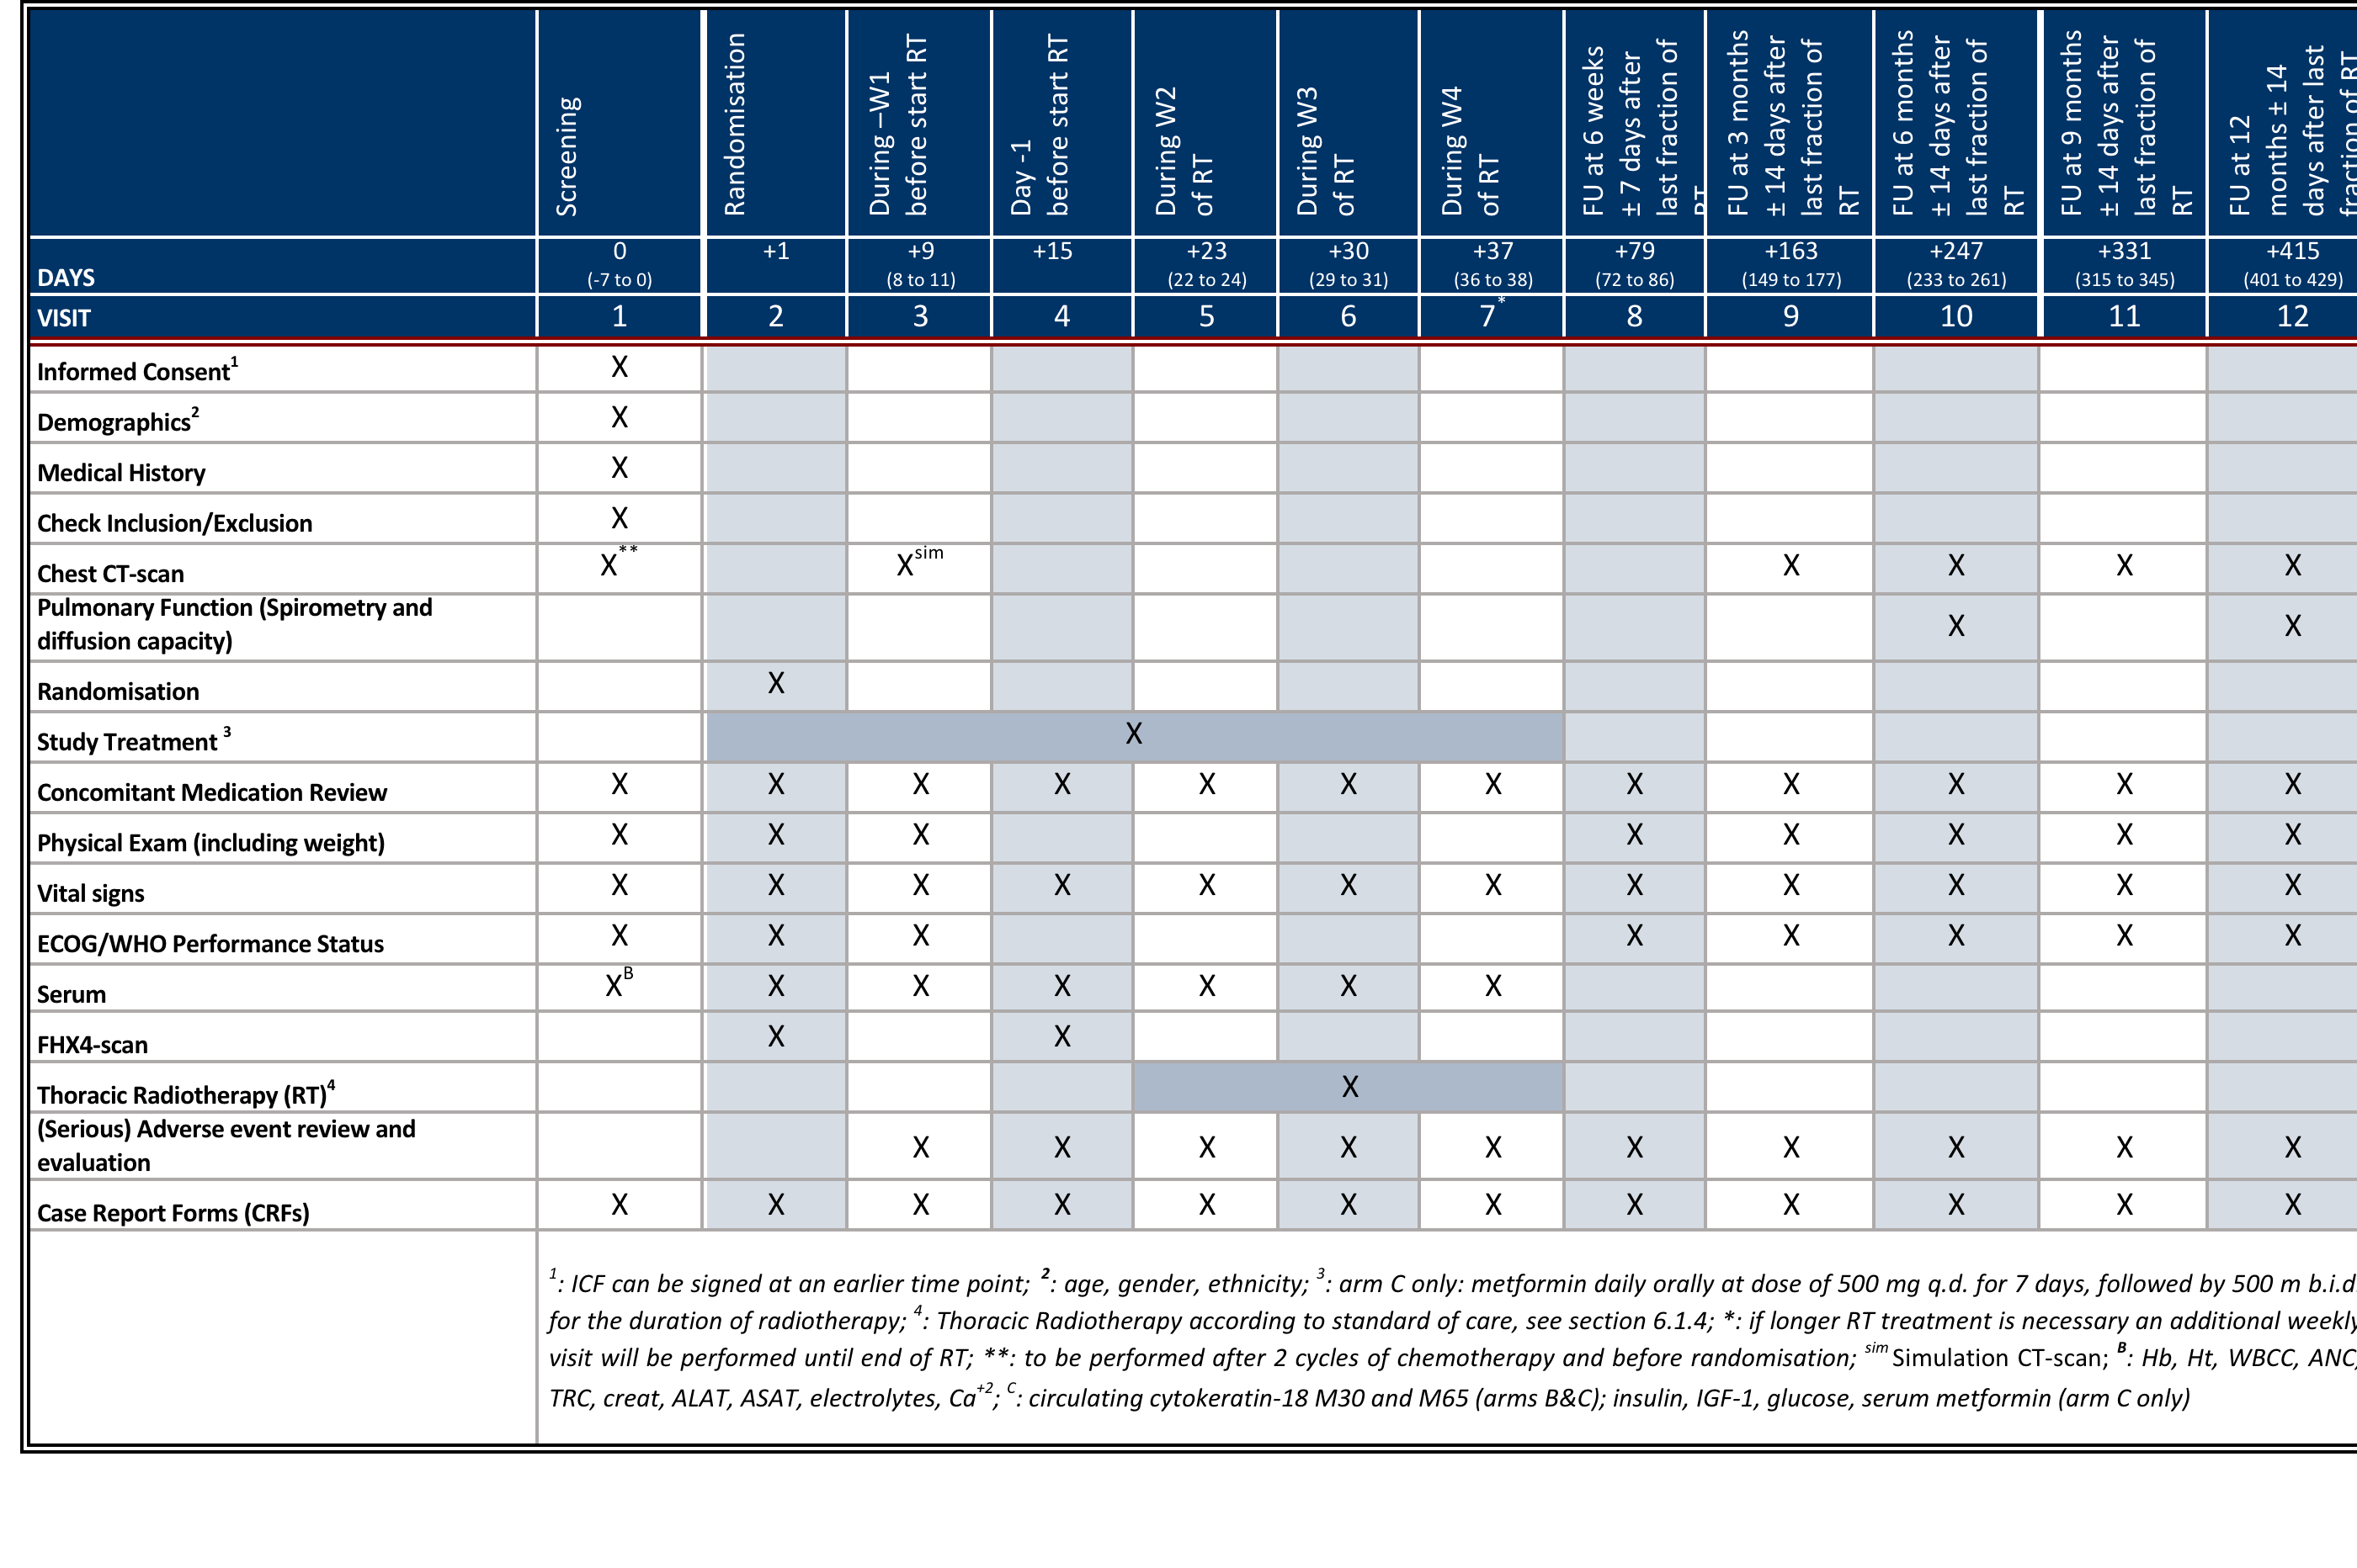
8. SCHEDULE OF ACTIVITIES

Slide 29
WAT BETEKENT DIT IN DE PRAKTIJK?
Gerandomiseerde fase II studie, multicentrisch
NSCLC Stadium III: Sequentiële CRT ± metformine
Patiënt:
Geen extra kosten
Potentieel benefit met minimale neveneffecten
2x bezoek aan het UZA voor hypoxie scan
Arts:
Geen extra werk
Geen extra kosten
Verwijzend longarts blijft behandelend arts. Patiënt verdwijnt dus NIET uit uw circuit
Notes:
Wat houdt dit nu in voor u? Wat verwachten we van u?

Slide 30
Enrolling soon!
FAGG approval (15 MAY 2018)
EC approval (12 JUN 2018)

