Slide 1
The next Asia? Globalization, dependence and African development
Discussion
Alice Nicole Sindzingre
National Centre for Scientific Research (CNRS); EconomiX-University Paris-Nanterre; Visiting Lecturer, School of Oriental and African Studies (SOAS), University of London, department of economics
Debating Development
University of Antwerp, USOS-Institute of Development Policy (IOB)
28th November 2017
For two decades, African economies have been growing by an average of 5 to 6%: Africa as the next Asia? Yet, IMF forecasts that growth in SSA is expected to reach barely 1.5% in 2016. This debate investigates the sources of African growth and stagnation. How did the continent fare in the global era? What is the impact of China’s shift from export-oriented growth to domestic consumption? How did SSA use its natural resources to position itself in the world-economy?

Slide 2
Prof. Taylor:
‘Africa rising’, ‘next Asia’, is a rhetoric
What actually are SSA economic outcomes? Poor performances…
What it really means? Other measures considering sustainability show a decline…
This analysis is the most relevant and crucial indeed.
The question examined here: why?
Among several possible explanations:
Cumulative causation processes, vicious circles, are fostered by commodity - and aid - dependence
Here emerging countries – e.g., China – tend to maintain existing patterns
Dependence fosters the ‘externalisation’ of policies : limited control of governments on their own public policies (driven by international markets or International Financial Institutions/IFIs)

Slide 3
The detrimental effects of cumulative causation
The variety of growth paths can be explained by the concepts of cumulative causation, increasing returns, path dependence, ‘lock-in’, irreversibility. Divergence may stem from self-reinforcing processes; thresholds and tipping points; multiple equilibria (attractors).
A ‘poverty trap’ is a key case: it is a ‘self-perpetuating condition whereby an economy, caught in a vicious circle, suffers from persistent underdevelopment’ (Matsuyama, 2009): due to limited industries, human capital, market size, financial development; low wealth-low investment; demographic traps…
Arthur (1989), David (1985): growth paths differ because of, e.g., locking-in by technological choices, mental models leading to different incomes and perpetuating poverty (Durlauf and Young, 2001)..: large effects may be caused by ‘small events’.
Cumulative causation allows for the combination of heterogeneous causes (economic, political, social, cognitive) that build virtuous or vicious circles.
SSA illustrates the coalescence of specific economic structures (commodity-based), policies and institutions (limited state credibility, high inequality).

Slide 4
A divergence?
Abramowitz (1986) ‘catch-up’: income levels should converge across countries.
This theory has been challenged by empirical evidence: over the long-run, divergence between Europe, Asia and Africa.
Many factors: institutions fostering efficiency in the use of technology and innovation (Clark, 2007), higher total factor productivity (Clark and Feenstra, 2001).
The divergence across regions: GDP per capita, 1820-2010
Source: Angus Maddison database: http://www.ggdc.net/maddison. 1990 Geary-Khamis dollars. Western Offshoots: USA, Australia, Canada, New Zealand.

Slide 5
SSA income performance differs from other regions, driven by low-income countries (27 of the 48 SSA economies) (GNI<1005 US$ in 2016)
Most low-income countries are in SSA and that 27 of the 48 SSA economies are low-income countries (GNI below 1005 US$ in 2016).
GDP per capita, SSA, the world, other regions, 1960–2016 (constant 2010 US$)
Source: World Bank, World Development Indicators database, July 2017

Slide 6
Excluding oil-economies, where growth is driven by oil prices, there seems to be many successes, including economies not based on primary commodities, coined SSA ‘developmental states’, e.g., Rwanda, Ethiopia (Booth and Golooba-Mutebi, 2012; Clapham, 2017).
Ethiopia and Rwanda, GDP per capita (constant 2010 US$), 1960-2016
Source: World Bank World Development Indicators database, July 2017.

Slide 7
Yet these successes are limited: ‘empirical evidence’ is a relative notion: the inclusion of other (richer) countries flattens individual growth paths (and aid has contributed to performances: e.g., it financed 80% of Rwanda’s government expenses in 2015). Ghana, Kenya, Tanzania, other ‘successes’, remain low/lower-middle-income economies.
Also, even if for some SSA countries incomes have more than doubled over 3 decades, levels remain very low.
Moreover, most SSA countries diverge vis-à-vis Botswana, Namibia, South Africa.
SSA, selected countries, GDP per capita (constant 2010 US$)
Source: World Bank World Development Indicators database, July 2017

Slide 8
Divergence of SSA is compatible with a slow increase of its constant GDP per capita.
SSA remains characterised by long periods of negative growth, especially the 1980s and 1990s (‘lost decades in spite of policy reform’, Easterly, 2001), until today.
SSA, GDP per capita (constant 2010 US $) (left axis), GDP growth and GDP per capita growth rates (right axis), 1960-2016
Source: World Bank World Development Indicators database, July 2017.

Slide 9
Commodity dependence as a key factor of divergence?
For SSA, key factors of divergence have been its dependence on primary commodities for its exports, and a low level of manufactures exports.
‘Hard’ commodities (fuels + ores and metals) represent since the 2000s more than half of SSA exports (about 63%) (to be added to the ‘soft’, agricultural, ones) – and manufactures less than 24%.
SSA: exports by category as % of total merchandise exports, 1996-2014
Source: World Bank, World Development Indicators database, November 2017

Slide 10
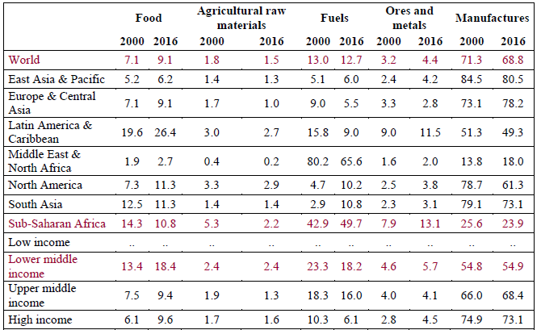
It could be argued that commodity-dependent export structures are not unusual. Yet a comparison shows the amplitude of the distortion in SSA, the region being the most dependent on primary commodities, with the share of manufactures in exports even declining.
But indeed, commodity dependence combines with other factors resulting in cumulative causation - institutions, political economy (‘for every Nigeria or Venezuela, there is a Norway or a Botswana’, Torvik, 2009).
Structure of merchandise exports, world, percentage of total exports
Source: World Bank World Development Indicators , table 4.4, September 2016 and September 2017. http://wdi.worldbank.org/table/4.4#

Slide 11
Commodities are characterised by price volatility: SSA growth is driven by external processes (commodity prices) and moreover is volatile. This volatility induces repeated shocks on terms of trade (Blattman et al., 2007), and fosters Dutch disease (exchange rate appreciation). It negatively impacts growth and structural change (Rodrik, 2011), induces deindustrialisation and explains SSA divergence.
Also, growth rates driven by commodity prices are an incentive for governments to keep this structure when prices are high: hence self-reinforcing processes locking producers in their past export structure.
SSA economies’ growth rate (right scale) and commodity prices (real 2010 US$, left scale), 1960-2016
Source: World Bank Commodity Price Data, http://www.worldbank.org/en/research/commodity-markets; World Bank World Development Indicators, July 2017.

Slide 12
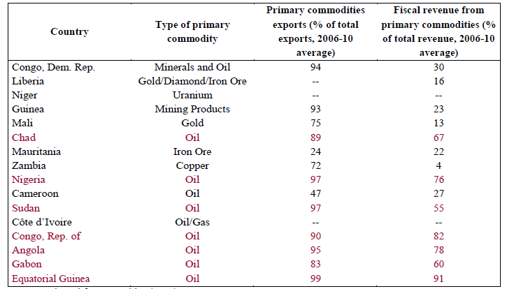
Price volatility generates volatile revenues, hence structural fiscal deficits (and debt), hence volatile public investment and redistributive capacity (weakening political legitimacy): this cumulative causation (‘trap’) fosters SSA divergence.
Indeed, since colonial times, a great part of SSA fiscal revenues rely on international trade (Frankema, 2014) (‘easy-to-collect’ taxation, Aizenman and Jinjarak, 2009; Sindzingre, 2007), particularly in oil economies. Also, in low-income countries the tax ratio is very low (‘Wagner law’). Yet, for the IMF, below 12.75% of GDP, tax ratios cannot contribute to growth (Gaspar et al., 2016).
SSA low- and lower-middle-income economies: dependence of fiscal revenues on the export of commodities, 2006-2010 average
Source: adapted from Venables (2016).

Slide 13
A consequence of fiscal vulnerability stemming from SSA dependence on international markets’ volatility is dependence on external aid and multilateral institutions’ lending for financing needs, rather than domestic resources (savings, revenues). Yet this external financing is conditional (‘exchange of finance for policy reform’).
Net ODA represented 3.0% of its GNI in 2015, 14.1% of gross capital formation and 9.0% of its imports of goods, services and primary income - with disparities. Aid may have detrimental effects, being also volatile and inducing Dutch disease.
Net Official Development Assistance (ODA) received in percentage of Gross National Income (GNI), 1960-2015
Source: World Bank World Development Indicators, July 2017

Slide 14
At the global level, the share of SSA in world exports steadily declines, due to the low value-added of the exports of SSA economies (primary commodities)
Share of exports in world exports, selected regions, 1948-2016 (percent)
Source: UNCTAD Statistics: http://unctadstat.unctad.org, July 2017

Slide 15
The share of SSA in world exports has diminished, while the value of its exports has increased: but less so than the value of other countries’ exports:
I.e. a detrimental effect of a distorted export structure based on commodities that have a low value-added and limited industrialisation.
Note the negative effect of the fall in commodity prices after 2011: another example of the detrimental impact of commodity dependence….
SSA exports: % of world exports (right axis) and value (left axis), 1948-2016
Source: UNCTAD Statistics: http://unctadstat.unctad.org, July 2017.

Slide 16
Can China be a factor of change regarding such patterns?
China is indeed the first destination of SSA exports.
Sub-Saharan Africa: total exports, all products, bns US$, annual, 1995-2016
Source: UNCTAD Statistics: http://unctadstat.unctad.org/wds/ReportFolders/reportFolders.aspx. November 2017.

Slide 17
Yet the composition of SSA exports to China is similar to SSA general pattern of exports and dependency (Taylor, 2014; 2016): fuels, then ores and metals…
SSA exports to China by key product groups, 1995-2016, billions US$
Source: UNCTAD Statistics. http://unctadstat.unctad.org/wds/ReportFolders/reportFolders.aspx?sCS_ChosenLang=en. November 2017.

Slide 18
China implements two key policies: ii) the shift from export-based to domestic consumption-based growth – and lower growth rates (‘New Normal’), i.e. a rise in technology-driven services and a decline in agriculture and manufactures in investment and consumption (Guo et al., 2017); ii) the Belt-and-Road Initiative (BRI) (2013), centred on transport infrastructure, securing Chinese trade and FDI.
These may not change the current distorted composition of SSA exports: China’s domestic consumption implies needs in energy; the BRI continues China’s focus on infrastructure. The commodities demanded by China may change, inducing winners/losers for individual SSA economies. E.g., China has diversified its quest for oil towards more stable suppliers (Brazil, Australia, Yao et al., 2017).
Yet, there are elements for optimism: China implements large projects in SSA infrastructure (‘resources-for-infrastructure’): infrastructure positively impacts growth and structural change (Sindzingre, 2016).
China invests in SSA industrial and manufacturing sectors – large projects in natural resources, and involving Chinese SMEs. Labour costs have increased in China. FDI and outsourcing express a demand for Chinese technology (Yao et al., 2017), and may have positive spillovers on SSA industrialisation and employment .

