Slide 1


Payments for Ecosystem Services: Gambling on Nature?
Gert Van Hecken
Debating Development: The Global Resource Grab?, December 2017

Slide 2
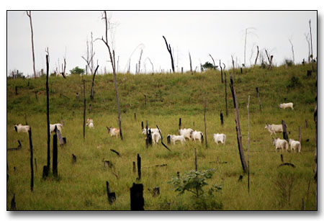
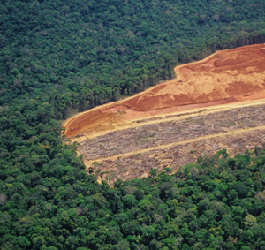
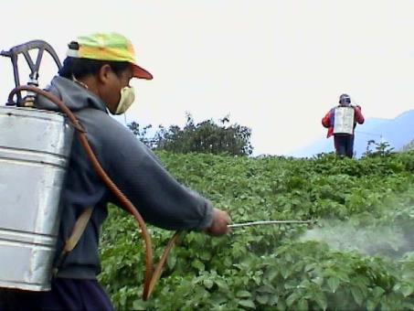
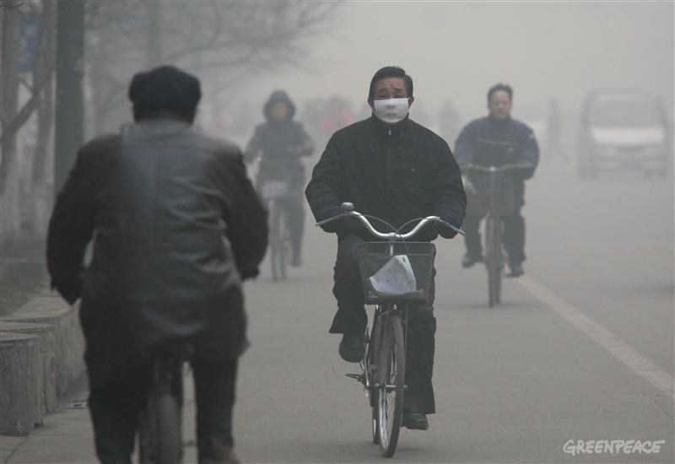


“Anthropocene”

Slide 3
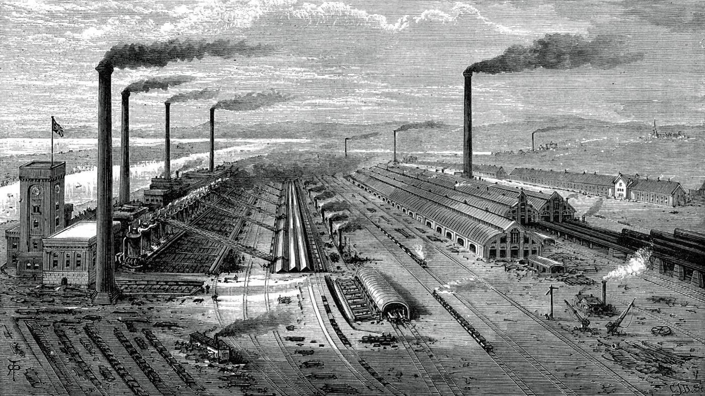

Slide 4


Slide 5
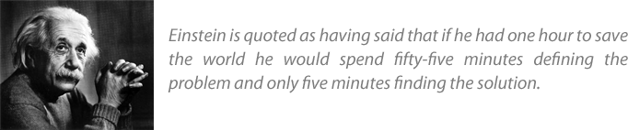
Problems define solutions
Different perspectives on and approaches to policy interventions for ‘sustainable development’
Dominant paradigm today: Ecosystem Services & Market-Based Instruments (MBIs)

Slide 6
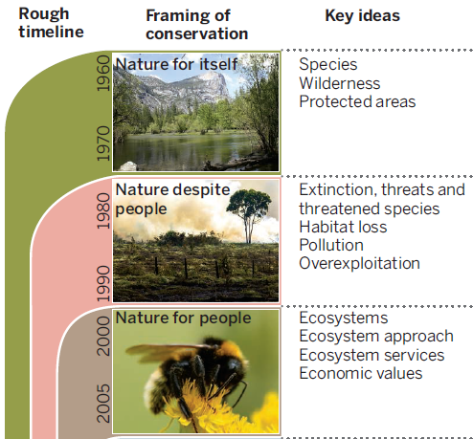
Ecosystem Services
Policy perspectives on environment and development past 50 years:
Environment on global political agenda
Command & Control; top-down
Community-based approaches (Ostrom, 1990)
Economic framework
Ecosystem Services (ES) framework
From: Mace, 2014

Slide 7
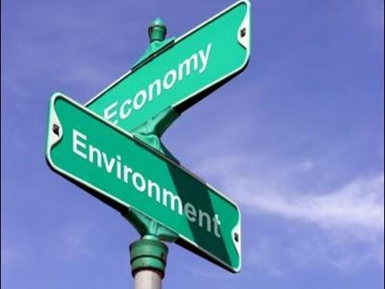
Ecosystem Services
Environmental economists: need to value nature
Ecosystem Services (ES)
  Ecosystems as fixed capital ‘stock’, generating/producing flows of benefits (ecosystem services) to human societies
  = ‘the direct and indirect benefits people obtain from ecosystems’ (Costanza & Daly, 1992)

Slide 8
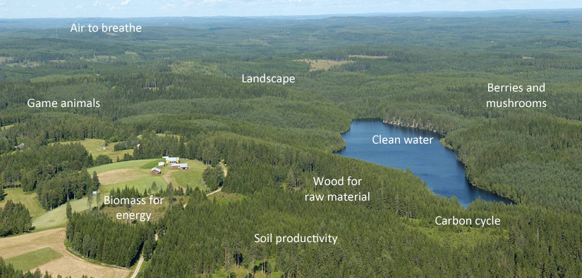
Ecosystem Services
e.g.: forest: not only timber, also regulate water, provide biodiversity, clean air through carbon sequestration, etc.

Slide 9
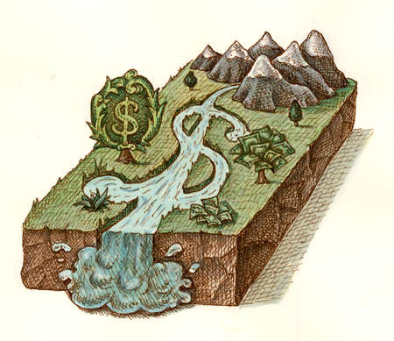
Ecosystem Services
Environmental economists:
Monetary value on ES
Costanza et al., 1997:
Total value of
ecosystem services:
> 33 trillion US$/year
9

Slide 10
Ecosystem Services
Ecosystem Services concept:
Extremely popular (‘eye opener’) ~ Norgaard, 2010
Finally a way to demonstrate and clearly communicate the importance of nature/ecosystem to our society
ES mainstream paradigm for conceptualizing the links between environment and development
Commitment of policy makers, industry and society as a whole (integration of environment, economy, social and political thinking)

Slide 11
Ecosystem Services
BUT:
ES metaphor developed a life of its own
Original goal: awaken society; educational and symbolic function
Now used as the underpinnings of new (market-based) conservation policies, aimed at securing the provision of ES
→ Commodification and trading of Ecosystem Services

Slide 12
Markets and Payments for ES
The emergence of markets for Ecosystem Services:
Discourse: ‘Traditional’ economic instruments (taxes & subsidies), but also state regulation: costly, inefficient & ineffective
(e.g. Wunder, 2005)
’80s-’90s: neoliberal reforms
…markets and well-defined property titles as the most efficient way to guarantee ‘environmental supply’
International markets:
    CDM (Clean Development Mechanism – Kyoto Protocol);
    E.U. emission trading system;
    Voluntary carbon markets

Slide 13
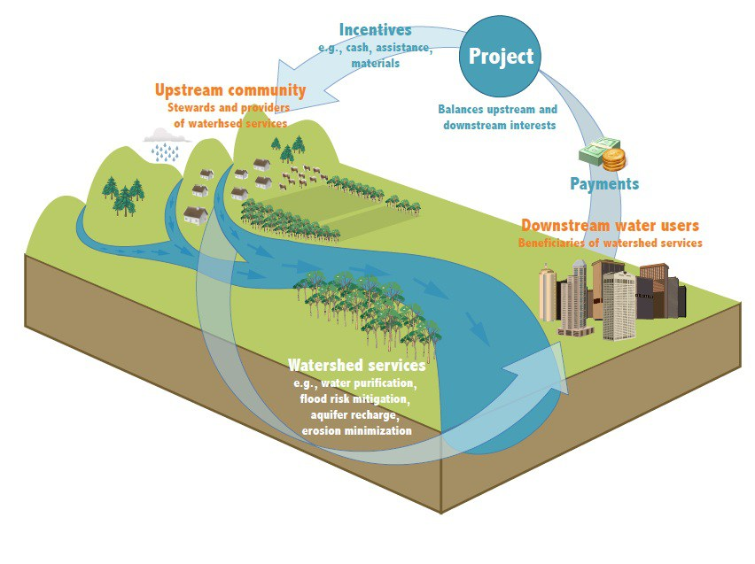
Markets and Payments for ES

Slide 14
Markets and Payments for ES
Definition of PES:
‘a voluntary transaction where a well-defined ES (or a land use likely to secure that service) is being “bought” by an ES buyer from an ES provider if and only if the ES provider secures ES provision (conditionality)’ (Wunder, 2005: 3)
Recognition of difficult environment and development trade-offs: reconcile conflicting interests through conditional / performance-based payments
Numerous initiatives in developing countries to establish national and local payment systems (e.g. Costa Rica, Mexico, China, Vietnam, South-Africa, Brazil, Ecuador, Peru,…)

Slide 15
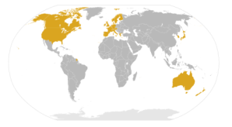






Markets and Payments for ES
Example of PES at the international level: REDD+
(Payments for Reducing Emissions from Deforestation and Forest Degradation in developing countries)
International community and national governments
(ES beneficiaries)
Carbon sequestration
(clean air), biodiversity conservation,…
Payments
Developing countries
(ES providers)

Slide 16

Markets and Payments for ES
PES new panacea in environmental policy and conservation?

Slide 17
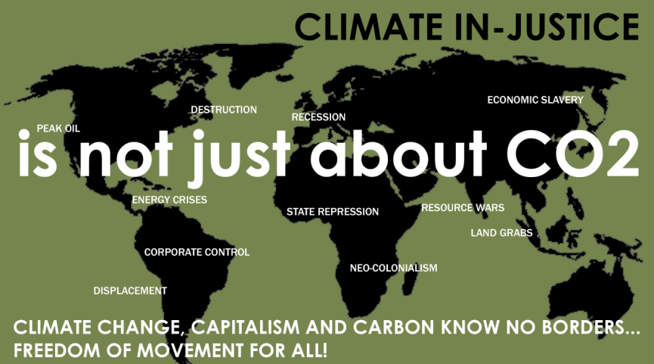
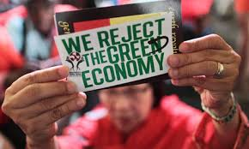

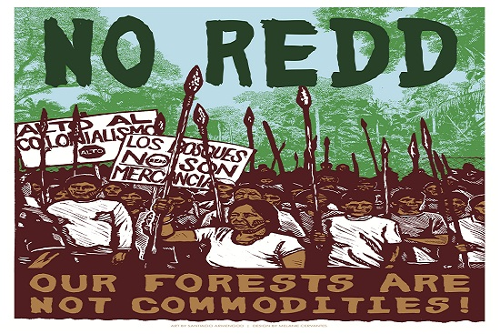
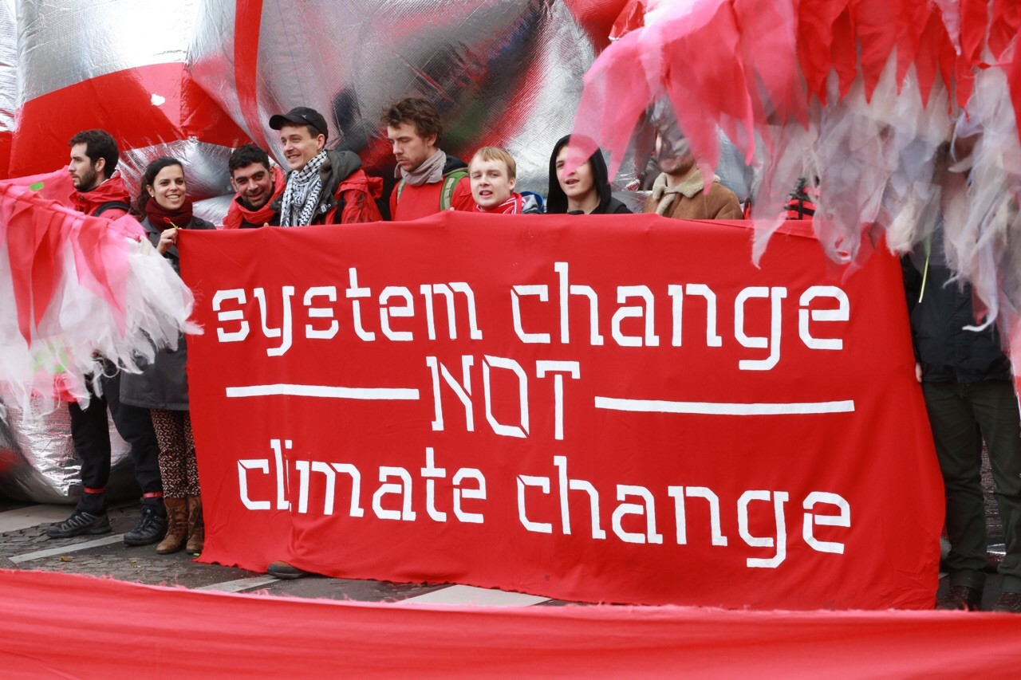

Slide 18
Pitfalls of Markets and Payments for ES
Main assumption green economy:
Ecological crisis = market-failure
(no markets for ES, no price on nature, therefore neglected in economy)
→ abandoning the market model?
  No! Need of more markets!
  In areas where it was previously thought to be impossible to create markets
  = neoliberal market philosophy

Slide 19
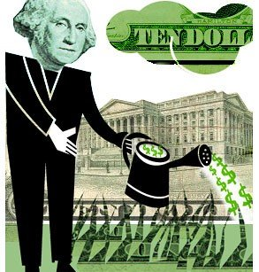



Pitfalls of Markets and Payments for ES
    1) PES and markets for ES: perverse, created illusion
    PES are not so much about saving nature, but about finding new arenas for markets to operate in (e.g. Büscher et al., 2012; McAfee, 1999; Lohmann, 2009)
    Continuous growth, no need for structural changes
    “Justify an economic model that is driving us to catastrophe” (Monbiot, 2017)

Slide 20
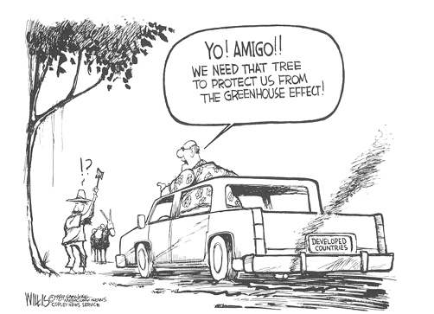
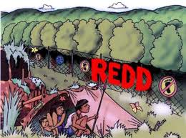
Pitfalls of Markets and Payments for ES
2) Unequal social consequences
    Markets reinforce social inequality (attribution of value by powerful)
    Increased competition for control over ecosystems that produce valuable flows of services; processes of land grabbing / green grabbing (expropriation of indigenous lands) (Hall & Lovera, 2009)
    North-South relations: buy biodiversity ‘from the poor who sell cheap’ (efficiency criterion!); buy development

Slide 21
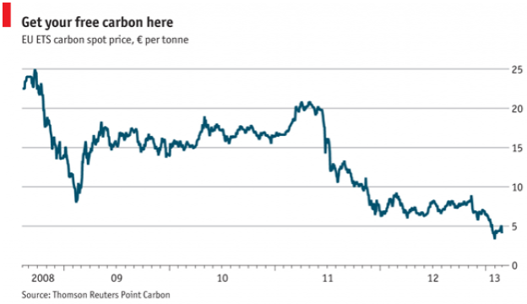
Pitfalls of Markets and Payments for ES
3) Permanence?
    Carbon prices
    What happens if you stop paying?
    → No pay, no care?

Slide 22
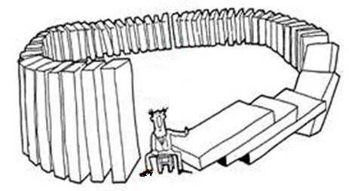
Conclusions?

Slide 23


Thank you for your attention!
Gert.vanhecken@uantwerpen.be

