Slide 1
A new framework for development and international cooperation after 2015

Slide 2
Absolutely necessary / almost impossible?

Slide 3
MDG and the life cycle of a mobilizing concept
A new context
The new framework for development and international cooperation post 2015 : into something (really) new?
Coping with dilemmas

Slide 4
Between love and hate

Slide 5
What about the root causes?
Job (not even) half done
Development as an accounting exercise
Chinese MDG footprint
Very (N) - S

Slide 6
Merits

Slide 7
direct
focus on (and beter geography of) poverty
mobilization of donor community
Public and mediatized monitoring of improvement and failures (= pressure)
Importance of national and international policy work (cfr Brasil)

Slide 8
indirect
Spurred (‘helped’ by crisis context) debate on inequality
Post 2015 strengthened position of UN in international landscape
But: subject to maximum ‘paradigm’ lifecycle (is the best way to survive: to reïncarnate into something new ?)

Slide 9
A new context

Slide 10
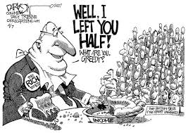
85 = 3.500.000.000

Slide 11
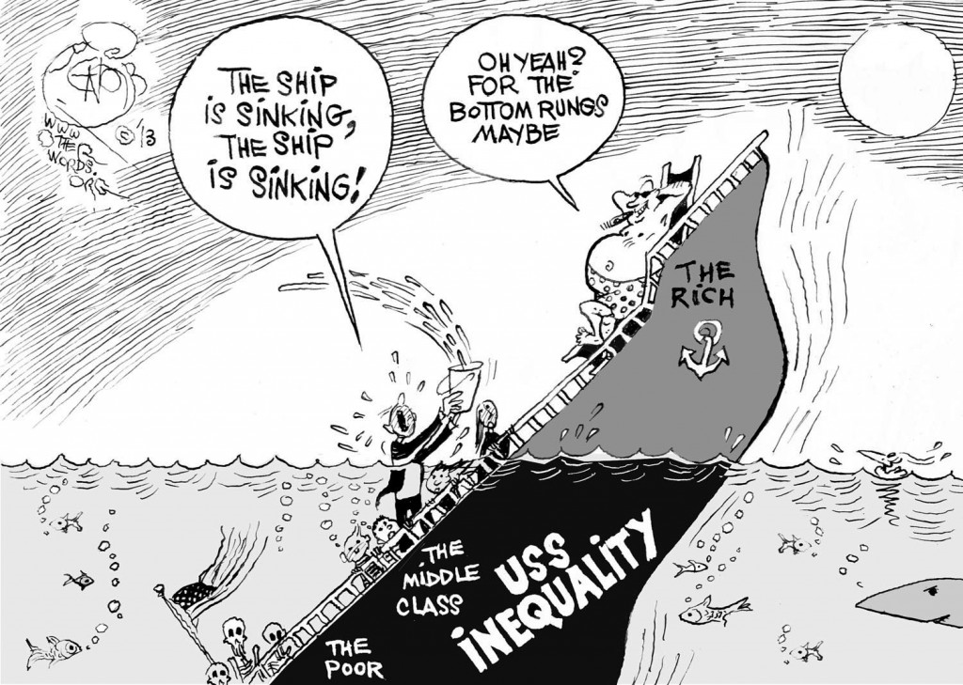

Slide 12
The needs are enormous and relatively small
All the additional money needed in 2015 to realize the MDG is goingaround in the currency exchange market in 45 minutes

Slide 13
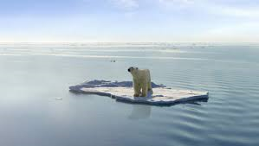

Slide 15
‘direct exchange between Chinese currency and EURO !!!

Slide 16
Into something (really) new
?

Slide 17
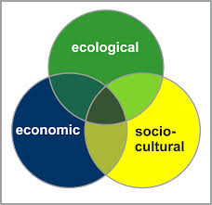
Coherence²: 3Dpolicy

Slide 18
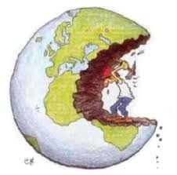
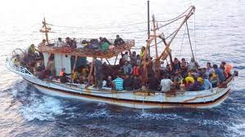
Ook hier

Slide 19
Right on

Slide 20
implementation

Slide 21
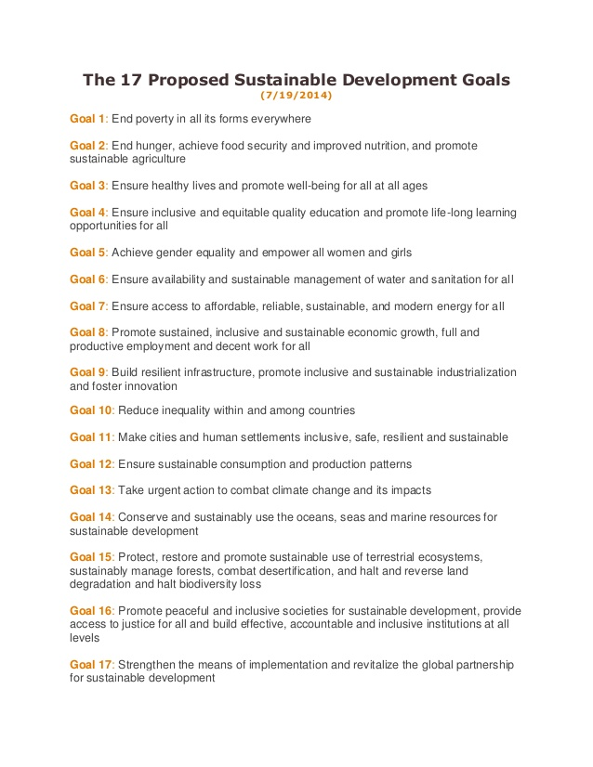

Slide 22
DILEMMAS ?

Slide 23
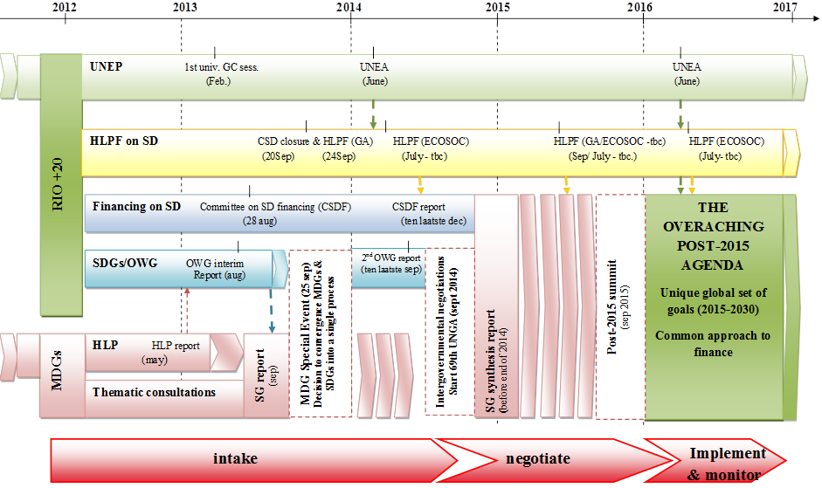
Keeping it simple?

Slide 24
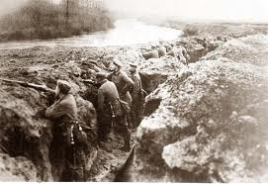
Planning the future from the trenches?

Slide 25
New wine in old wineskins

Slide 27
Just a few
Human rights/ Right to development
Common but differentiated responsibility
Taxes
Regulation of private sector (
Unifying project vs power analysis
Rights vs ‘trust’
Growing interest for ‘outside world’ but solidarity undermined (cfr repositioning EU)
etc

Slide 28
Giving up is not an option
The 3D agenda is not ging to go away
Alternatives are fairly frightening
New ideas may be supported by ‘light disaster’
Momentum for tackling inequality (for how long?
EU is going back to ‘normal’ more equal level: dealing with common agenda? (even more ‘pessimistic’ than emerging regions)

Slide 29
Absolutely necessary / not (yet) impossible?

