Slide 1
Dr Nic Cheeseman
Why it is too early to give up on democracy in Africa

Slide 2
Argument outline
Argument 1 – Democracy is doing better than you think
Argument 2 – Democracy is good for development
Argument 3 – Authoritarianism is performing worse than democracy

Slide 3
Argument 1 – The state of democracy
Key indicators of competition and institutionalization are getting better not worse.
Competition: The level of political dominance on the continent is declining (Ian Cooper)
Institutionalization: More presidents are respecting term-limits than breaking them (Posner and Young)

Slide 4
Ian Cooper – The Decline of Dominance

Slide 5
Posner and Young – Term Limits

Slide 7
Argument 1 – The state of democracy
Support for democracy is high & rising:
“Demand for democracy is rising in Africa” (Afrobarometer 2014)
71% want democracy
77% reject one-party rule, 84% one-man rule
“Demand for Democracy” index increased by 15% from 2002 to 2012

Slide 8
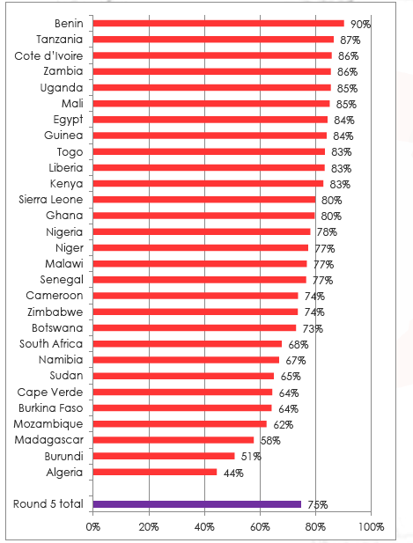
Argument 1 – The state of democracy
Africans continue to believe in democracy
Support for democracy as the best form of political system has remained high
High public support for term limits

Slide 9
Argument 2 – Democracy & development
Democracy is good for development
On average, democracies grow faster than authoritarian states (Masaki and van de Walle)
→ the longer countries are democratic, the greater the advantage
Democracies are more likely to provide free education (Harding and Stasavage)

Slide 10
Argument 2 – Democracy & development
The only countries in Africa not to offer free primary education are …
Angola
Cameroon
Gabon
Cote d’Ivoire
Somalia
Sudan

Slide 11
Argument 3 – Authoritarianism is worse
Authoritarian states fail to achieve growth or state building in Africa:
→ economic collapse and civil conflict in 1980s
→ few parties manage to sustain early gains
Increasing breakdown of electoral-authoritarian states:
→ Burkina Faso
→ Burundi
→ Eritrea
→ Ethiopia

Slide 12
Cheeseman (2015)

Slide 13
Cheeseman (2015)

Slide 14
Conclusion
Democracy in Africa is doing better than you think
Democracy generates a wide range of other benefits in terms of development
Authoritarian states perform worse than their democratic counterparts
So … it is far too early to give up on democracy in Africa …
… and doing so would be politically unfeasible

Slide 15
@fromagehomme
nicholas.cheeseman@politics.ox.ac.uk
www.democracyinafrica.org

