Slide 1
Should inequality be a central goal of the post-2015 development framework? Stephan Klasen Universität Göttingen Debating Development December 2, 2014

Slide 2
Introduction
Inequality discussions ubiquitous:
Picketty: focus on capital income and super-rich;
Milanovic: focus on global income inequality;
Roemer, Ferreira: inequality of opportunities;
World Bank: Poverty, inequality goal (growth of poorest 40%)
Many demand that inequality be included in MDGs as separate goal (with targets, etc);
This short presentation:
Clarifies which inequality ought to be considered;
Considers impact of inequality on development;
Should there by an inequality MDG?

Slide 3
Which inequalities matter?
Dimension:
Income? Education? Health?
Inequalities in education and health much lower than in income, and tend to close with rising achievements;
What is the relevant group to consider?
Between countries? (high and little change)
Within countries? (mostly increasing, except Lat. America)
Among the world‘s population? (some decline recently)
Levels and trends depend greatly on these choices;
Most discussion focuses on within-country income inequality.

Slide 4
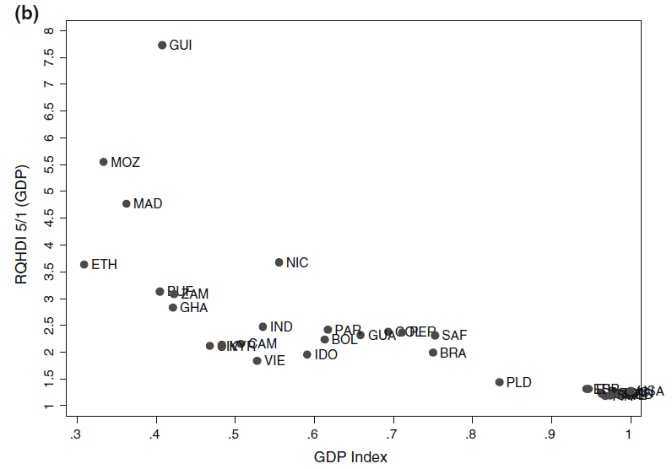
Source: Grimm et al. 2010
Source: World Bank (2014)

Slide 5
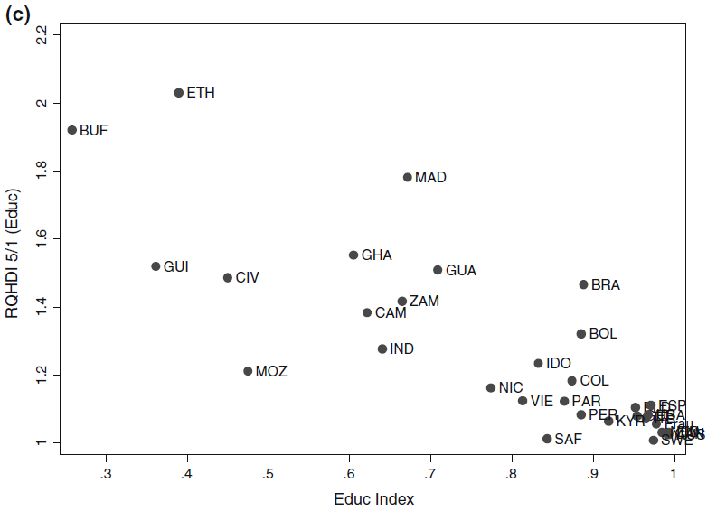
Source: Grimm et al. 2010

Slide 6
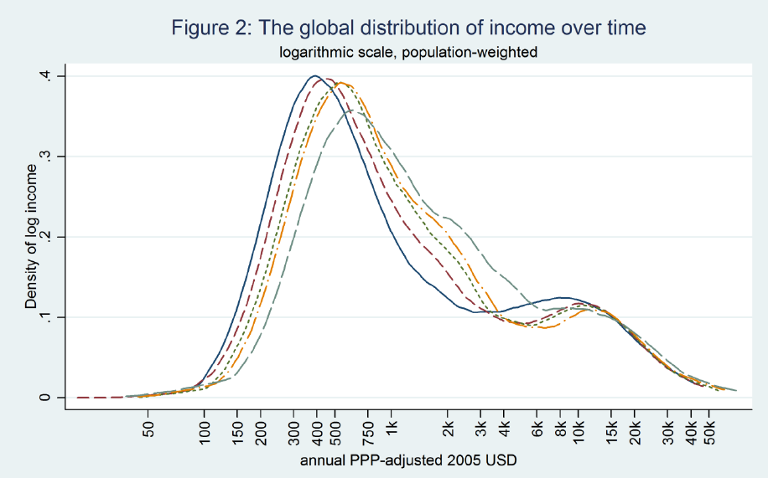
Source: Lakner qnd Milanovic 2014

Slide 7
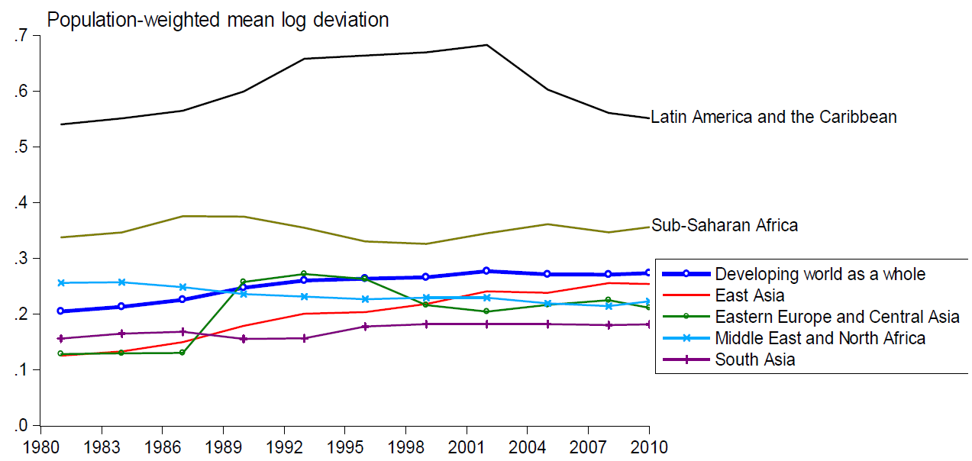
Source: Ravallion (2014)
Notes:
Not just a policy agenda, but a scientific agenda, where there are many gaps in current research, for example, on measurement and drivers of poverty reduction

Slide 8
Why does inequality matter for MDGs?
Triple effect of income inequality on absolute poverty reduction:
Reduces poverty directly;
Reduces poverty impact of growth;
Increases growth (?);
Impact on non-income MDGs:
Achieving non-income MDGs only possible if worst performers improve;
E.g. They are the ones out of school;
E. g. They disproporationately affect the average performance (e.g. U5M 1990: 270, 30, average 150, goal 50; U5M 2015: 140, 0, average 70; or: 60, 30 average: 45);
Linkage income inequality non-income inequality;
Impact on governance, subjective well-being, stability;
Indirect impact on MDG achievements;
But what is the optimal level of inequality?

Slide 9
A separate goal for inequality?
Current problems of MDG process:
Farcical number of goals, targets in indicators;
Impossible to see this as a development framework that can lead to concrete prioritized action;
Confusion between means and ends (e.g. wastewater, harvest loss)
Many unmeasurable items (‚good and decent‘ jobs? Sustainable practices? Enabling environment?)
In this context, inclusion of inequality goal possible;
Alternative approach:
Focus on few ends: income poverty, health, nutrition, basic and equal social rights, safety; education, sustainability;
Inequality would be important means to achieve these ends;
But no separate goal (and target);

