Slide 1
Inside and beyond the BRICs: Strategies to influence the global order of development
David Hulme
University of Manchester
www.manchester.ac.uk/bwpi
www.effective-states.org
University of Antwerp, 18 November 2014

Slide 2
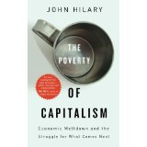
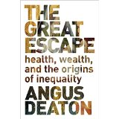
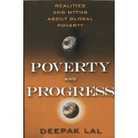
Development – the Great Escape
How is humanity doing?
Incomes up, life expectancy up, human development up…best time to be born!
But, spiralling inequality and unsustainability

Slide 3
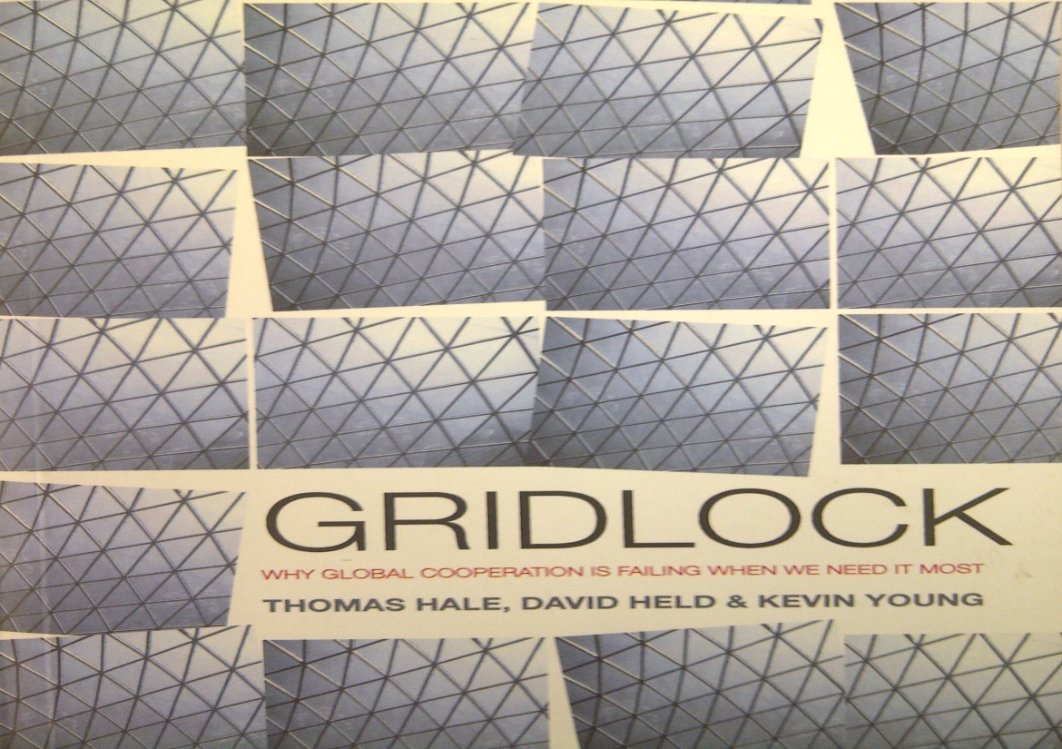
Global governance and gridlock
Gridlock: Why Global Cooperation is Failing when we need it most
Key idea in IR of Gridlock – security, trade, environment
But, this is not the case for development – major changes

Slide 4
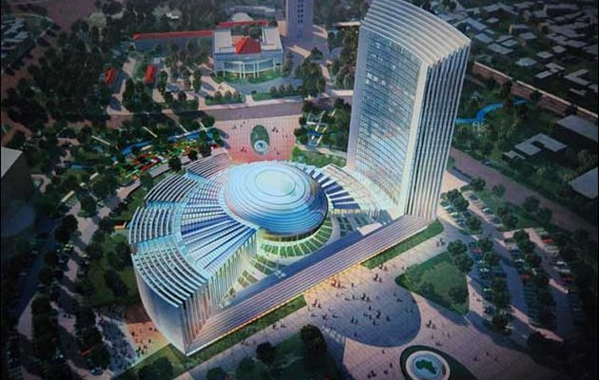
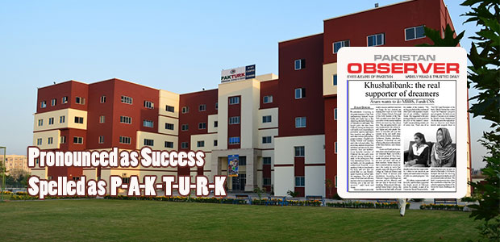
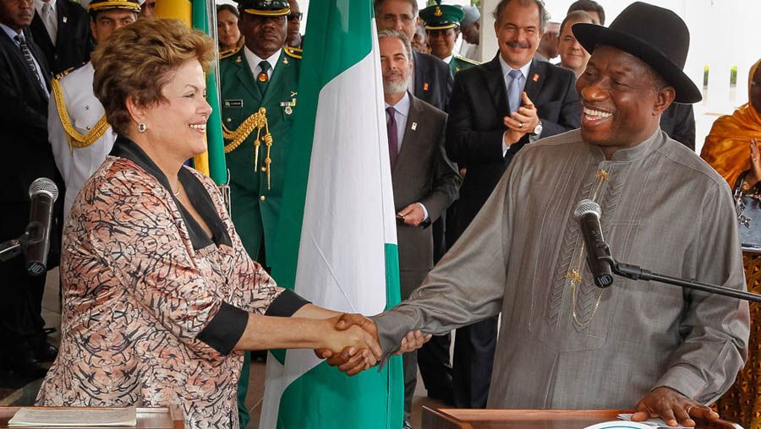
The global order and development
1) A New AU Headquarters in Addis Ababa built
and donated by China; 2) Gulen Movement School in Pakistan;
3) President Rousseff of Brazil and her Nigerian counterpart Goodluck Jonathan in Abuja, Nigeria

Slide 5
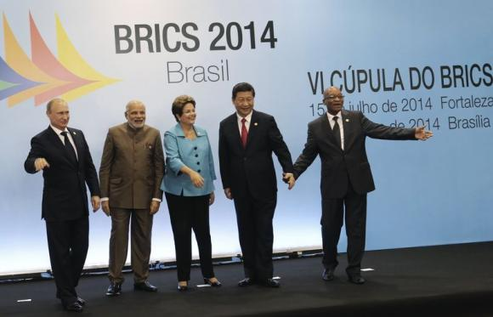
Global governance and development: times of change in finance
End of the World Bank/IMF control on finance
New Development Bank and Contingency
Reserve Agreement (BRICS)
Asian Infrastructure Investment Bank
Mega-bilateral funds for infrastructure
- China US$20 Billion for India (5 years)
- Japan US$35 billion for India (5years)
- China US$1.5 billion for Sri Lanka
- India US$2.6 billion for Nepal
- Brazil US$1.5 billion for African agriculture
BRICS leaders celebrating NDB creation & the Contingency Reserve Arrangement (CRA) in Fortaleza July 15, 2014.

Slide 6
Global governance and development: times of change in agenda-setting
The aid-focussed MDGs are morphing into the truly global Sustainable Development Goals
The SDGs have been shaped by ‘Southern’ voices, Rio+20, Brazil, and G77 not just OECD/G7
Sustainability
Inequality
Means of Implementation
Broaden and strengthen participation of developing countries in global governance
Common but differentiated responsibilities (CBDR)?

Slide 7
Global governance and development: times of change in multilateral structures?
Less progress – higher level positions for emerging powers (e.g. Chief Economist WB) but governance not really tackled
Great hope of G20…stalled…slow to evolve?
But, competition from BRICS ND Bank and Contingency Reserve Arrangement (CRA)
‘In the future people will talk of the Porto Allegre Institutions in the same way as the Bretton Woods Institutions’

Slide 8
What is driving change?
Robert Cox’s International Political Economy framework suggests we look at
Material capabilities…productive and destructive capabilities
Ideas…concepts, theories, narratives, mental constructs
Institutions…authoritative organizations, epistemic communities
These interact and re-shape each other - often seeking to maintain existing structures

Slide 9
Material capabilities
Rise of the BRICs is changing everything
China - FAGIA pledge of US$190 billion
Brazil – active in region, Africa and beyond
India – dozing giant…lacks foreign policy?
Russia – ‘bad boy’, does not do development?
Next 11 or emerging middle powers – Turkey, Indonesia, South Africa, Nigeria…Bangladesh
But (i) do not write off USA (Nye): 1941-2041
But (ii) a backdrop of climate change

Slide 10
Ideas
MDGs to SDGs - from poverty reduction to poverty eradication, sustainability and growth
Rise of ‘inequality’ on agenda (and as a measure)
From ‘good governance’ to ‘effective institutions’
Common but differentiated responsibilities (CBDR)
Measurement & Indexes - Governance by measurement
Turkey – moderate Islam/growth/democracy
BRICs and Next 11 are recognising ‘soft power’
Latin American intelligentsia…US and beyond

Slide 11
Institutions
For development key institutions still designed to solve the problems of mid-20th century
Pressure for change at moments of crisis…2008 and G20?
BRICs New Development Bank (NDB) and Contingency Reserve Arrangement (CRA)
New financial institutions
More energy/strategic focus in G77 and AU?

Slide 12
Strategies to Influence the Emerging Order 1?
Material capabilities
Difficult for individuals/groups to reshape this…unless you are Bill Gates (he does)
EU as a ‘unit’ on development agenda? But lack of EU voice and reversals…Netherlands.
UK still playing/seeking global leadership role
Brazil appears to have a strategic understanding of how its rising capabilities might be used

Slide 13
Strategies to Influence the Emerging Order 2?
Ideas
Why it’s good to be an academic…lot’s happening
Especially by links to Southern partners - Bangladesh
Social protection
Sustainability…sustainable growth/green growth?
Inclusivity…’leave no one behind’
Inequality…progress on agenda compared to human rights
Measures (goals, targets, indicators) especially of ‘governance’ and ‘institutions’…but from Washington DC ?

Slide 14
Strategies to Influence the Emerging Order 3?
Institutions
UN is very ‘sticky’...sclerotic…support UNA?
IFIs…reform or slide towards financial irrelevance?
Evolving - chaos or multi-multilateralism?
BRICs and BRICS, G20 (and L20), 3G, g20
NGOs…for me INGOs now too professional and donor-centric. Return to the grassroots?
Social media, crowd-power…Arab Spring with all change/no change

Slide 15
Conclusions
Development looked in relative gridlock in 2010…stuck in the 20th century
Aid-centric and the MDGs agenda
World Bank leading…and UN struggling
But, clear that change is underway in 2014
Choices for development finance
New ideas on agenda: sustainability, inequality, inclusiveness, effective institutions
New institutions: NDB, CRA, AIIB
Could 2015 be a tipping point? It may be.
I am optimistic…naïve? Chinese/Brazilian/Turkish & other duplicity replaces US/European duplicity?

Slide 16
References
Banks, N., Hulme, D. and Edwards, M. (2015) ‘NGOs, States and donors revisited: Still too close for comfort?’, World Development 66(2), 707 – 718.
David Hulme (2010 and 2015) Global Poverty: How Global Governance is Failing the Poor, London : Routledge
Emma Mawdsley (2012) From Recipients to Donors: Emerging Powers and the Changing Development Landscape, London : Zed
Vom Hau, M., Scott, J. and Hulme, D. (2012) ‘Beyond the BRICs: Alternative strategies of influence in the global politics of development’, European Journal of Development Research, 24, 187 – 204.
IRIBA website: http://www.brazil4africa.org
My World website: http://vote.myworld2015.org

Slide 17
Thank You

