Slide 1
LEERSTOEL AANSPRAKELIJKHEIDS- EN VERZEKERINGSRECHT
www.allic.be
Antwerp Liability Law and Insurance Chair

Slide 2
RESEARCH
Independent, critical research of high quality in the field of Liability Law and Insurance Law: PhD’s, publications and opinions.
POSTGRADUATE TRAINING Postgraduate training in Liability Law and Insurance Law starting from October 2017.
PROVISION OF SERVICES
Conferences and seminars and an academic platform for discussions on Liability Law and Insurance Law.

Slide 3
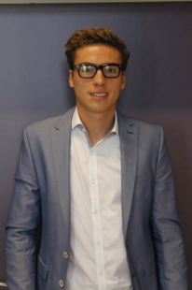
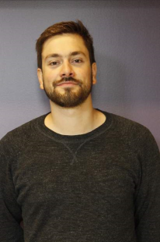
PhD RESEARCH
Glenn Heirman
The insurance contract: contractual freedom and transparency
CHRISTOPHE DE RIDDER
The general standard of care

Slide 4
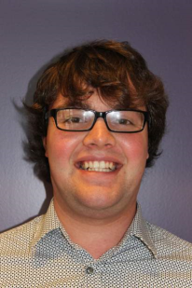
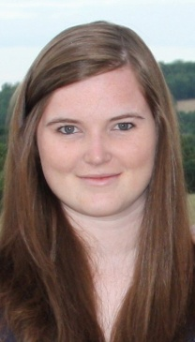
PhD RESEARCH
Dimitri Verhoeven
Product safety and product recall: the relationship with product liability in the EU
Charlotte Henskens
Liability insurances: between protection and prevention

Slide 5
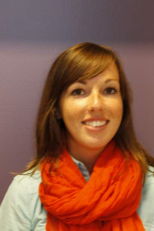
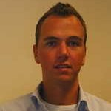
PhD RESEARCH
Steffi Illegems
Financial supervision in the insurance sector. The influence on the statute and the liability of insurance companies and insurance intermediaries
Nick Portugaels
The statute and role of settlement agreements in insurance disputes
Compensation Funds?
1 October 2016

Slide 6
ALLIC IS GRATEFUL TO:

Slide 7
ALLIC Congres 20 oktober 2016
13u00 | Onthaal
13u30 | Inleiding door de congresvoorzitter Prof. T. Vansweevelt en prof, B. Weyts (UAntwerpen)
13u40 | Zelfrijdende auto’s: een uitdaging voor het aansprakelijkheids- en verzekeringsrecht? Drs. J. De Bruyne en J. Tanghe (UGent)
14u20 | Drones: een nieuw aansprakelijkheidsrisico onderworpen aan een verplichte verzekering K. Moors (KBC Verzekeringen)
15u00 | Cybercriminaliteit en verzekeringen Mrs. H. Keulers en S. Lodewijckx
15u40 | Koffiepauze
16u10 | Terrorisme en verzekeringen Drs. G. Heirman (UAntwerpen)
16u40 | Naar een echtscheidingsverzekering? Prof. J. Ghysels (Maastricht University)
17u00 | Slotrede Prof. Dr. K. Van Hulle (KULeuven)
17u40 | Vragenronde
18u00 | Einde

Slide 8
CONFERENCE on COMPENSATION FUNDS
7th June 2016
13u15 | Introduction Prof. Thierry Vansweevelt, Chairman (University of Antwerp)
13u30 | Compensation Funds in France and Germany Prof. Jonas Knetsch (University of Réunion, France)
14u30 | Compensation Funds in the United Kingdom Prof. Ken Oliphant (University of Bristol)
15u15 | Coffee break
15u45 | Compensation Funds in the Netherlands Prof. Gerrit van Maanen (Maastricht University)
16u30 | Compensation Funds in Belgium Larissa Vanhooff (University of Antwerp)
17u15 | Discussion speakers + Wauthier Robyns (Assuralia)+ Britt Weyts (University of Antwerp)

